Slide 1
Presentation title slide
Where do we risk marginalising those with social vulnerabilities with a blanket transport emissions policy?
Claire Shadbolt

Slide 2
Presentation title slide
Notes:
Climate change - we see it all over the news and on social media.
It is incredibly likely that humans are the dominant cause of the observed change in climate, through our own production of GHG emissions. Therefore, the only way to combat this is to decrease of GHG emissions.
How is the UK faring so far?

Slide 3
Presentation title slide
Notes:
From looking at each sector, the UK have reduced their emissions in most sectors, particularly in the energy supply sector.
HOWEVER, surface transport is the only sector where emissions have increased.
This is significant because surface transport is the largest emitting sector in the UK and travel is something most of us do each day.
My project focuses on reducing emissions in this sector. But first, I will talk you through current UK surface transport initiatives, how there is a gap in the policy and how my project addresses this gap.
What is the UK currently doing in this sector to decrease emissions?
Source: Tables 3, Final UK greenhouse gas emissions national statistics 1990-2017 Excel data tables.
https://www.gov.uk/government/statistics/final-uk-greenhouse-gas-emissions-national-statistics-1990-2017

Slide 4
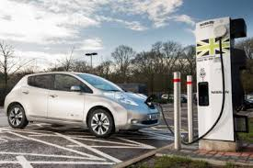
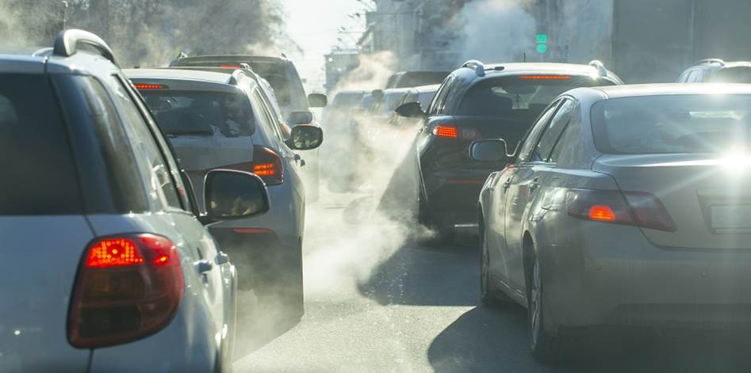
Presentation title slide
What are the government’s current initiatives to reduce emissions in the road transport sector?
Notes:
There is a huge focus on phasing out petrol and diesel cars.
Incentives to increase the market share of hybrid, electric and low-emission vehicles.
Schemes to support walking, cycling and public transport.
Increase of using biofuels and fuel-efficient fleets.
How effective are these policies?

Slide 5
Presentation title slide
Notes:
Emissions went down between 2007 and 2013, but they are increasing once again.
There is a policy gap between emitted emissions and targets the government has set - current policies are not enough. There is too much focus on supply, when demand needs to be tackled too. In terms of surface transport, this means reducing car miles travelled and the reduction of cars needed.
Where is the demand coming from?
Source: Tables 3, Final UK greenhouse gas emissions national statistics 1990-2017 Excel data tables.
https://www.gov.uk/government/statistics/final-uk-greenhouse-gas-emissions-national-statistics-1990-2017

Slide 6
Presentation title slide
Notes:
One way to look at demand is income.
As this graph shows, higher-income groups travel more miles - almost double the lowest income group.
Implementing a blanket policy like a tax, or a congestion charge, is disproportionate and risks marginalising groups. Higher income groups can easily afford this charge compared to lower income groups.
Policy-makers need to apply policies in the right area and target the right demographic, because vulnerability is context specific.
Source: NTS0705: Travel by household income quintile and main mode or mode: England from: https://www.gov.uk/government/statistical-data-sets/nts03-modal-comparisons

Slide 7
Presentation title slide
Engage with travel behaviour across demographics
What types of trips do transport users take?
Where do they go to?
How long do they typical travel for a certain trip purpose?
How many cars are not used in a given time and in a specific area?
Notes:
These are the questions we need to ask to understand transport behaviour.
With an increasing population, this will increase energy demand and the climate impact further.
An effective response to climate change will require more rapid reductions in energy demand.
This leads on to the aim of my project with Ian Phillips.

Slide 8
Presentation title slide
Aim of the project
Describe a set of indicators for equitable transport policies by implementing a individual and household level microsimulation.
Assess the effect a policy might have on a specific location.
Where can people reduce their demand for transport?
Which services, technologies and policies are the most effective?
What vulnerabilities and inequalities might arise?
Notes:
By implementing a spatial microsimulation with a synthetic population, the project will describe a set of indicators to help policy-makers identify potential equitable transport demand reduction.
It will assess the effect a policy might have on a particular location and try to understand which services, technologies and policies may be effective at decarbonising transport in particular places. We want to be mindful of vulnerabilities and inequalities that may arise from the enforcement policies.

Slide 9
Presentation title slide
Methodology
Constraint Table:
Probability of a travel attribute occurring depending on the constraints
Create a probability distribution for the attribute
National Travel Survey
UK Census
(SPENSER)
Master Table
Monte Carlo Sampling
Assign Travel Behaviour
Constraint Table
Notes:
The first stage is to produce a constraint table using the NTS data that calculates the probability of a particular travel behaviour occurring depending on the constraints. We cumulatively sum these probabilities to get a probability distribution for the attribute.
To get a synthetic population, I have used the algorithm SPENSER. This projects future UK populations using the 2011 census. For the project so far we have got a synthetic population of Manchester for the year 2018. Next, we join the individual census data with the NTS constraint table to create a Master table. By combining these two data sets, we now have a table of individuals where each individual has a travel behaviour probability distribution.
(SPENSER – algorithm constructed by Nik Lomax, Ben Wilson and Luke Archer.)
As part of the Monte Carlo sampling process, we roll a dice, then see where the dice roll lies along the probability distribution to assign a travel behaviour.
Repeat the assignment process as many times as necessary to get a modal average for every individual in the synthetic population, or an average for the location.
Let me take you through an example.

Slide 10
Presentation title slide
Methodology
Age | Sex | pTripPurpose1 | pTripPurpose2 | pTripPurpose3 | pTripPurpose4 | pTripPurpose5 | pTripPurpose6 | pTripPurpose7 | pTripPurpose8
4 | 1 | 0.20616 | 0.02539 | 0.27189 | 0.08834 | 0.02394 | 0.05726 | 0.30428 | 0.02275
Trip Purpose
1
2
3
4
5
6
7
8
Probability Distribution
0
0.2062
0.2316
0.5034
0.5918
0.6158
0.6730
0.9773
1
0.44
0.71
Notes:
In this basic example, using 2016 and 2017 travel survey data, the constraints are gender and age group to give the probability for each trip purpose. Gender and Age are two constrains that are shared with the census data, therefore it is straightforward to join the constraint table to the census data.
The trip purposes are coded 1 to 8 in the NTS dataset set. So, given that an individual is aged 17-20, age group 4, and male, gender group 1, this is the probability of each trip purpose occurring.
Now we consecutively add each of these probabilities to get a probability distribution. It is noted that each distribution will be different for each gender/age combination.
Where the dice roll lies will indicate the trip purpose. For example, if R rolled 0.44 then this will assign the person with trip purpose 3. If R rolled 0.71, this will assign the person trip purpose 7.
I repeated this assignment process 50 times for every individual in the synthetic population of Manchester for the year 2018 to get a modal trip purpose for each person.

Slide 11
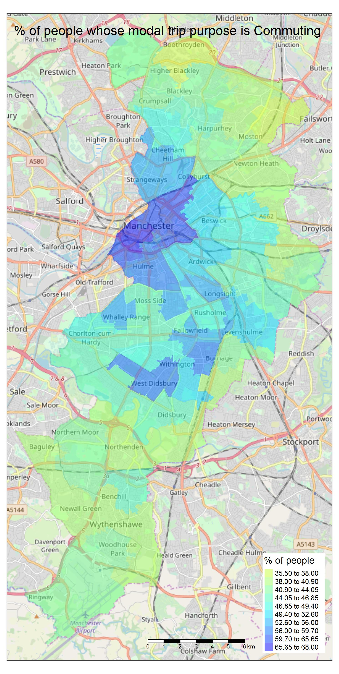
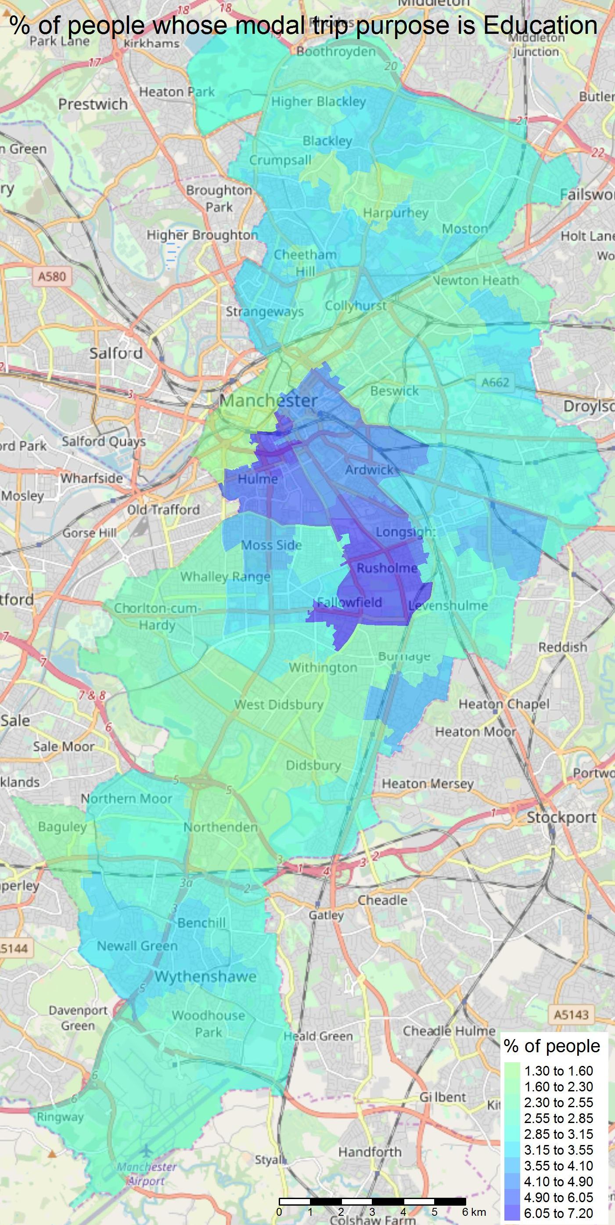
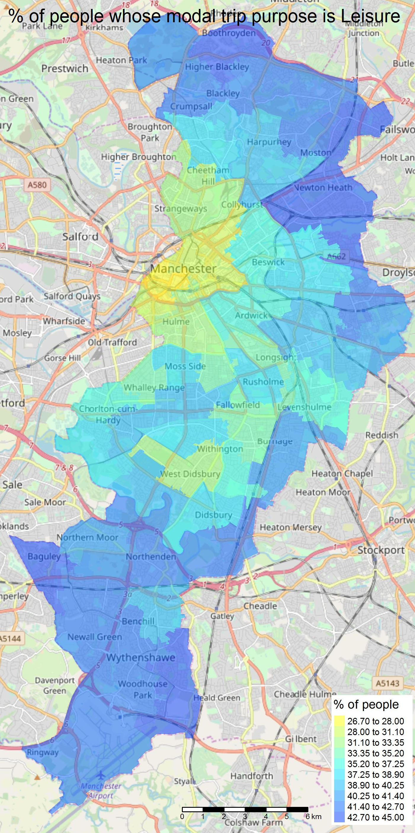
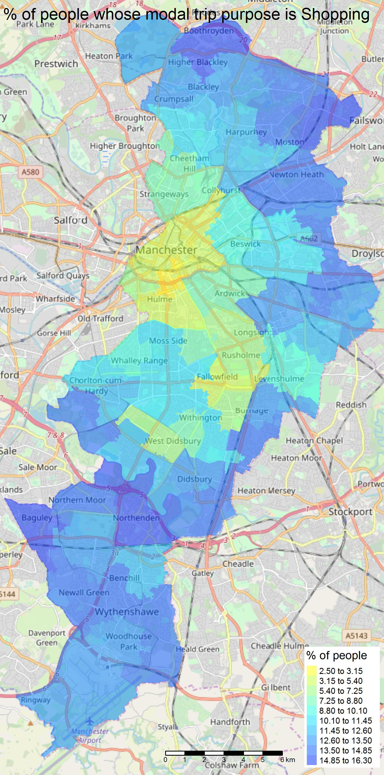
Presentation title slide
Notes:
Here are some examples of the maps I drew that represent the modal transport purpose for every individual in the synthetic population of Manchester. The size of each area is at the MSOA level.
Blue indicates a higher percentage and yellows a lower percentage, and yellow a lower percentage. As you can see there is a difference between inner and outer city areas.
This demonstrates that there is a spatial element to trip purpose type based on the demographic of the area. Inner city area people typically take trips for work and education. Whereas, the outer city trips are typically leisure and shopping.

Slide 12
Presentation title slide
Refine the process
Assign individuals to a household.
Add more constraints:
Dwelling type, number of cars, economic status and OA Class
Behaviours to look at:
What is the distance travelled for leisure? How long are these trips?
Car usage
Notes:
To refine these maps, the next step is to assign the individuals to a household. This is something the SPENSER algorithm can do.
Therefore, we can add more constraints to the constraint table so we can look at both individual and household level attributes. For instance, the dwelling type of the household, the number of people in the household, the number of cars the household has, economic status of the household, and the output area class.
We also want to look at different travel behaviours. How long do people typically travel for leisure? What distances are these trips? This will add a temporal and another spatial element to the research. Also look at which households typically have low usage cars, which again is insightful for policy-makers.

Slide 13
Presentation title slide
Refine the process
Identify where the demand is for travel.
Where services will be the most effective.
Where vulnerabilities are likely to occur.
Notes:
This provides a greater insight into travel behaviour and identify where the demand is for travel.
For an equitable decarbonatization solution, we want to identify areas where new mobility services may be effective, or where vulnerability is likely to occur in the event of any transport policy.

Slide 14
Presentation title slide
Notes:
Going back to this graph, I want to reiterate the point that demand will continue to increase with an increasing population. This research project is one way to identify how demand can be reduced, while also being mindful of any groups that might be at risk to certain policies.
Focusing on supply is not the solution, need to policies to focus on demand as well for the UK to mitigate and combat the effects of climate change.

