Slide 1
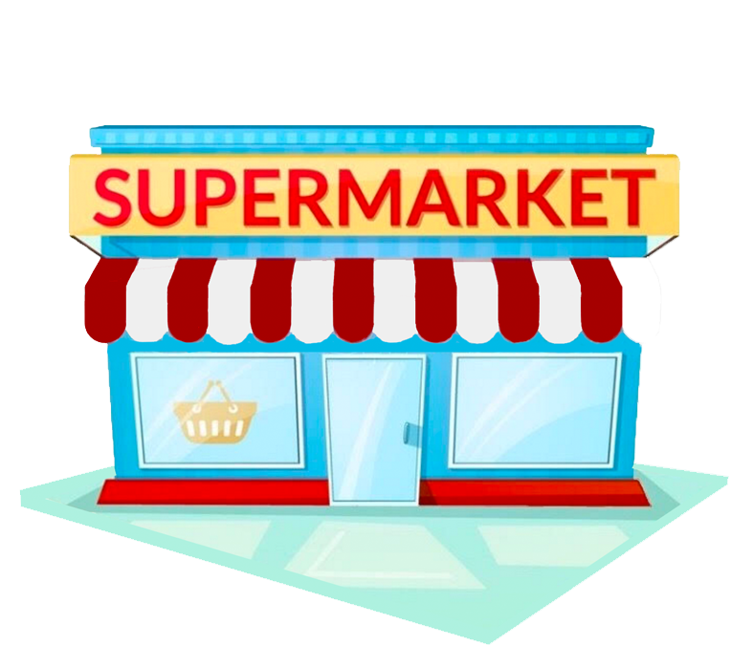
Notes:
Imagine that you live in a desert.
Naturally you would have to go grocery shopping from time to time, but the nearest supermarket is a few miles away.
Let's also consider that the weather and the sand make walking or driving there really difficult.
Considering we have an internet connection, what would you do?
You would go on that particular retailer’s website, choose your items, pay and select a delivery time slot.
And of course would until the delivery team arrives and you get your groceries.
Well, this is what is supposed to happen.

Slide 2
Sorry!
We don’t deliver in that area…
Notes:
Well it turns out that if we you live in a place like this you will likely experience the same as before.
Generally the nearest supermarket is far far away, you might not own a car and the public transport is of poor quality.
So you’d think you’d have every right to go on the internet, order your groceries and get them easily.
But in some areas unfortunately you will get an error on the website saying:

Slide 3
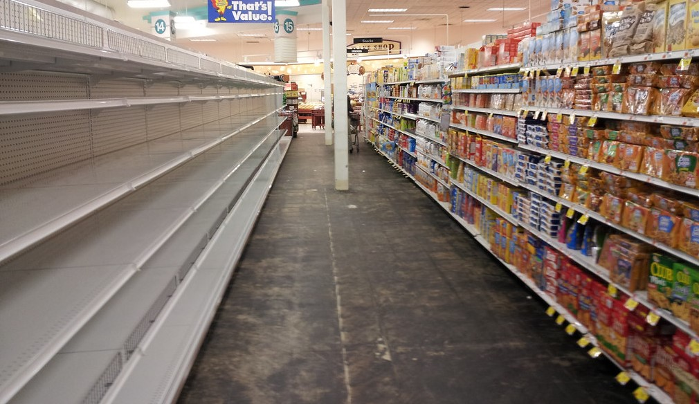
Presentation title slide
Assessing the presence of
food deserts in the UK
Francisco Videira
Supervisor: Dr. Andy Newing
Honourable mentions:
Jack Lewis, Ryan Urquhart
e-
Notes:
So what I’ve just illustrated in the first slide was the concept of food desert - which are areas where you might experience physical or economic barriers in accessing healthy food (= having the power to make a choice about what kind of products you want and their quality.)
On the second scenario, in addition to those physical and economic restrictions in accessing physical stores, we also experienced poor quality of food delivery systems. These areas are known as e-food deserts and they're are typically rural and remote catchments that retailers often fail to cover.

Slide 4
Web-scraping
Spatial interaction model
Food Deserts Index
Lower Super Output Areas
Notes:
(When we are studying something like this, we should consider the size of the zones or areas we are analyzing, We want them to be sufficiently small. Luckily the ONS has exactly what we need. They are called LSOAs and are small and well-defined geographic areas which were designed to have a consistent number of households.)
Web-scraping
For those you might not be aware of the concept, is a way of mimicking a user/person browsing a website. So this way we were able to get information from 7 retailers about whether they were delivering to a set of areas.
Spatial interaction modelling
With SPM, which essentially tries to predict flows of things from a set of origins to a set of destinations (in our case of money from a set of areas to a set of retailers), we’ll be able to extract a sophisticated measure of “access” to healthy food.
Food Deserts index
Which we can then use on a Food Deserts Index, whose goal is to sort of rank every area we are studying according to a set of indicators (car ownership, percentage of elderly people, public transport quality)

Slide 5
What have we found out?
Only 31 LSOAs (9,947 households) have no delivery coverage – 0.039% of all households.
197 LSOAs (66,853 households, 0.3%) have no choice of online delivery provider.

Slide 6
What have we found out?
Delivery coverage by brand
Retailer | LSOA count | % of LSOAs | Household count | % of households
Tesco | 41,702 | 99.92% | 25,729,960 | 99.96%
Asda | 41,420 | 99.25% | 25,602,765 | 99.46%
Sainsbury’s | 40,805 | 97.77% | 25,336,799 | 98.43%
Morrisons | 36,010 | 86.28% | 22,714,459 | 88.24%
Waitrose | 35,302 | 84.59% | 22,257,587 | 86.47%
Iceland | 34,857 | 83.52% | 21,690,464 | 84.27%
Ocado | 29,557 | 70.82% | 19,763,226 | 76.78%
Amazon Fresh | 5,471 | 13.11% | 3,677,320 | 14.29%
TOTAL | 41,735 |  | 25,740,745
Notes:
Tesco Asda and Sainsbury’s have the highest coverage. Followed by Morrisons, Iceland and Waitrose. Then Ocado and Amazon Fresh, which only operates in London.
And this is somewhat consistent with the market share data we have.

Slide 7
What have we found out?
Household coverage by brand and IMD decile
IMD | Tesco | Asda | Sainsbury’s | Morrisons | Waitrose | Iceland | Ocado | Amazon
1 | 100.00% | 99.86% | 99.50% | 94.76% | 79.31% | 98.31% | 75.60% | 8.15%
2 | 100.00% | 99.41% | 99.60% | 92.85% | 85.10% | 96.33% | 77.84% | 20.48%
3 | 99.99% | 99.09% | 98.98% | 90.21% | 84.36% | 92.92% | 76.53% | 18.85%
4 | 99.96% | 99.35% | 98.08% | 85.90% | 85.80% | 85.90% | 72.54% | 15.87%
5 | 99.85% | 99.13% | 97.29% | 84.89% | 86.00% | 80.07% | 71.68% | 14.03%
6 | 99.83% | 98.99% | 96.68% | 84.87% | 85.67% | 75.45% | 75.15% | 12.70%
7 | 99.99% | 99.39% | 97.09% | 85.31% | 85.98% | 76.05% | 76.21% | 12.11%
8 | 99.97% | 99.60% | 98.17% | 86.94% | 87.84% | 77.65% | 78.13% | 11.74%
9 | 100.00% | 99.96% | 99.36% | 87.81% | 89.81% | 80.07% | 80.37% | 12.50%
10 | 100.00% | 99.94% | 99.68% | 88.80% | 95.82% | 78.77% | 84.63% | 16.36%
Most deprived decile
Least deprived decile
Notes:
You might have heard about the index of multiple deprivation. It’s a way of measurgin deprivation across england and so there are areas which can be less or more deprived.
We sort of see an hourglass: coverage is high at both most deprived and least deprived areas having the lowest value somwhere in the middle. So we could argue that retailer might have been trying to increase their coverage on deprived areas.
Waitrose and Iceland have the highest coverage on opposite ends of the spectrum. This in example of consumer demand / retailer business plan.

Slide 8
What have we found out?
Conurbation:
Urban Major Conurbation, Large Urban Areas
Urban:
All other urban
Remote Rural:
Remote and very remote rural areas
Rural:
All other rural
Household coverage by urban-rural classification
Retailer | % of all households | Conurbation | Urban | Rural | Remote Rural
Tesco | 99.96% | 100% | 100% | 100% | 92.26%
Asda | 99.46% | 99.40% | 99.95% | 99.38% | 63.57%
Sainsbury's | 98.43% | 99.99% | 99.49% | 95.02% | 25.92%
Morrisons | 88.24% | 97.80% | 87.78% | 74.81% | 1.58%
Waitrose | 86.47% | 90.69% | 87.39% | 78.89% | 4.43%
Iceland | 84.27% | 98.05% | 91.40% | 43.53%
Ocado | 76.78% | 83.98% | 80.19% | 57.28%
Amazon Fresh | 14.29% | 32.59% | 6.28% | 2.51%
Notes:
If we split these areas in a way that reflects their urbanization, wee see that as we move to rural areas, coverage starts to decrease and is the lowest in remote rural areas.

Slide 9
What have we found out?
Conurbation:
Urban Major Conurbation, Large Urban Areas
Urban:
All other urban
Remote Rural:
Remote and very remote rural areas
Rural:
All other rural
Coverage of households with no car by urban-rural classification
Retailer | % of all households | Conurbation | Urban | Rural | Remote Rural
Tesco | 99.97% | 100.00% | 100.00% | 99.72% | 91.61%
Asda | 99.22% | 98.90% | 99.95% | 98.53% | 61.78%
Sainsbury's | 98.80% | 99.98% | 99.38% | 92.69% | 24.40%
Morrisons | 91.01% | 98.27% | 88.20% | 71.24% | 1.59%
Waitrose | 86.50% | 91.63% | 84.99% | 71.24% | 4.25%
Iceland | 90.66% | 97.75% | 93.37% | 45.70%
Ocado | 76.62% | 82.33% | 77.30% | 47.75%
Amazon Fresh | 20.12% | 38.53% | 5.27% | 1.86%
No coverage | 0.02% |  |  |  | 7.77%
Notes:
If we look at the coverage for households with no car, coverage worsens slightly and almost 8% of HH w no car have no coverage in RR areas.
(Almost all households without access to private transport benefit from online delivery coverage.
1637 households with no car have no delivery availability – these are all located in Remote Rural areas, where they represent almost 8% of all no car households in remote rural areas.)

Slide 10
Findings
Conurbation:
Urban Major Conurbation, Large Urban Areas
Urban:
All other urban
Remote Rural:
Remote and very remote rural areas
Rural:
All other rural
Coverage of households with a lone pensioner
Retailer | % of all households | Conurbation | Urban | Rural | Remote Rural
Tesco | 99.95% | 100.00% | 100.00% | 100.00% | 92.21%
Asda | 99.45% | 99.58% | 99.93% | 99.26% | 62.14%
Sainsbury's | 98.04% | 99.99% | 99.70% | 94.20% | 23.94%
Morrisons | 86.66% | 97.73% | 87.88% | 73.41% | 1.28%
Waitrose | 85.50% | 90.04% | 88.37% | 78.01% | 4.29%
Iceland | 82.42% | 98.00% | 91.43% | 42.28%
Ocado | 74.13% | 81.65% | 79.87% | 54.16%
Amazon Fresh | 11.36% | 27.31% | 5.46% | 2.31%
No coverage | 0.05% |  |  | 0.23% | 7.34%
Lone pensioner = aged over 65 and self-report living alone.
Notes:
If we look at housholds with no pensioners the scenario is really similar to the previous one.

Slide 11
Spatial interaction modelling
 | O | Retailer1 | Reatiler2 | Retailer3
LSOA1 | 5 | 3 | 1 | 1
LSOA2 | 4 | 1 | 2 | 1
Notes:
A way to model/predict flows (people, goods, money) from origins to destinations.
In our case flows of money from LSOAs to Retailers.
So if each LSOA has a fixed amount of money to spend, based on the attractiveness of the retailer and the distance between the LSOA and retail stores, how will that money be distributed across the retailers? That’s what the spatial interaction model tries to predict.

Slide 12
Indicators
Food Deserts Index
Domain 1
Distance to nearest supermarket
Domain 2
…
E-Food Deserts
Average commute distance
Public transport quality
Food Deserts Index
Notes:
Finally we are looking into building a Food Deserts index. If we have a set of indicators such as …, we can group them in different domains and by using statistical methods, we’ll be able to rank each LSOA according to a Food Deserts score. SO LSOAs with a good public transport quality would rank higher. BTW…
Using the SIM we’ll be able to extract a more sophisticated measure of “access to healthy food” and incorporate it in the index.
Also, one of the domains will involve a measure of e-food deserts and the idea is that by varying the delivery cost and the time slots consumers must choose we’ll see if we can create food deserts.

Slide 13
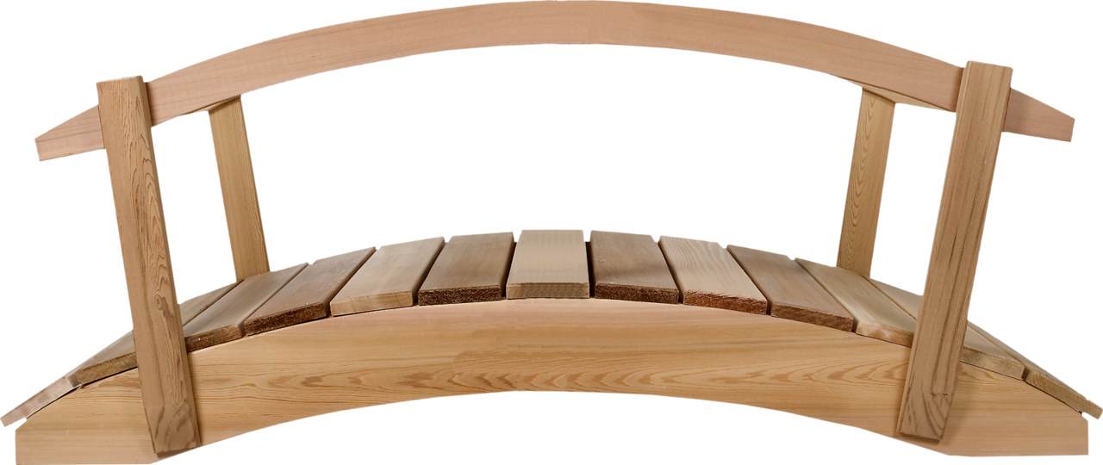
Thank you for listening.
Notes:
Going back to our scenario, hopefully this bridge will be made of
supporting retailers in planning their home delivery services and
policy makers or local planning authorities in evaluating local retail provision.

