Slide 1
Presentation title slide
Can data help give children equal access to education in Bradford? A look at the school admissions process.
Holly Clarke
Supervisory Team: Mark Mon Williams, Ning Lu, Alison Heppenstall, Nick Malleson

Slide 2
Presentation title slide

Slide 3
Presentation title slide
Pupils in England

Slide 4
Presentation title slide
Pupils in England

Slide 5
Presentation title slide
Pupils in Bradford

Slide 6
Presentation title slide
Free School Meals Pupils in Bradford

Slide 7
Presentation title slide
What role does the school admissions process play in giving different groups of students access to Good schools?

Slide 8
Presentation title slide
Apply to up to 5 schools with preferences
Schools apply over-subscription criteria
Algorithm matches pupils with the top preference school they were accepted to
Pupils who don’t get into any preference school are assigned to their closest school with available places
Pupils

Slide 9
Presentation title slide
Geography
Schools’ Selection
Parents’ Preference

Slide 10
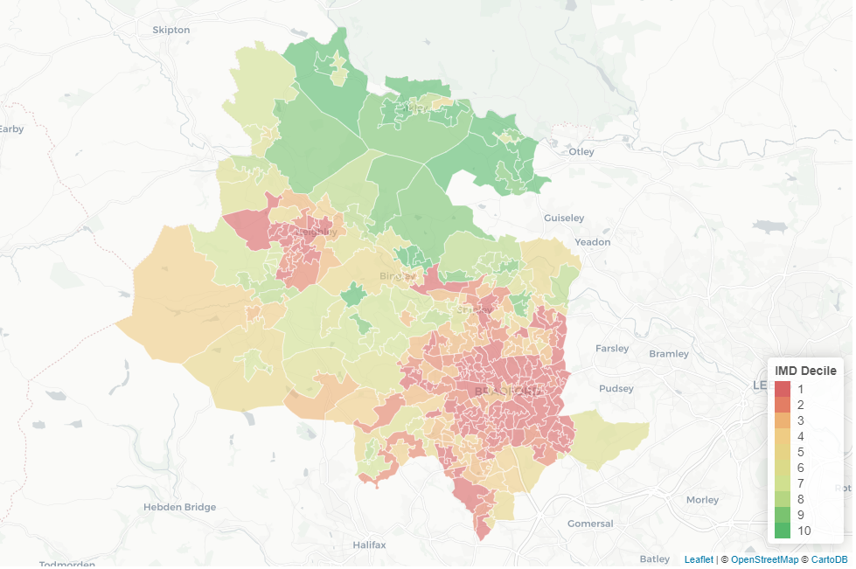
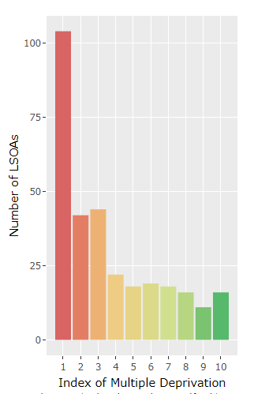
Presentation title slide

Slide 11
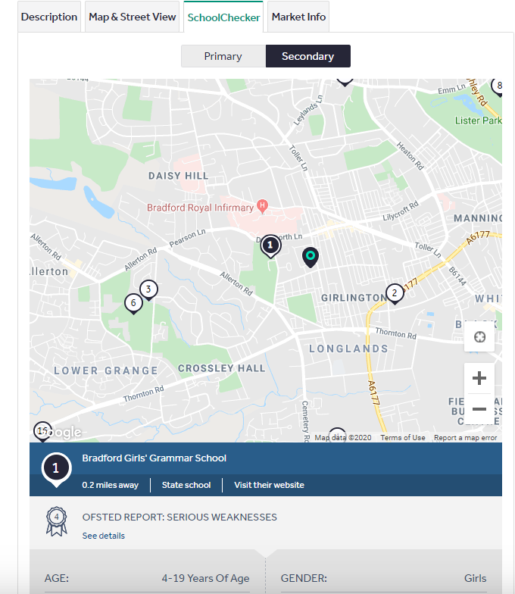
Presentation title slide

Slide 12
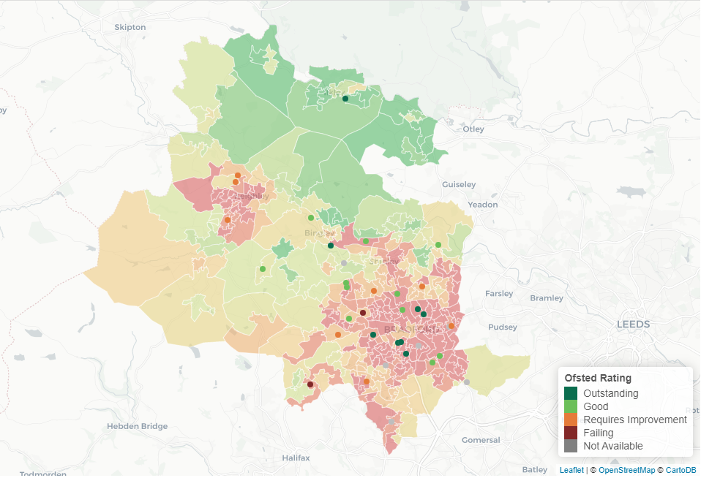
Presentation title slide

Slide 13
Presentation title slide
Parental Preference

Slide 14
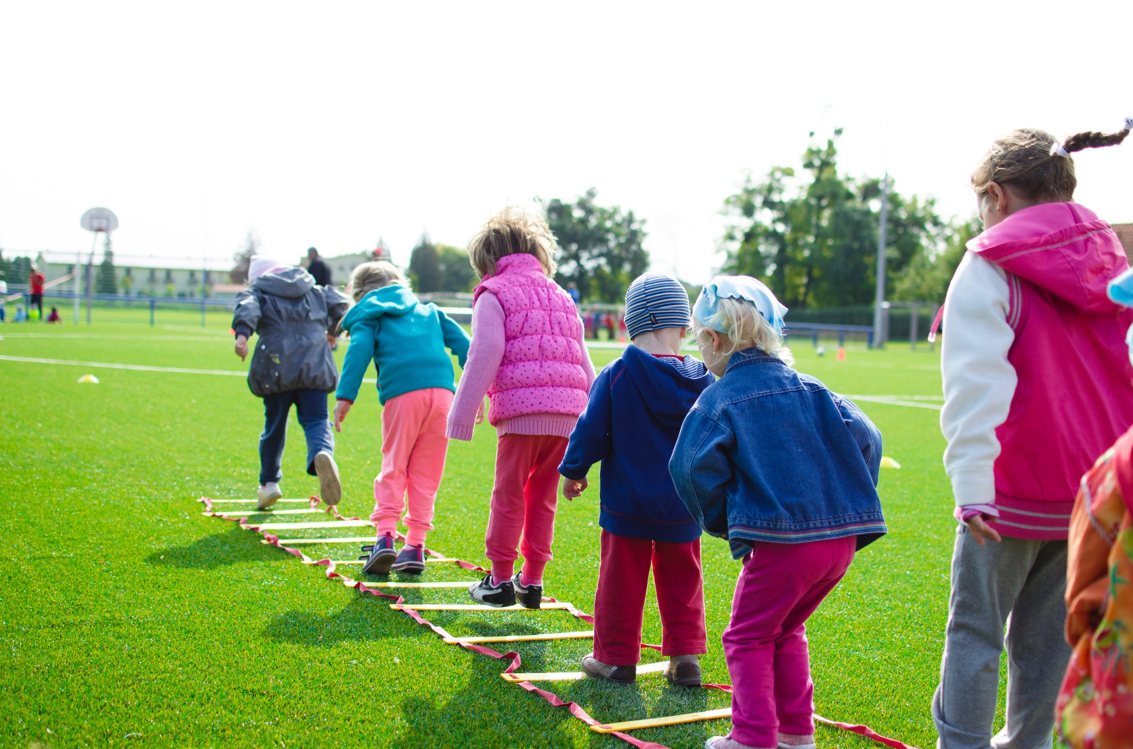
Presentation title slide

Slide 15
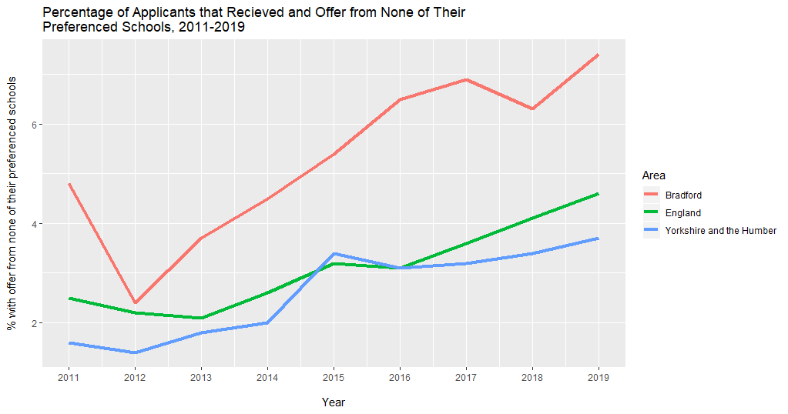
Presentation title slide

Slide 16
Presentation title slide
Schools’ Selection

Slide 17
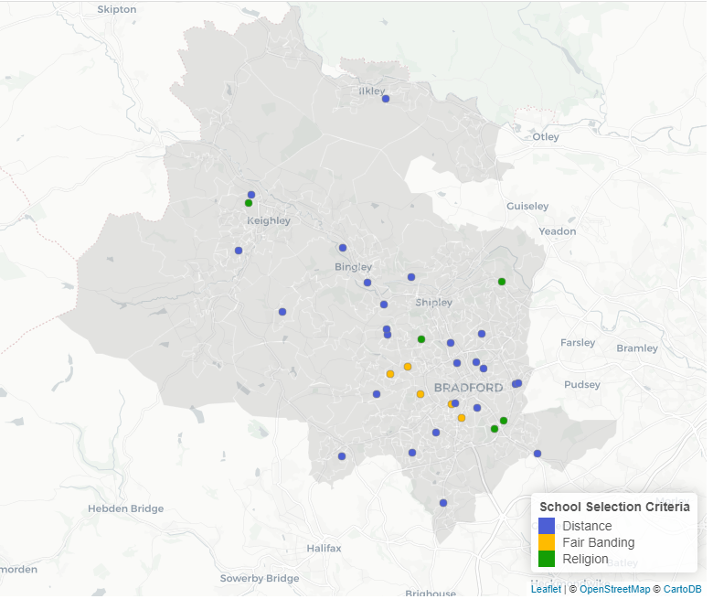
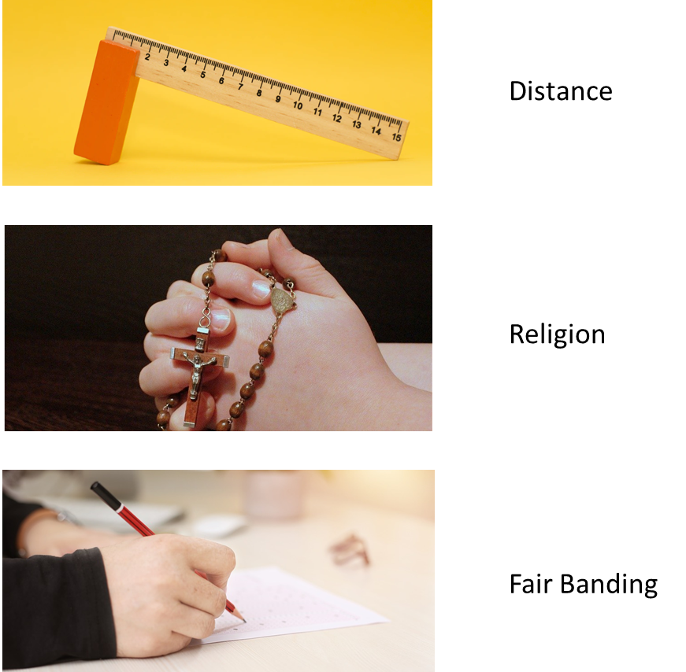
Presentation title slide

Slide 18
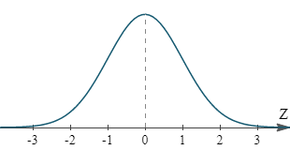
Presentation title slide
Fair Banding

Slide 19
Presentation title slide
How does a school’s selection criteria effect the demographic of its intake and the intake of the schools around it?

Slide 20
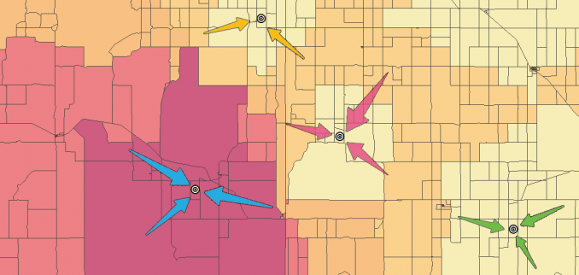
Presentation title slide
SPATAL INTERACTION MODEL

Slide 21
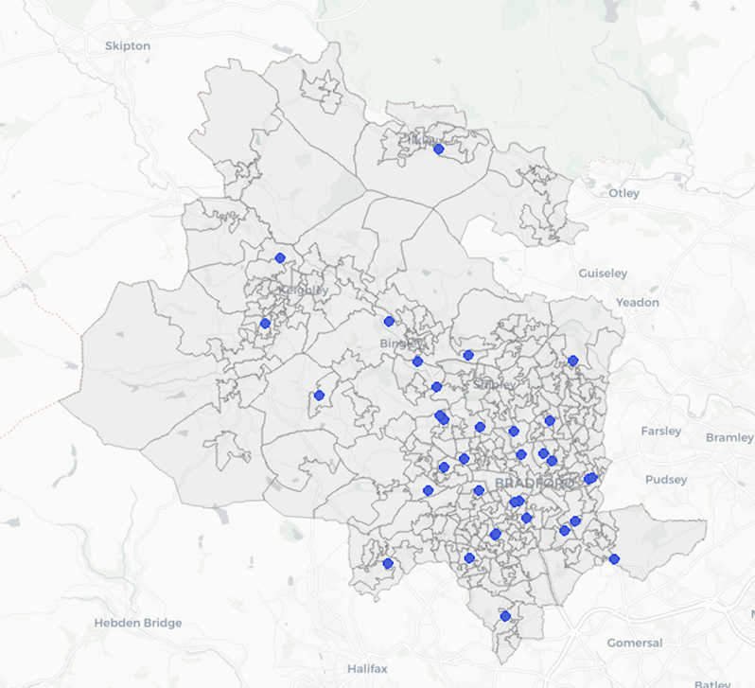
Presentation title slide

Slide 22
Presentation title slide
constraint
‘mass’ of destination zone j
distance decay function
Flow between origin(i) and destination(j)
‘mass’ of origin zone i

Slide 23
Presentation title slide
A B
i
j
‘mass’ of destination zone j
Constraint so number of children attending each school and leaving each LSOA is conserved
distance decay function
Flow between origin(i) and destination(j)
‘mass’ of origin zone i

Slide 24
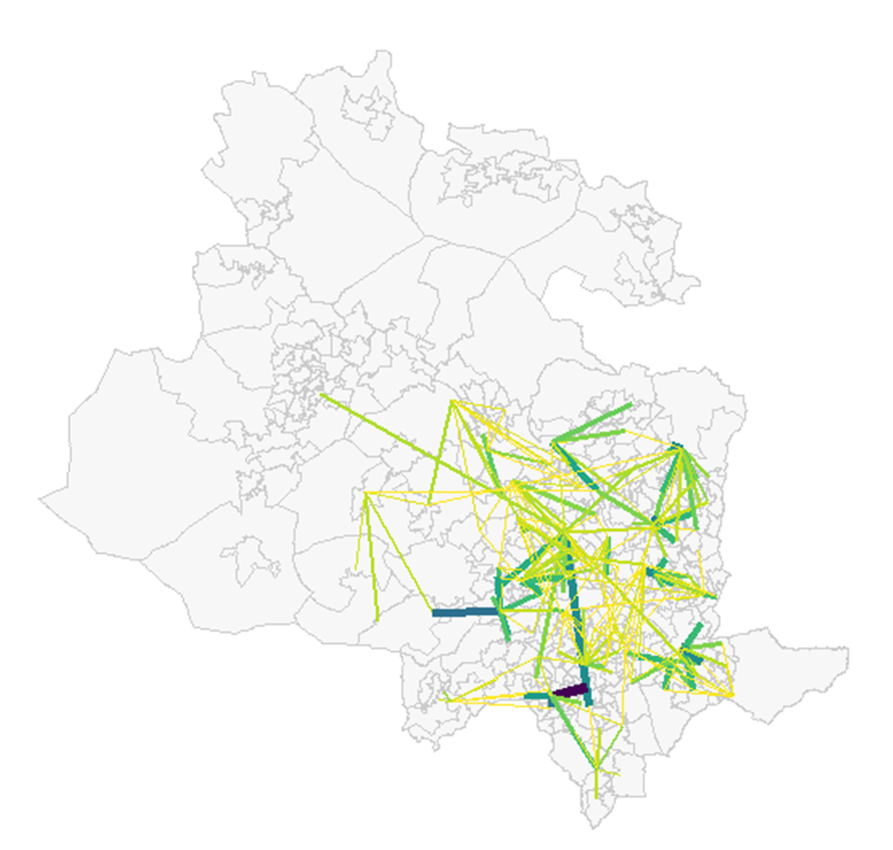
Presentation title slide
Spatial Interaction Model Predictions
Real Flows
 | D1 | D2 | D3
O1 | 55 | 0 | 6
O2 | 0 | 20 | 104
O3 | 7 | 4 | 0
O4 | 9 | 56 | 0
O5 | 0 | 3 | 0
O6 | 1 | 0 | 0
 | D1 | D2 | D3
O1 | 41 | 0 | 6
O2 | 3 | 21 | 80
O3 | 106 | 3 | 1
O4 | 0 | 50 | 0
O5 | 0 | 3 | 0
O6 | 1 | 0 | 21

Slide 25
Presentation title slide
Spatial Interaction Model Predictions
Real Flows
Difference
 | D1 | D2 | D3
O1 | 55 | 0 | 6
O2 | 0 | 20 | 104
O3 | 7 | 4 | 0
O4 | 9 | 56 | 0
O5 | 0 | 3 | 0
O6 | 1 | 0 | 0
 | D1 | D2 | D3
O1 | 41 | 0 | 6
O2 | 3 | 21 | 80
O3 | 106 | 3 | 1
O4 | 0 | 50 | 0
O5 | 0 | 3 | 0
O6 | 1 | 0 | 21
 | D1 | D2 | D3
O1 | 15 | 0 | 0
O2 | -3 | 1 | 24
O3 | -99 | 1 | -1
O4 | 9 | 6 | 0
O5 | 0 | 0 | 0
O6 | 0 | 0 | -21

Slide 26
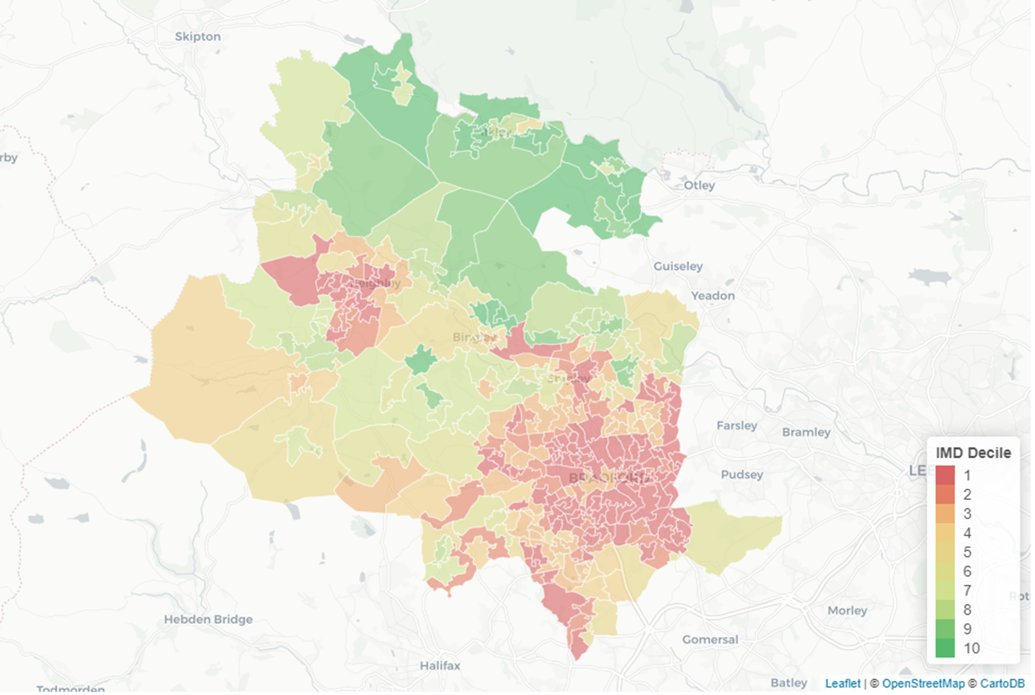
Presentation title slide
Difference
 | D1 | D2 | D3
O1 | 15 | 0 | 0
O2 | -3 | 1 | 24
O3 | -99 | 1 | -1
O4 | 9 | 6 | 0
O5 | 0 | 0 | 0
O6 | 0 | 0 | -21

Slide 27
Presentation title slide

