Slide 1
Notes:
To understand the purpose of this project let’s take a scenario where Mrs Green started noticing some symptoms like high fever, dizziness and a lump in the lymph nodes.

Slide 2
The NHS Cancer plan since 2000
62 Days Wait
GP
Diagnosis/Treatment
Start cancer Treatment
Specialist
2 week wait/ 14 days
31 days wait
Notes:
The NHS Cancer pathway plan is developed to have a maximum of 62 days wait.
1-Mrs Green will go the GP for the first visit.
2-In the case where Mrs Green symptoms are suggesting cancer, the GP will send a 2 week wait referral request which is request for an urgent appointment when there are symptoms that might indicate cancer or there is a need for further investigations.
3- Mrs Green will see a specialist doctor and get a hospital assessments and investigations.
4-Depending on the assessment results, The Doctor will then give a diagnosis and a treatment plan in the case of cancer diagnosis.
5- Mrs Green or the patient will then receive the first definitive treatment within 31 days of a cancer diagnosis.
This plan is a 62 days pathway: where patients begin their first definitive treatment for cancer within 62 days following an urgent GP referral for suspected cancer.

Slide 3
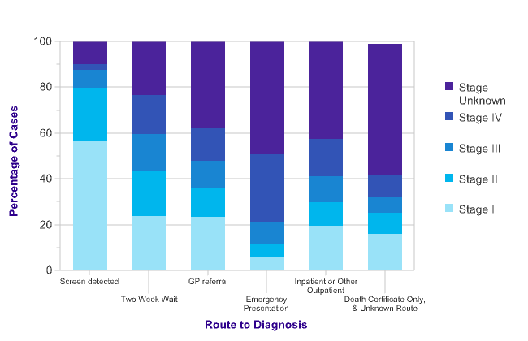
Late Cancer Diagnosis and Survival Rate
Three Times Higher Survival rate with early diagnosis
62%
81%
Diagnosed late
Diagnosed Early
Stage III, Stage IV
Stage I, Stage II
Notes:
Even though the two week referral Pathway was developed to speed the diagnosis and treatment process , yet more than 60% of the patients in the route to diagnosis get a diagnosis in the late stages.
Patients getting an early diagnosis increases their survival rates by 3 times.
* Source: Cancer Research Centre UK

Slide 4
Presentation title slide
How can we detect Cancer Symptoms from Electronic Health Records?
Maab Ibrahim
Supervisory team: Prof. Eric Atwell, Prof. Geoff Hall, Dr Richard Savage, Dr Ciarán McInerney
Notes:
With the massive amount of data being stored in EHRs. We present this project that aims to extract the cancer symptoms from These medical unstructured notes to help clinical decision support and quality care improvement as well as using clinical data for research.

Slide 5
NLP Model
Objectives
STATISTICS
Performance

Slide 7
NLP model for Cancer symptoms Extraction
Early Cancer Detection
25% role out
500,000 patients
Save
£150m
Notes:
Pinpoint Data science ongoing project for early stage cancer detection achieved nearly 25% rule out last year with a prototype , which if deployed will give 500,000 patients peace of mind in a few days and saved the NHS over £150m.
The symptoms extraction NLP model is an augmentation of the pinpoint project by adding the symptoms probability element to the Pinpoint project ML algorithm.

Slide 8
2142 2ww
EHRs
1721 different patients
NICE Guidelines
DART Forms
Notes:
1- Electronic Health Records (EHRs) are the medical notes that are used during the cancer referral pathway from the initial symptoms’ assessment to the final diagnosis and treatment step. The distribution of the derived symptoms was described in (2142) EHRs of (1721) different patients.
2-The National Institute for Health and Care Excellence (NICE) provides and evidence-based national referral guidelines for suspected cancer patients. These guidelines are recommended as a reference for healthcare providers in England through the patient cancer diagnosis pathway. These predefined guidelines were used to develop the symptoms rules.
3-the ‘Digitally Assembled Referral Toolkit’ (DART), is a proposed ‘standard’ for the referral assembly process and filled by the GP with basic information about the patient symptoms and suspected cancer pathway. It is a structured data that was used as a human annotation mechanism to label the health records by medical experts.
However, It should be noted that the DART annotation is not a syntactic annotation but rather an annotation based on the doctors observations on the patients

Slide 9
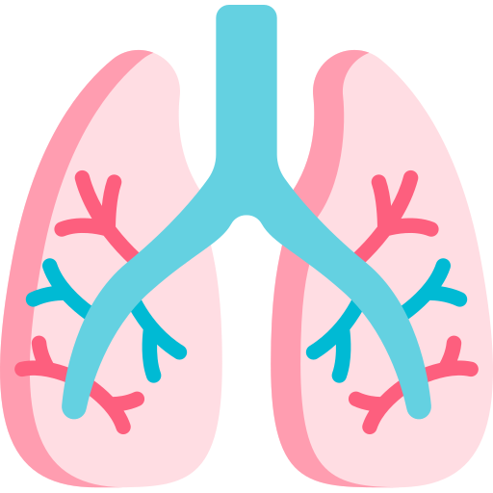
approx. (192) NICE symptoms detected from (12) different NICE cancer pathways.
Notes:
Settings:
From the NICE Guidelines approx. (192) NICE symptoms from (12) different NICE cancer pathways we detected.
We started with 7 Breast Cancer, 12 Upper GI Cancer and 27 Lower GI cancer symptoms.
The medical terms and concepts were matched to the UMLS. DART tool answers were used to label the dataset.
Started with Breast Cancer, Upper GI Cancer and Lower GI cancer symptoms.

Slide 10
Breast Cancer Symptoms distribution using DART
Notes:
It is noticed that the breast lump is the most common symptom in the breast cancer patients.
Since DART forms are used to label the data we identified any missingness in the dataset and eliminated the reports with the missing DART Answers. We can see that there are more than 50% of the DART Forms answers are missing because we are dealing with the scraping of the forms rather than the actual forms which can lead to data lose.
These were no data available from the Other Breast Symptoms question. Therefore, this symptom was extracted but not included in the ML Modelling.

Slide 11
Natural Language Processing (NLP) Model
Notes:
How do we develop NLP model that extracts the symptoms from the EHR

Slide 12
Characteristics
limited use of verbs
extensive use of abbreviations
low structure
Dictionary & Thesauri
Medical terminology synonyms
Entity Traits
Concepts
negation
patient history family history
Notes:
What is NLP?
A language is a mean of expression and communication between people.
NLP is the task of applying computations to analyse a language and extract knowledge.
In this project the sublanguage we are processing is the medial notes language.
Understand Medical notes Sublanguage:
Entity traits (negation, patient history, family history, Concepts)
Characteristics (limited use of verbs, extensive use of abbreviations, low structure)
Medical terminology, synonyms
UMLS, language consistency

Slide 13
NICE Symptom description | Concept | Modifiers examples | Number of rules
aged 30 and over and have an unexplained breast lump with or without pain or | Breast Lump | -Cluster of Calcification - tumour -mass in the breast -breast irregular nodularity | 11
aged 50 and over with nipple discharge | Nipple Discharge | -Blood stained – clear fluid | 3
aged 50 and over with nipple Retraction | Nipple Retraction | Retract* - evert* - flatten | 7
with skin changes that suggest breast cancer | Skin Changes | -Skin thickening –changes in the skin – peau d’orange - dimpling | 13
aged 30 and over with an unexplained lump in the axilla | Lump in the Axilla | -axillary lump -lymph node* | 4
aged 50 and over with other Changes of Concern | Other Changes of Concern | -chest swelling -painful shoulder -spinal met | 10
Other breast symptoms | Other Breast Symptoms | -tenderness -distortion -infection | 15
Notes:
I developed a set of rules for symptoms extraction.
7 symptoms were defined for beast cancer, 27 for the upper GI cancer and for the lower GI cancer.
This is an example of the breast cancer set of rules. As described by the NICE guidelines there are 7 key symptoms that will get the patient sent to the 2ww pathway for an urgent appointment.
Each rule is a combination of concepts and medical terminology alternatives that can be used to present the NICE symptom. The rules are also based on the linguistic consistency used by the hearth providers.
The rules are developed for lexical parsing of the text and to recognize the patterns in symptoms presentation.

Slide 14
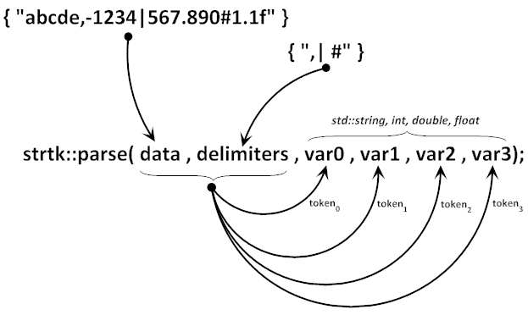
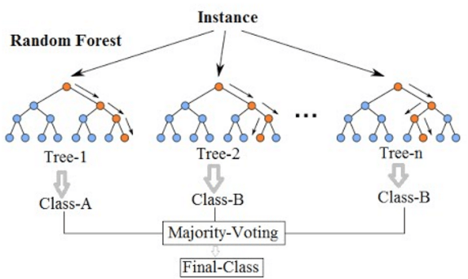
String tokenization and features extraction
word N-gram features
Text pre-processing:
Noise removal
punctuations removal
lower casing
text normalization
stemming
text classification
Random Forest Classifier to classify the reports based on the dominant features
String Vectorization
Notes:
Text pre-processing:
Noise removal, punctuations removal, lower casing, text normalization, stemming
Stemming
POS tagging was tested -> since we are looking for lexical patterns rather than grammatical structure.
String tokenization and features extraction:
Bag of word/word N-gram features: specify the N number of consecutive words for the tokenization of the features.
String Vectorization: convert string into vectors of numbers
text classification
to classify the reports based on the dominant features

Slide 15
Notes:
term frequency–inverse document frequency, is a numerical statistic that is intended to reflect how important a word is to a document in a collection or corpus of documents.

Slide 16
a 62 years old female present with left sides fungate nipple lesion notice a week ago not relieve by antifungal creams there is an underlying mass tender
has fever for 3days, no palpable lymph node just stop breast feed youngest child is 2 years old, her mother and aunt
nipple lesion
mass
Tender
no palpable ln
A 62 years old female presented with lt sides fungating nipple lesion , noticed a week ago , not relieved by antifungal creams , there is an underlying mass, tender,3*4 , has fever for 3days, no palpable ln, just stopped breast feeding, youngest child is 2years old, her mother and auntie ……
Health Report
Symptom
Mass
Nipple lesion
tenderness
Negated Symptom
axillary lymph nodes
History
(20, 0) 1.34
(20, 5) 0.85
(20, 9) 0.95
Text Classification
Notes:
Lets see how Mrs Green Health Report will be processed:
1- Text cleaning and reprocessing.
2- Stemming and normalization
3- Tokenization using Ngram feature selection
4- String Vectorization and TF-IDF calculation
5- The generated vector of features and then used in the text classification task

Slide 17
Performance Measurement
Notes:
What matrices we used to evaluate the performance of our models.

Slide 18
Symptom | AUC | F1-score | Accuracy%
Lump in the Breast | 0.98 | 0.90 | 92%
lump in the axilla | 0.81 | 0.79 | 95%
Skin Changes | 0.78 | 73% | 89%
Nipple retraction | 0.77 | 68 | 94%
Other Symptoms | 0.56 | 0.39 | 54%
Notes:
-The nipple retraction performed poorly. Almost
-There model generated for the (nipple discharge) symptom classification is not reliable since it uses only 17 EHRs and there for was eliminated
- The (Other Breast symptoms) had 100% missing DART answers and therefore no model was generated for it.

Slide 19
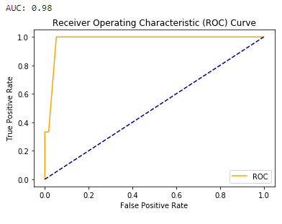
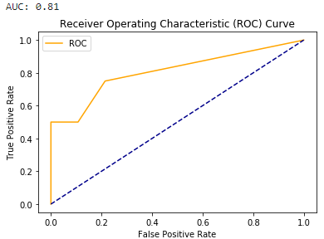
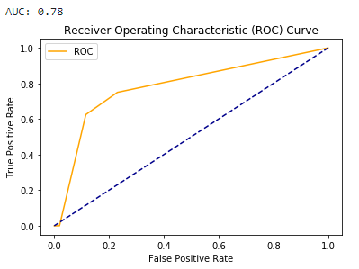
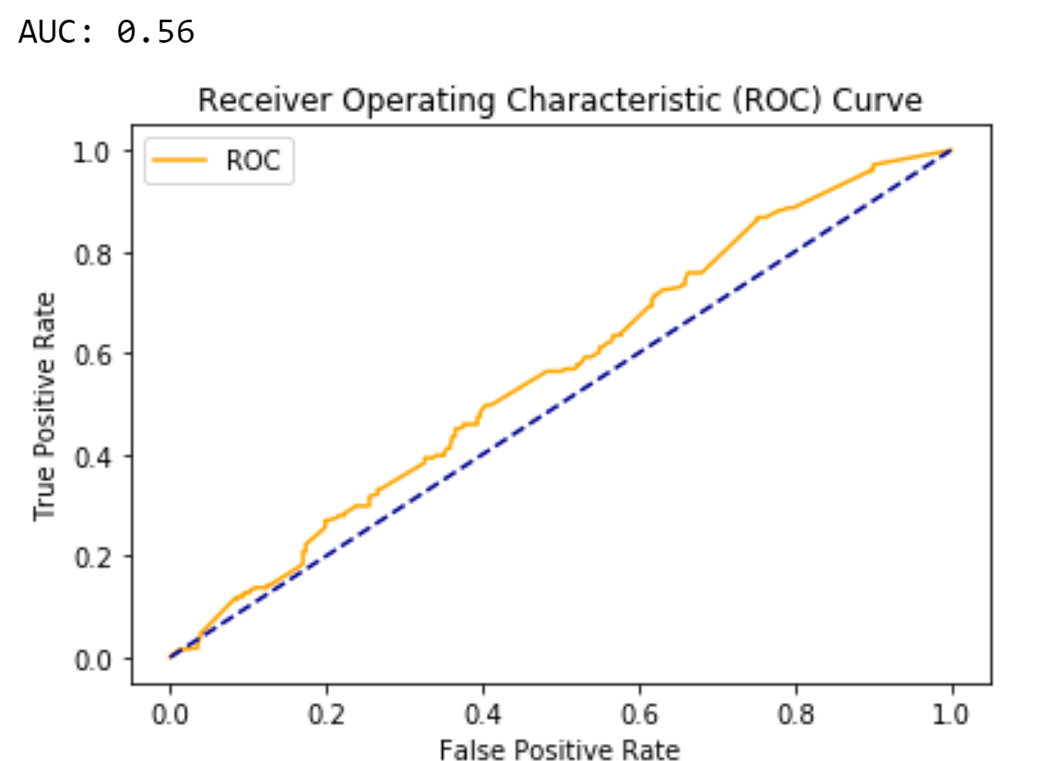
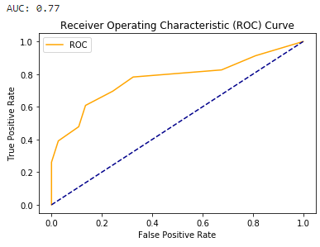
ROC Curve Plotting
Lump in the Breast
Lump in Axilla
Skin Changes
Other Symptoms
Nipple Retraction
Notes:
The ROC Curve is a visualization of a binary classification performance. In this case Whether the EHR has the symptom (Yes/No).
For a ROC Curve we compare between the predications to the true classification. The Curve is generated by calculating TPR to the FPR for all the possible classification thresholds (0-1) rather than a single thresholds.
The perfect classification performance is indicated by the curve meets the upper left corner of the plot. (AUC=1)
The other symptoms model is performing poorly since if the curve is close to the diagonal line then the classification is no better than random guessing of the class. (AUC=0.55)
Why AUC?
Useful for datasets with highly unbalanced classes.
Based on the FPR and TPR.
Uses all possible classification thresholds.
Evaluates how well the classifier separates the 2 classes.

Slide 20
Notes:
To Conclude conclusion, in this project we used the EHR, DART forms, NICE guidelines to build a rule-based NLP model that extracts the symptoms form the medical reports and performed text classification on the reports to calculate the probability of cancer symptoms occurrence.
THANK YOU!

