Slide 1
Presentation title slide
Notes:
1 in 3 people in UK live in poor housing
15% greenhouses gas emissions in the UK comes from homes – mainly heating
In addition to being bad for the planet, poor homes are also bad for the people who live in them:
35000 people die every winter as a result of poorly heated homes
Better quality housing could save the NHS 1.4 billion each year, about 60% of which is due to poor heating.
This kind of burden on our health system is similar to smoking or alcohol abuse.

Slide 2
Presentation title slide
Notes:
Build new homes – 1000-1500 Leeds per year – not a solution
80% of today’s homes will still be there in 2050, so need to retrofit

Slide 3
Presentation title slide
Notes:
Fabric measures: insulate roof, walls, floor, triple glazing, draught proofing
More efficient boiler or heat pump, solar panels for hot water or electricity

Slide 4
Presentation title slide
Low Carbon Cities: creating a road map for retrofitting the Leeds social housing stock
Natalie Nelissen
School of Earth and Environment
Notes:
In response to the climate emergency, Leeds has committed to becoming carbon neutral by 2030.
15% of Leeds houses are LCC housing stock

Slide 5
Presentation title slide
2020
 |  |  |  |  |  |  | ?
 |  |  |  |  |  |  | ?
 |  |  |  |  |  |  | ?
 |  |  |  |  |  |  | ?
…
Notes:
Data we’re working with:
Different retrofit measures, for different types of houses and flats
For each measure, we have (National Household Model)
estimated cost to install, cost to renew (limited lifespan), energy savings in terms of gas and electricity (kWh)
From this, we can calculate equivalent CO2 emission savings and energy bill savings
Finally, for a given housing stock, we know how many houses/flats are eligible for each measure (data to be provided by Leeds City Council)
What we want to do: estimate how many of each retrofit measures to implement each year

Slide 6
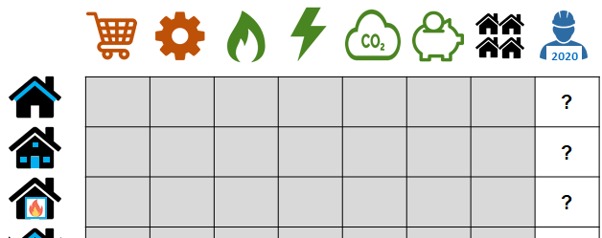
Presentation title slide
Linear programming
Maximise c1 x1+ c2x2 + c3x3
Under constraints:
a1x1 + a2x2 + a3x3
<= total_budget
a1
c1
m1
x1
x1 <= m1
x1 >= 0
a2
c2
m2
x2
x2 <= m2
x2 >= 0
a3
c3
m3
x3
x3 <= m3
x3 >= 0
Notes:
This type of optimisation problem is typically solved with linear programming, general expression given here
Maximise (minimise) X by changing Y under specific constraints
Let algorithm choose number of each retrofit measures (x’s) in order to maximise equivalent CO2 emisison savings
Under constraints:
Can’t spend more money on implementing retrofit measures than available council budget
Can’t implement more retrofit measures than maximum number of eligible houses/flats
Number t implement should be 0 or positive integer – can’t implement 0.5 boilers

Slide 7
Presentation title slide
simplex algorithm
Emissions
factors -> 0
Budget + 80% savings
Notes:
DISCLAIMER: not real data from Council!
2019 baseline
2030 Leeds target to be carbon neutral
2050 UL target to be carbon neutral
Blue line is equivalent CO2 emissions: want this to go to zero asap!
Graphs:
Original model assuming emission factors for gas and electricity to remain constant (no decarbonisation of national grid)
Slow decarbonisation of national grid by 2050
Reinvest 80% of tenant savings in retrofit measures to implement all retrofit measures by 2030

Slide 8
Presentation title slide
Notes:
To reiterate, quick look at how we’re creating a model that can help people decide on a retrofit strategy to
create houses which are good for our budget, good for our health, and good for our planet

