Slide 1
Changes in meat consumption patterns in the UK – investigation using loyalty card data
Patrycja Delong

Slide 2
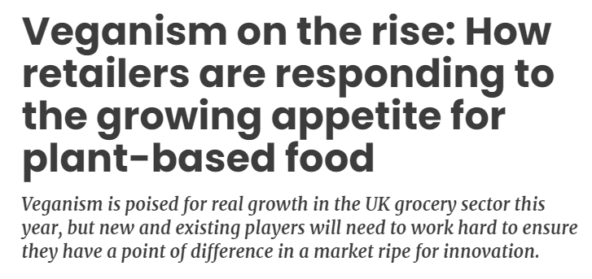
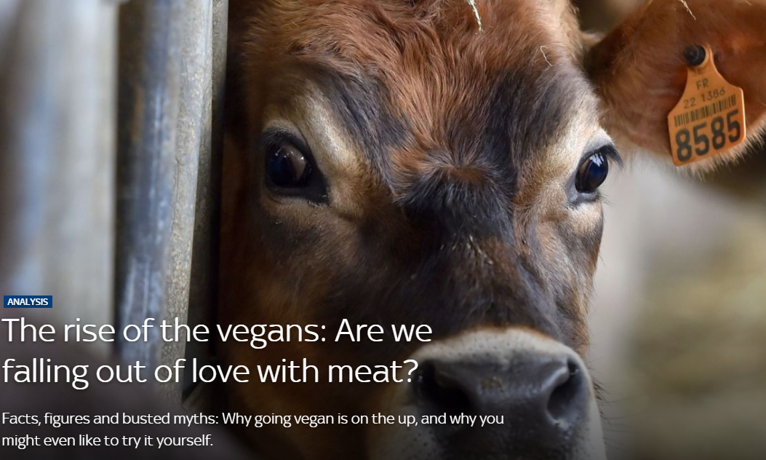

Slide 3
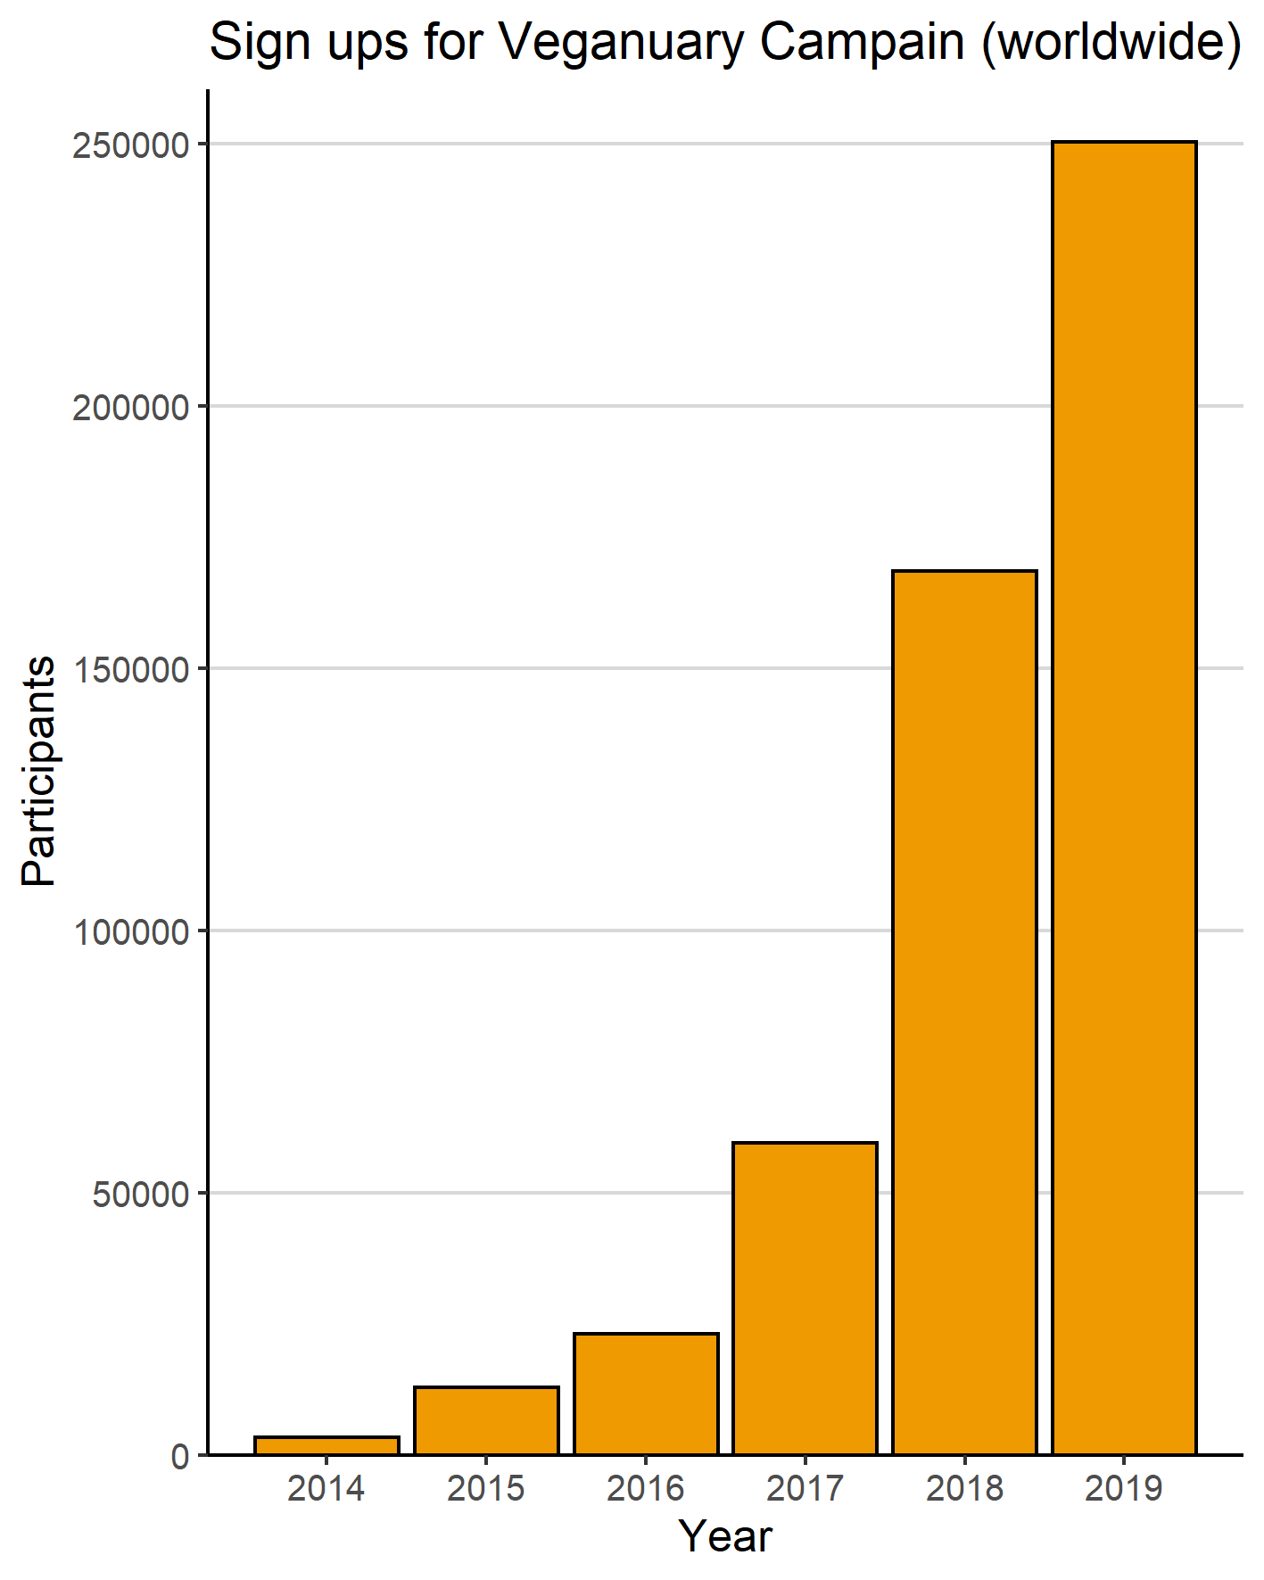
Source: trends.google.com
Source: Veganuary.com

Slide 4
Why people go vegan/vegetarian?
Graphics from: Veganuary.com

Slide 5
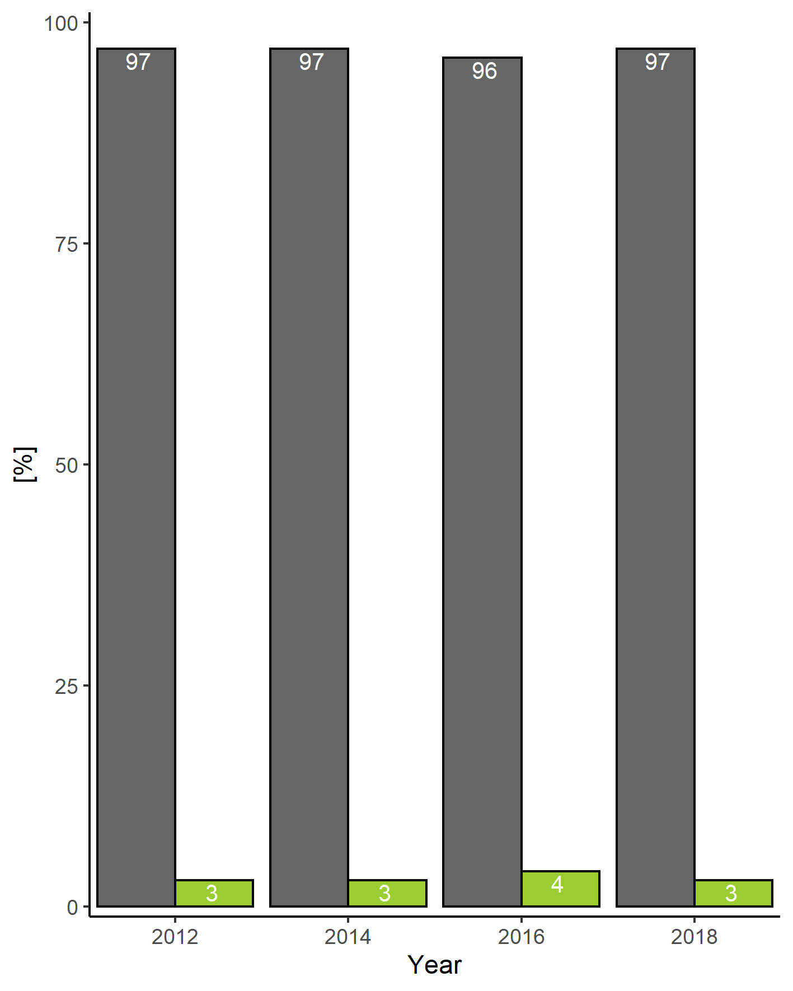
Meat consumption data based on traditional surveys
Source: Living cost and food survey/ Family Foods survey
Source: Food and You survey
Notes:
Food and you survey
The survey comprised 3,163 face-to-face interviews with adults aged 16+ (no upper age limit was applied) across the UK.

Slide 6
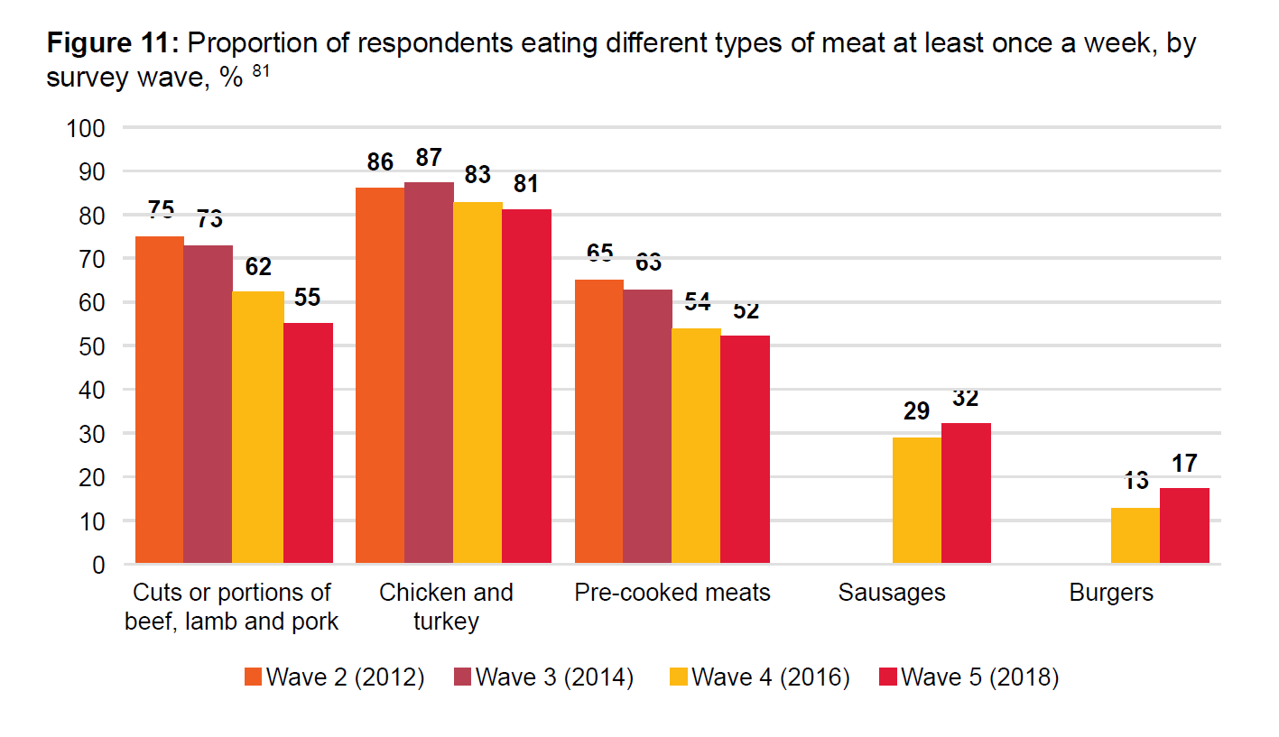
Meat consumption data based on traditional surveys
Source: Living cost and food survey/ Family Foods survey
Source: Food and You survey

Slide 7
Meat consumption data based on traditional surveys
Underreporting (intentional or unintentional)
Longitudinal information only on national level, but not for individual households
Limited nutritional information – weights estimated by participants, nutritional details estimated for typical products

Slide 8
Transaction data
No issue of underreporting
Longitudinal data for individual households
More detailed nutritional information – precise information about weights, detailed nutritional information for most items (and average estimates for the rest e.g. loose vegetables)
Large volume - counteracts problem of smaller groups (e.g. Vegans) being underrepresented in the sample

Slide 9
How dietary patterns change when people reduce their meat consumption?

Slide 10
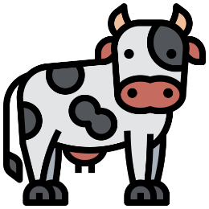
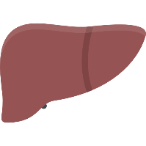
Red meat
Poultry
Other meat
Fish and seafood
Notes:
Source: flaticon

Slide 11
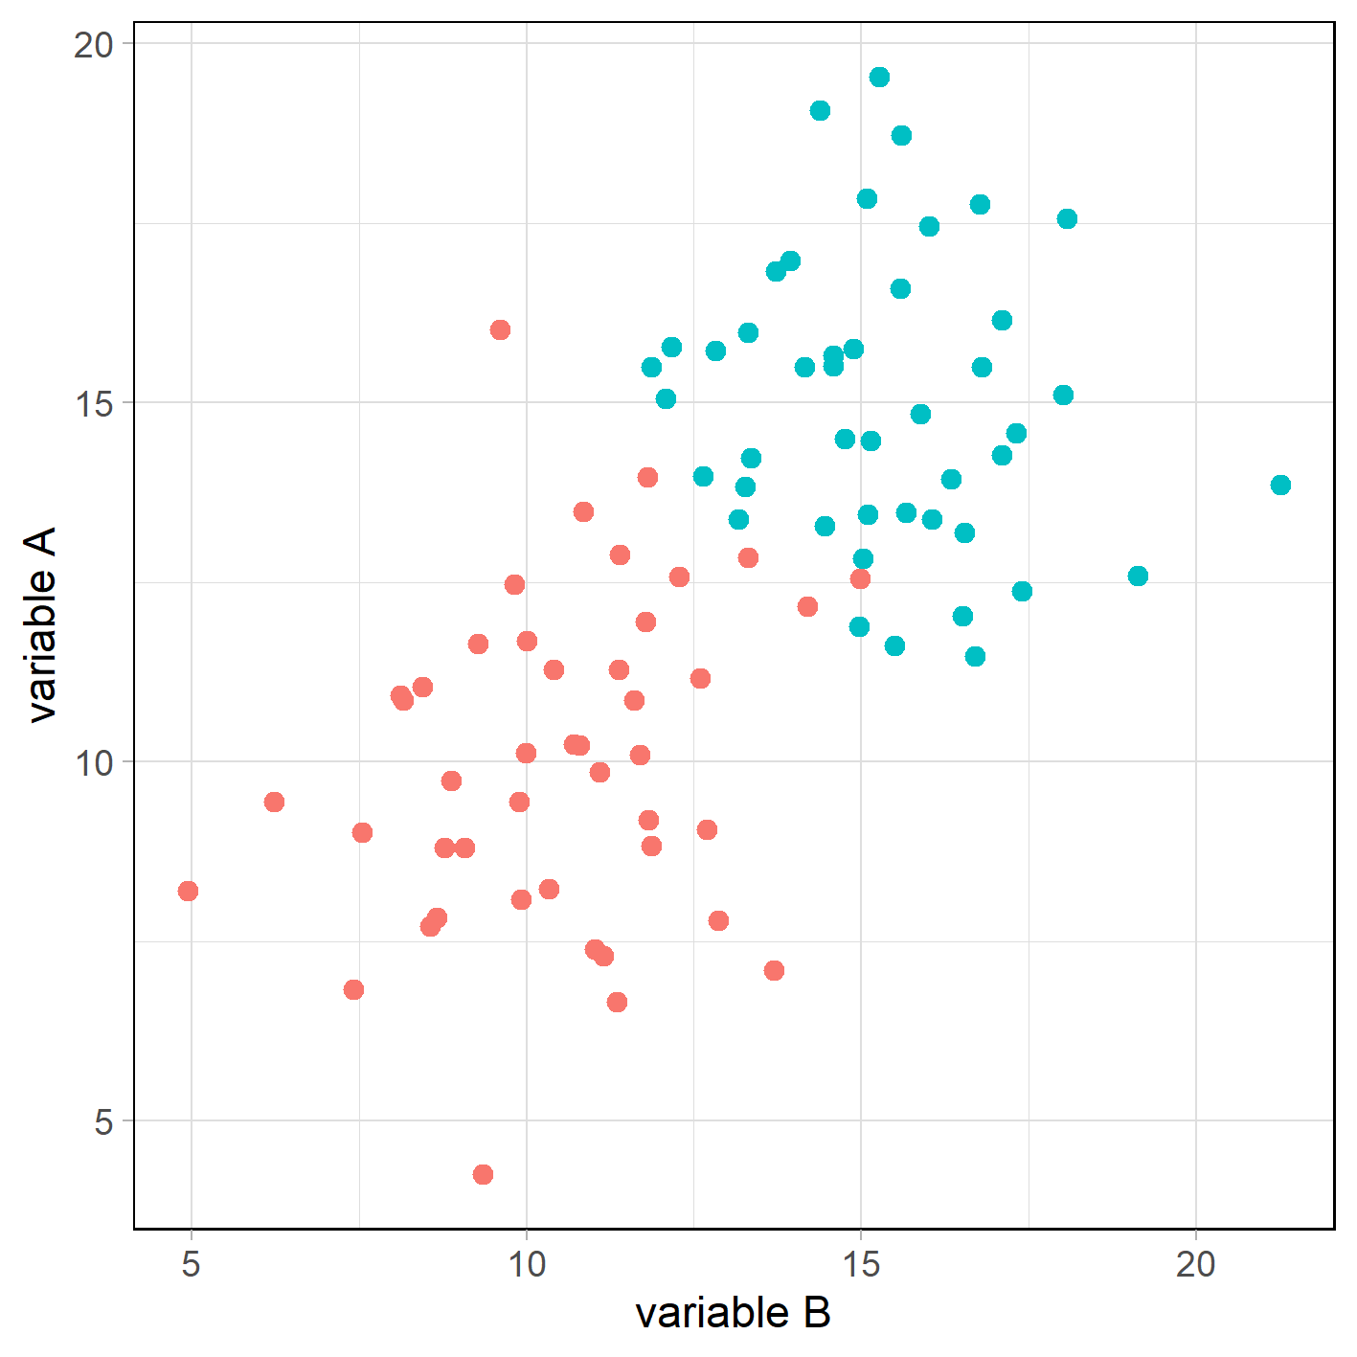
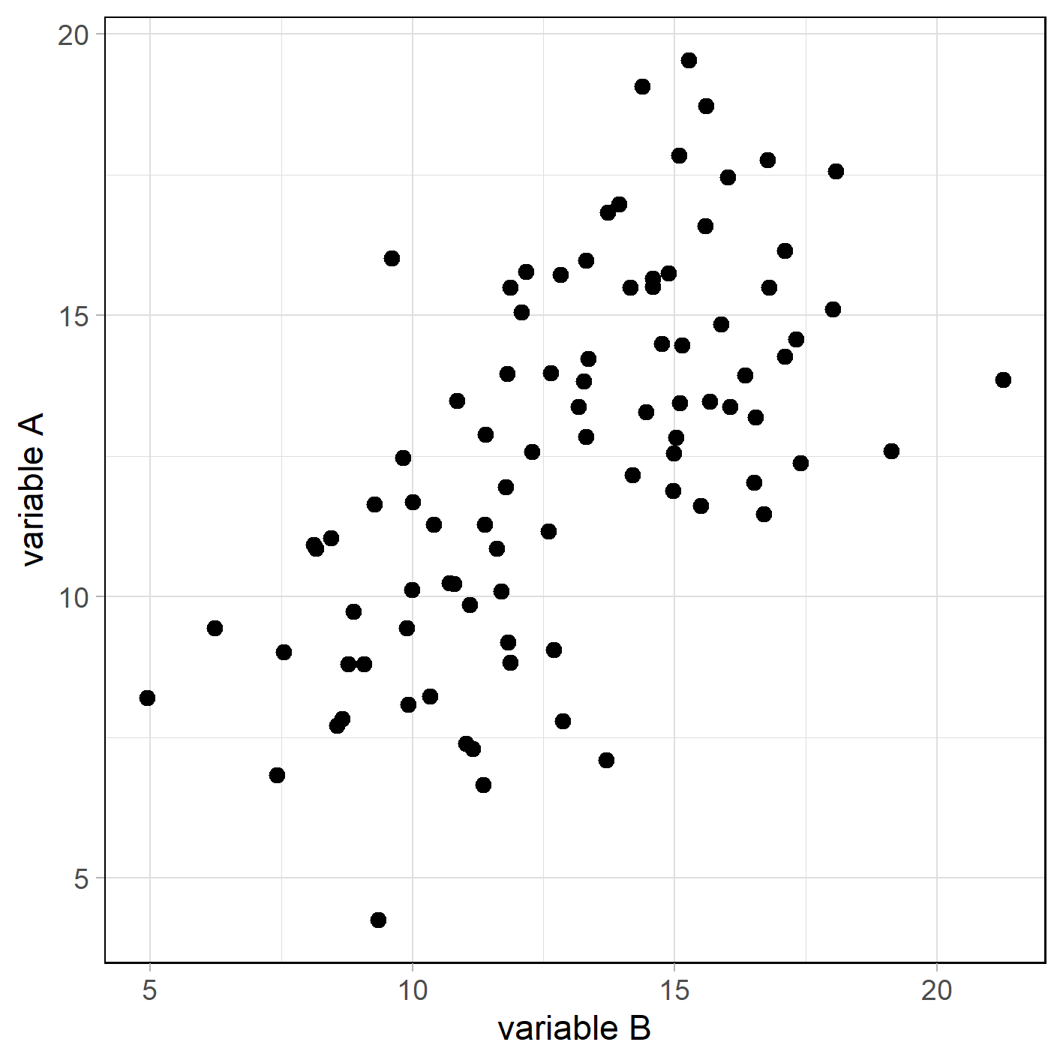

Slide 13
Red meat
Poultry
Other meat
Fish and seafood
Notes:
Source: flaticon

Slide 14
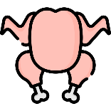
Meat mimics (substitutes)
Meat free protein
Bread & cereal
Oils & fats
Dairy
Dairy alternative
Fruits
Vegetables
Ready meals with meat
Ready meals with meat mimics
Ready meals without meat
Sugar products & confectionery
Beverages (excl. water & alcohol)

Slide 15
Presentation title slide
Would you like to find out what people eat when they reduce their meat consumption?
Come to the next series of LIDA Intern seminars (02.04.2020)!

