Slide 1
Presentation title slide
Simulations of crowd movements: from offline to real-time
Thomas Richards
Intern working on DUST project
Supervisory team: Nick Malleson, Jonathon Ward, Minh Kieu
Notes:
Design Ideas

Slide 2
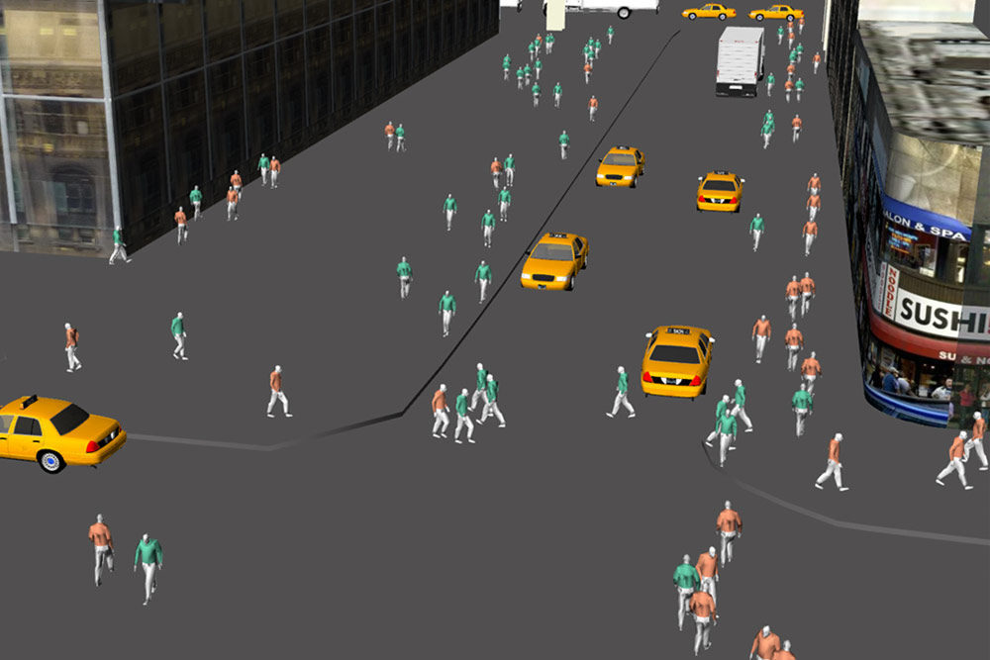
Presentation title slide
Crowd simulation using Golaem, Game of Thrones
A simulated crowd evacuating crowd, from Axblad and Gonzalez (2018)
Burrohappold Engineering urban planning tool
Notes:
There are many situations where it is useful to simulate how individual entities (for example vehicles or people) move and interact within a given spatial area.
For example, simulating evacuating crowds for emergency management, special effects in cinema, and simulating a street for urban management.
Broadly speaking there are 3 different modelling approaches depending on the time scale and the size of the crowd: the flow-based approach, the particle system approach, and the agent-based approach (Axblad 2018, p6).
In urban analytics, an agent-based approach is useful and I am going to discuss how we are working to improve this approach and then how we plan to demonstrate this in a proof-of-concept model of a real life situation

Slide 3
Agent-based models (ABMs)
Useful for simulating crowds with heterogenous behaviours of individuals
Offline models from historical data
But, no established methodologies for Dynamic Data Assimilation (DDA) in agent-based models of crowd simulations
Notes:
Title
Why are agent based models preferable to other techniques?
Flow-based models treat crowds as a single fluid entity which has the benefit of reducing computational cost, but cannot factor in details of individual agents.
Particle-based methods do model individual agents but focuses on the physical forces guiding the agents
Agent-based models however, allow us to model each as an intelligent individual that can decisions based on the environment.
Each agent is assigned a list of variables which will affect their behaviour.
This allows us to model behaviours such as speed of movement, response to panic, etc. at the individual level across a heterogenous population
Show point 1
So if we wanted to model the movements of individuals in a building, we could build a model based on historical data which might help us find design flaws in a structure we are building.
Show Point 2
However, models are usually calibrated once using historical data
This means that over time, the prediction tends to diverge from the real situation and would therefore be unable to predict future events based on the situation in a building right now.
We are working on improving these models by incorporating real-time data through methods known as dynamic data assimilation, thought there are no currently established methods for crowd simulations.
Show Point 3
These techniques can improve the predictive capability by calculating the difference between the model and the true state, and then constraining the model to the real situation.
Other fields such as meteorology have successfully applied DDA to improve predictions of weather patterns for example using the Kalman filter/particle filter.
We want to use these techniques to develop a real-life application of DDA into an ABM as a proof-of-concept

Slide 4
Project goal
Construct an agent-based model that uses dynamic data assimilation in a real world application
Notes:
Before we build a model we need to be able to obtain data.

Slide 5
Smart Building
Notes:
As part of the DUST project, researchers at University of Leeds are working in collaboration with Connected Places
They provide data-oriented solutions to businesses.
One project they have set up is a Smart building which has 18 sensors in different locations throughout the building
We want to use data from these sensors to build an ABM which models peoples movements through the building
Occupancy
Atmospheric volatile organic compound levels (VOC)
CO2 levels
Temperature
Pressure
Humidity
Light Intensity
Noise Levels

Slide 6
Cactus Smart Building, Ground Floor
Open-Office
Café
Desks: 201-208
Desks: 209-216
Desks: 217-220
Desks: 221-228
Café-1
Desks: 229-232
Desks: 233-240
Desks: 241-244
Desks: 245-254
Café-2
Café-3
Sensors
UM-Meeting-Room-UM01
Exhibition-Area
Exhibition-Area-1
Exhibition-Area-2
UM-Meeting-Room-UM01

Slide 7
Sensors measure:
Atmospheric volatile organic compound levels (VOC)
CO2 levels
Temperature
Pressure
Humidity
Light Intensity
Noise Levels
Occupancy (number of people)
Notes:
Environment sensors
Occupancy sensors on seats
Main entrance foot fall
Sensors provided by other companies access through that companies API

Slide 8
To obtain data from the Smart Building…
Access the data
Build Python module to retrieve data and visualise (understand) the data
Build SQL database to store data

Slide 9
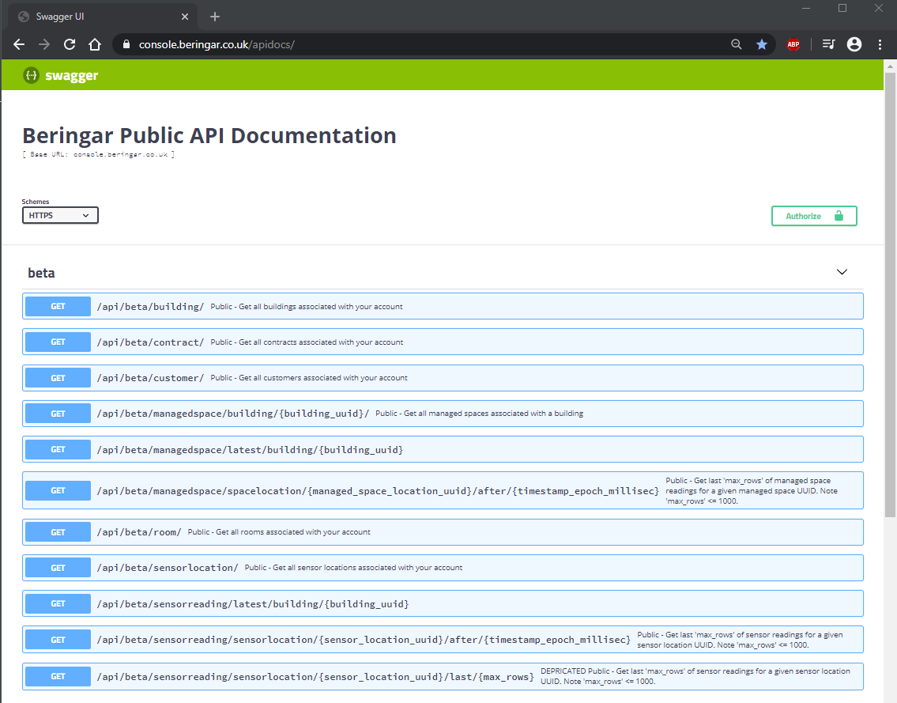
1. Smart building Application Programming Interface (API)
Notes:
People are likely familiar with the concept of an API, which stands for application programming interface.
An API essentially provides an intermediate to access data on a server.
For example, this could represent the back end of a website such as twitter.
In our case, it gives us access to data about the building and readings from the sensors, and this can be accessed through a web browser (pictured).
List the names of functions and say what data they return.
Some of the functions take inputs.

Slide 10
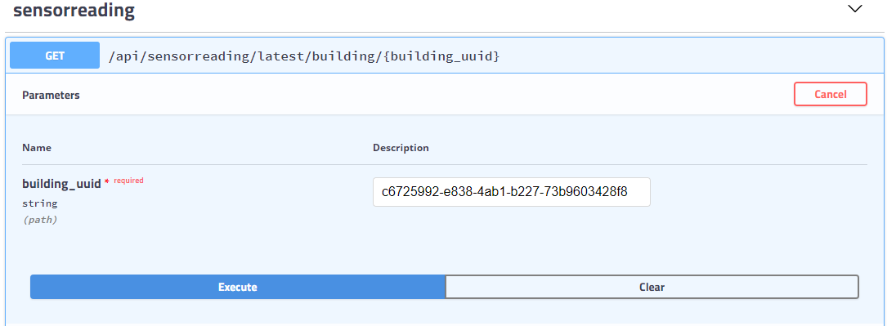
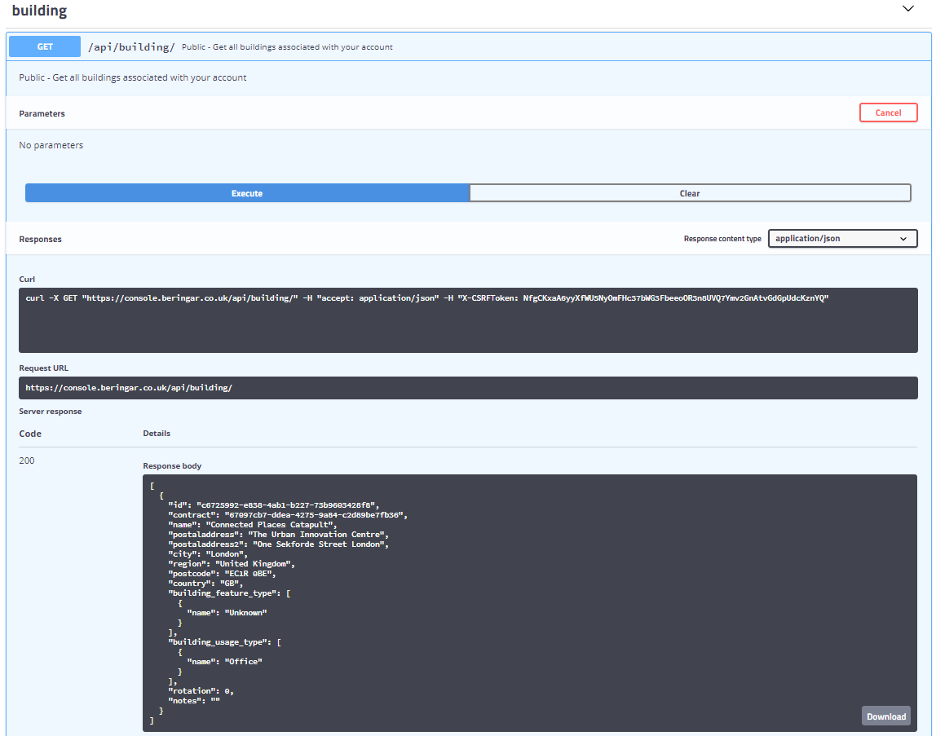
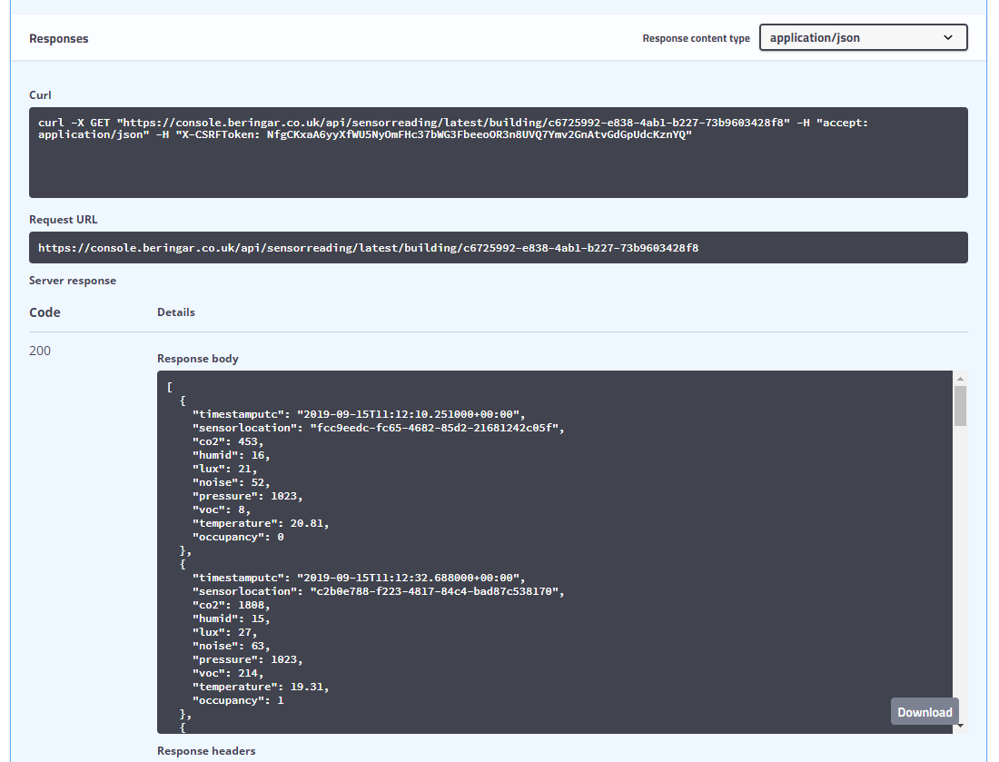
1. API functions
Notes:
In the web browser, you simply log in, then execute the functions to take the output.
Some of these functions require an input, which for most cases is the output of another function.
For example, you must call the building() function and obtain the building id to use the sensorreading function, which then gives you access to the data you require.
This data is returned in JSON format, and it is possible to download this data directly from the API.
Of course, this must all be done manually, which is time consuming and inconvenient because it gives you no option to automate data collection and utilization.

Slide 11
2. Python Module to access API
API architecture/function dependencies
Notes:
In order to utilize this data for use in a model, it must be possible to access data programmatically rather than manually.
As well as with the browser interface, APIs allow access to functions scripturally through a URL.
Because the modelling is mostly done in Python, I wrote a Python module to be able to access the data through the API.

Slide 12
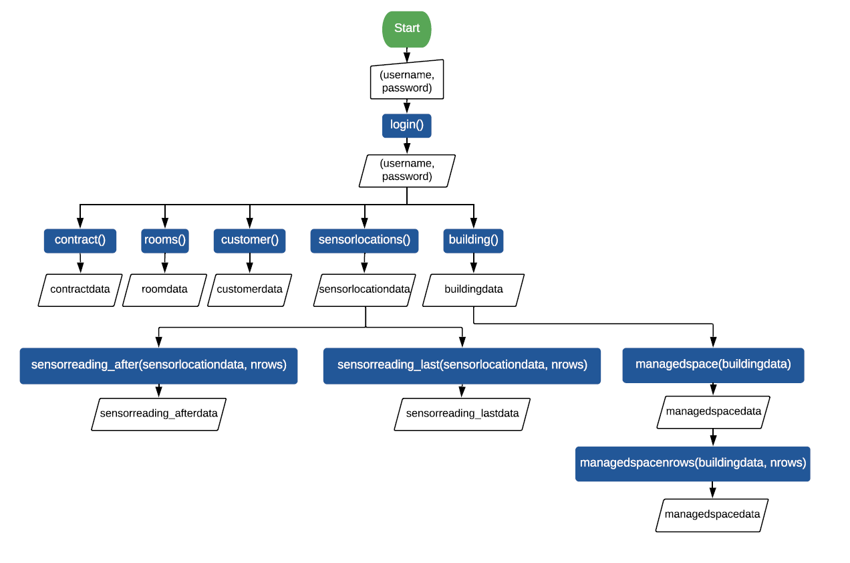
= start/end
= manual input
= process
= input/output
Notes:
This is a diagrammatic representation of the architecture of the API, with different rows requiring a different number of inputs from top to bottom.
All functions required the username and password to access them.
Many of the functions required one or more inputs.
Then the bottom row represents the raw data.
However, a lot of these do not change and therefore only need to be called once.
I therefore needed a way to avoid unnecessary effort for the user so they didn’t require 4 or 5 inputs as well as those related to the specifics of the function they are actually trying to call.
In the end I resolved this problem by declaring a class instance which uses methods when the instance is declared to store data which are constant as attributes of that class instant.

Slide 13
2. Python Module to access API
API architecture/function dependencies
Decode (deserialize) from JSON format - json package

Slide 14
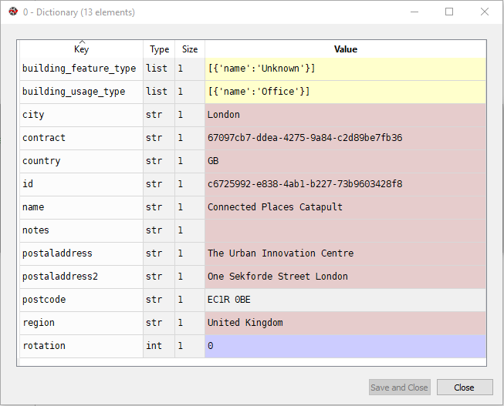

Slide 15
2. Python Module to access API
API architecture/function dependencies
Decode (deserialize) from JSON format - json package
Visualize - matplotlib, timestamps

Slide 16
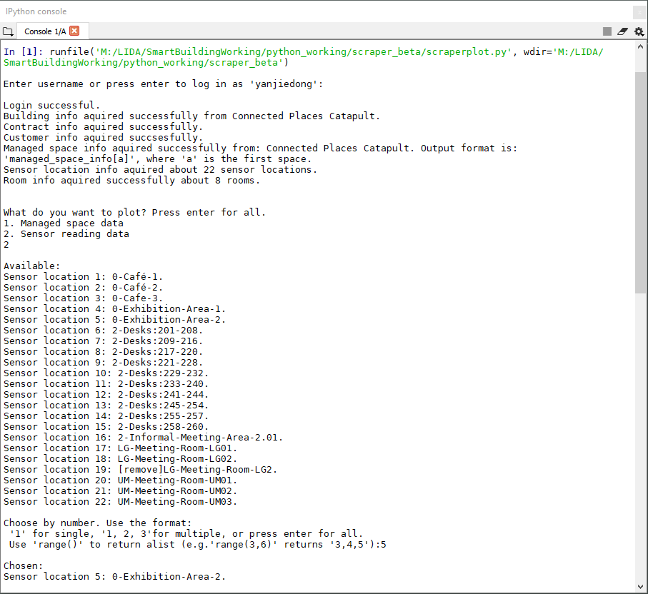
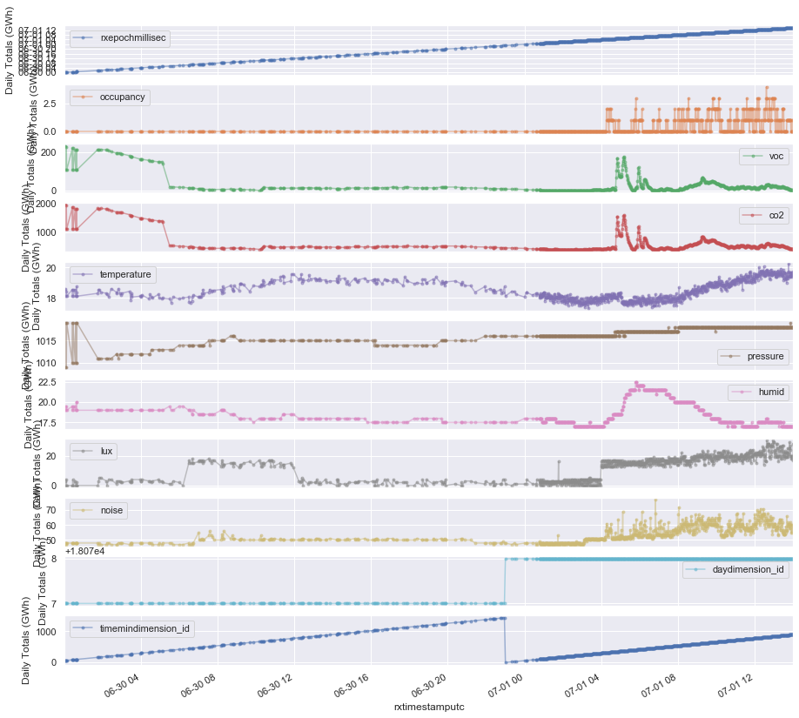
2. Python Module to access API
Notes:
For plotting I wrote a separate script to use functions from my module to plot data from user choices of sensors.
Talk through interactions/text input

Slide 17
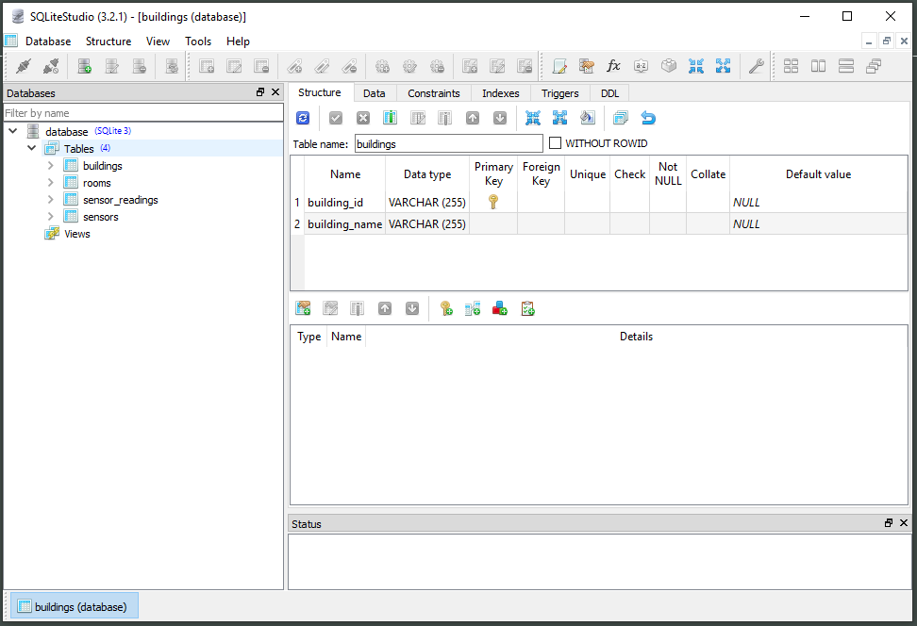
3. SQL Database to store data

Slide 18
Proposal for an ABM of the smart building
Agents: sensor areas
Variables: sensor readings
Outcome: “occupancy” (number of people in area covered by sensor)
Notes:
Currently sensors offline/sending historical data and no floor plan available, but next steps are to build an ABM of the smart building.
Need to emphasize in these slides how the parameters which are measured will feed into the model.
For example:
Can CO2 levels for example be used to predict occupancy?
Could the model predict the movement of people if there was for example a large increase in temperature/VOC levels?

Slide 19
Cactus Smart Building, Ground Floor
N people:
Open-Office
Café
0
1
2
Desks: 201-208
Desks: 209-216
Desks: 217-220
Desks: 221-228
Café-1
3
4
5
6
Desks: 229-232
Desks: 233-240
Desks: 241-244
Desks: 245-254
Café-2
Café-3
UM-Meeting-Room-UM01
Exhibition-Area
Exhibition-Area-1
Exhibition-Area-2
UM-Meeting-Room-UM01
7.00 am

Slide 20
Cactus Smart Building, Ground Floor
N people:
Open-Office
Café
0
1
2
Desks: 201-208
Desks: 209-216
Desks: 217-220
Desks: 221-228
Café-1
3
4
5
6
Desks: 229-232
Desks: 233-240
Desks: 241-244
Desks: 245-254
Café-2
Café-3
UM-Meeting-Room-UM01
Exhibition-Area
Exhibition-Area-1
Exhibition-Area-2
UM-Meeting-Room-UM01
8.00 am

Slide 21
Cactus Smart Building, Ground Floor
N people:
Open-Office
Café
0
1
2
Desks: 201-208
Desks: 209-216
Desks: 217-220
Desks: 221-228
Café-1
3
4
5
6
Desks: 229-232
Desks: 233-240
Desks: 241-244
Desks: 245-254
Café-2
Café-3
UM-Meeting-Room-UM01
Exhibition-Area
Exhibition-Area-1
Exhibition-Area-2
UM-Meeting-Room-UM01
9.00 am

Slide 22
Cactus Smart Building, Ground Floor
N people:
Open-Office
Café
0
1
2
Desks: 201-208
Desks: 209-216
Desks: 217-220
Desks: 221-228
Café-1
3
4
5
6
Desks: 229-232
Desks: 233-240
Desks: 241-244
Desks: 245-254
Café-2
Café-3
UM-Meeting-Room-UM01
Exhibition-Area
Exhibition-Area-1
Exhibition-Area-2
UM-Meeting-Room-UM01
10.00 am

Slide 23
Cactus Smart Building, Ground Floor
N people:
Open-Office
Café
0
1
2
Desks: 201-208
Desks: 209-216
Desks: 217-220
Desks: 221-228
Café-1
3
4
5
6
Desks: 229-232
Desks: 233-240
Desks: 241-244
Desks: 245-254
Café-2
Café-3
UM-Meeting-Room-UM01
Exhibition-Area
Exhibition-Area-1
Exhibition-Area-2
UM-Meeting-Room-UM01
11.00 am

Slide 24
Cactus Smart Building, Ground Floor
N people:
Open-Office
Café
0
1
2
Desks: 201-208
Desks: 209-216
Desks: 217-220
Desks: 221-228
Café-1
3
4
5
6
Desks: 229-232
Desks: 233-240
Desks: 241-244
Desks: 245-254
Café-2
Café-3
UM-Meeting-Room-UM01
Exhibition-Area
Exhibition-Area-1
Exhibition-Area-2
UM-Meeting-Room-UM01
12.00 noon

Slide 25
Cactus Smart Building, Ground Floor
N people:
Open-Office
Café
0
1
2
Desks: 201-208
Desks: 209-216
Desks: 217-220
Desks: 221-228
Café-1
3
4
5
6
Desks: 229-232
Desks: 233-240
Desks: 241-244
Desks: 245-254
Café-2
Café-3
UM-Meeting-Room-UM01
Exhibition-Area
Exhibition-Area-1
Exhibition-Area-2
UM-Meeting-Room-UM01
6.00 pm

Slide 26
Proposal for a more sophisticated ABM with DDA…
Agents: individual people
Variables: sensor readings
Outcome: behaviour (trajectory)
Notes:
With a spatial map of building and sensors, we could build a more specific ABM where the agents are people rather than sensor areas
Data from the sensors could be used to simulate the movements of individuals in real-time
Next slides show model where agents are people and sensor data is used to predict trajectory

Slide 27
Cactus Smart Building, Ground Floor
Open-Office
Café
Desks: 201-208
Desks: 209-216
Desks: 217-220
Desks: 221-228
Café-1
Desks: 229-232
Desks: 233-240
Desks: 241-244
Desks: 245-254
Café-2
Café-3
UM-Meeting-Room-UM01
Exhibition-Area
Exhibition-Area-1
Exhibition-Area-2
UM-Meeting-Room-UM01
Notes:
Each X represents an agent which is a person

Slide 28
Cactus Smart Building, Ground Floor
Open-Office
Café
Desks: 201-208
Desks: 209-216
Desks: 217-220
Desks: 221-228
Café-1
Desks: 229-232
Desks: 233-240
Desks: 241-244
Desks: 245-254
Café-2
Café-3
UM-Meeting-Room-UM01
Exhibition-Area
Exhibition-Area-1
Exhibition-Area-2
UM-Meeting-Room-UM01
Notes:
Red arrows demarcate the initial prediction of trajectory over time with each X along the line at different iteration of the model
Red arrows represent prediction from a static (?) model calibrated then run.

Slide 29
Cactus Smart Building, Ground Floor
Open-Office
Café
Desks: 201-208
Desks: 209-216
Desks: 217-220
Desks: 221-228
Café-1
Desks: 229-232
Desks: 233-240
Desks: 241-244
Desks: 245-254
Café-2
Café-3
UM-Meeting-Room-UM01
Exhibition-Area
Exhibition-Area-1
Exhibition-Area-2
UM-Meeting-Room-UM01
Notes:
Green arrows represent the divergence from this model based using a dynamic ABM which updates the model and recalibrates based on sensor readings.
This model could be used for real-time planning of events/emergency evacuation etc.
(am aware that this is purely speculative and lacks detail/substance about the model)

Slide 30
Future direction
Important proofs of concept:
- Do the sensors tell us anything interesting about how the building is being used?
- Is it possible to build an ABM with DDA for this building? (or at all?)
Use sensor data to model peoples’ movements incorporating real-time data with data assimilation
t.c.tichards@leeds.ac.uk

