Slide 1
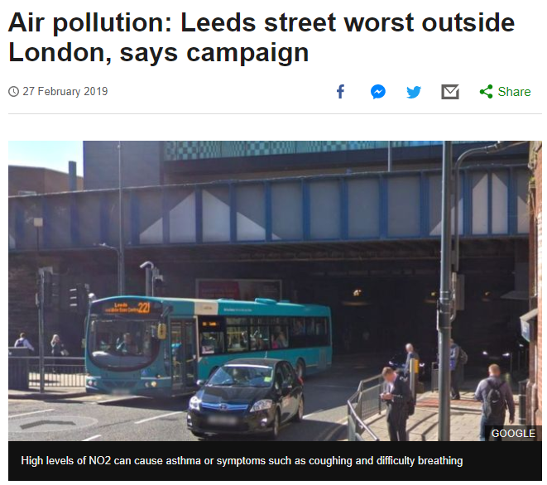
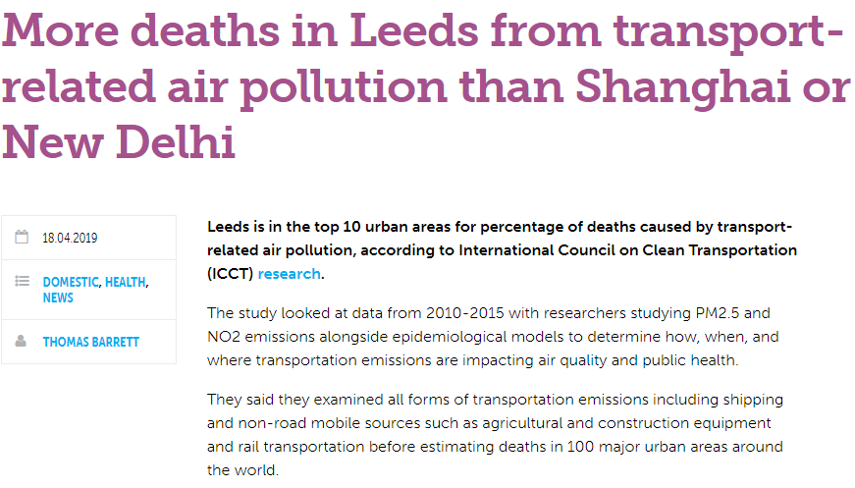
Pollution in Leeds
Notes:
My project is based around using statistics to better understand the public health risks related around pollution and exercise habits in Leeds. Pollution has been on the public’s mind for a while now and you don’t have to search far to see some warning signs that are cropping up locally. Here are a few articles I found.
First article- A study reported by the BBC shows out major cities across the UK, Leeds had the highest recorded value of NO2 emissions outside of London (NO2 caused by combustion engine emissions)
Second article- An independent study of 100 cites across the world found that for transport attributable fraction for deaths, Leeds ranked in the top 10 beating other hotspots such as Shanghai, New Delhi and Mexico City
It is obvious that something is going on here and our goal is to try and quantify this, link it other variables and model its effect on our health. To do such a thing we must choose an appropriate health outcome to measure.

Slide 2
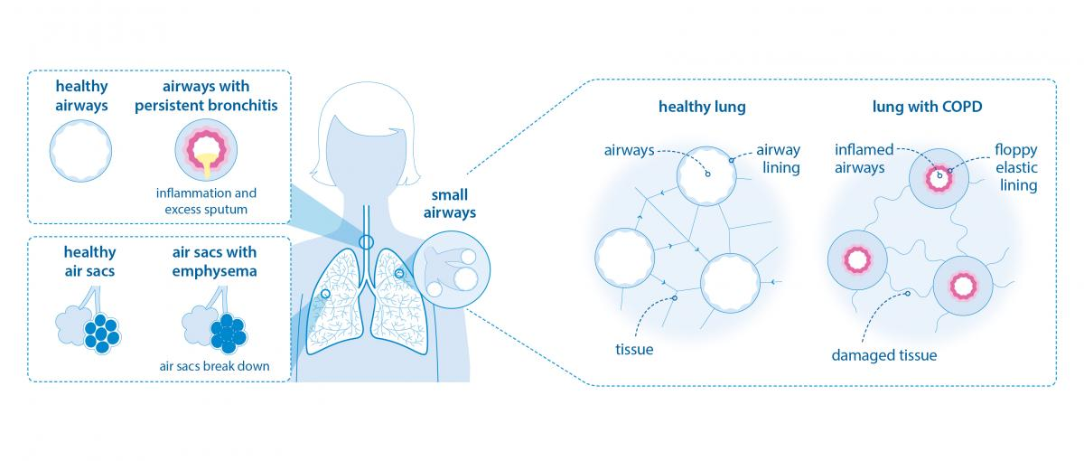
Chronic Obstructive Pulmonary Disease
Notes:
We have chosen to measure COPD hospital admissions. This Is because it is known that air quality can effect the symptoms of COPD.
COPD is an umbrella term for a group of lung diseases including emphysema and chronic bronchitis, it is characterised by sufferers having difficulty breathing, shortness of breath, air being trapped in the lungs. It can lead to a poor quality of life and if not managed properly can lead to the contraction of other fatal diseases.
(See diagram to see the effects COPD has on the body)

Slide 3
Objective
Gather, analyse and map COPD across Leeds
Map NO₂ across Leeds and find any links with COPD
Look at the population’s exercise habits and find any links with COPD
Test a temporal functional model to see the effects of both variables on COPD
Notes:
So what do we want to get from monitoring COPD?
Firstly, we want analyse and map COPD across Leeds by the geography of postcode districts and see if there are any interesting patterns.
Secondly, we want to do the same with NO2 across Leeds and see if we can link COPD and NO2 distribution
Thirdly, we want to look at the exercise habits across Leeds and link it to COPD
And finally, our end goal is to build a temporal function that accounts for both variables and maps their effect on COPD outcomes (hospital admissions) so we can see trends through time.

Slide 4
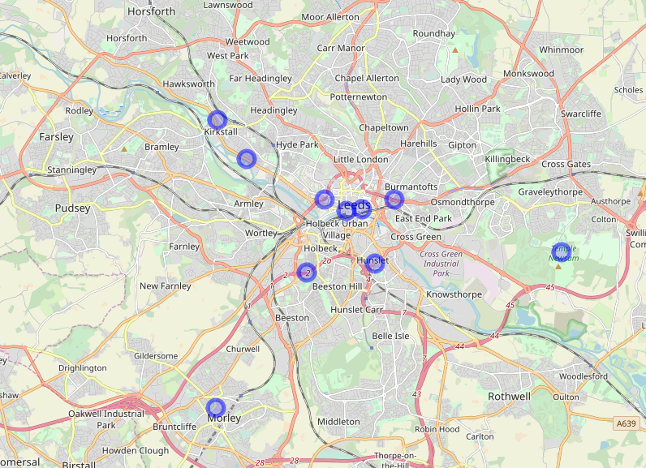
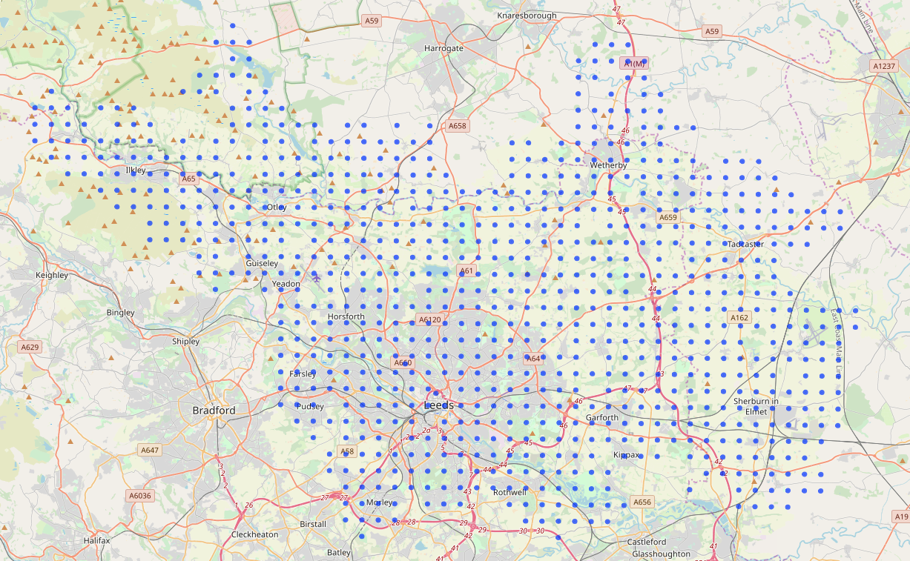
Pollution
Notes:
So lets have a look at how we used the publicly available pollution data.
Data on NO2 concentration is collected every 15 minutes by 11 different monitoring sites across Leeds (10 plotted on the left). However, we need a fuller picture of Leeds not just these specific points, therefore, we have used these points to carry out an interpolation over a 100km squared grid across Leeds (map on the right).

Slide 5
Notes:
If we plot the average NO2 from 2013 to 2018 we get this map. As you can see the highest average values are in the city centre.

Slide 6
Change in NO₂ from 2013-2018
Notes:
Now lets have a look at the change in NO2 across time. I have chosen two districts, LS1(red) and LS15(blue), I chose these because the difference in NO2 was large and noticeable. You can see there is a clear seasonality to this data. During the winter months NO2 levels rise, this is due to lower air temperatures causing NO2 to sit lower in the atmosphere. This is interesting as it is recorded that COPD hospital admissions rise in colder weather, is NO2 levels rising in colder weather a compounding factor that is causing this?

Slide 7
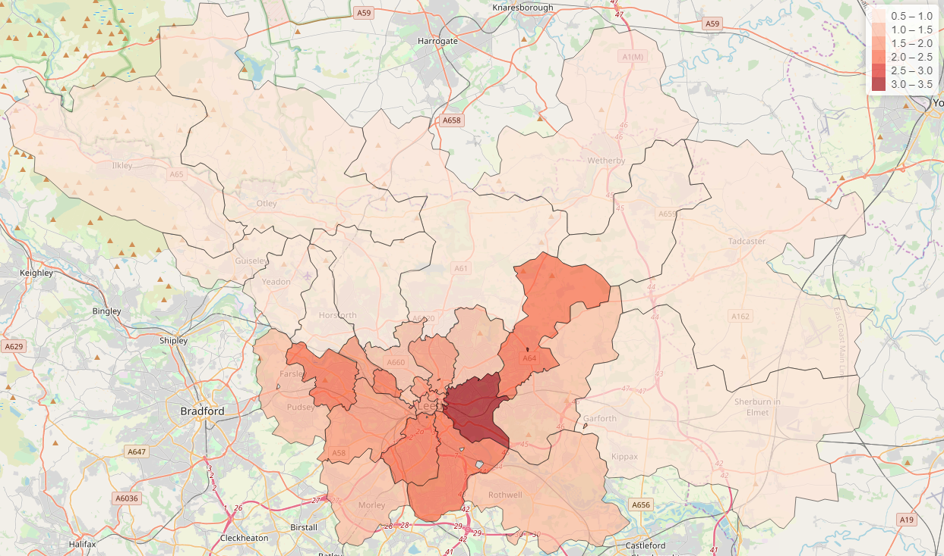
COPD Hospital Admissions 2013-2018
Notes:
We can also have a look at the COPD hospital admissions across Leeds and map it. This is a standardised count so 1 would be the average expected number of admissions for a district of that size populations. Here you can see that the city centre regions have the worst readings and values get better the further away you move from the city centre.

Slide 8
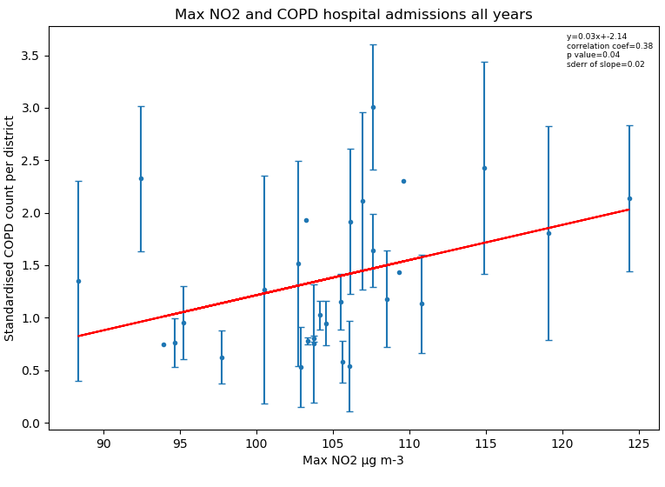
Static Models
Notes:
If we do some simple static regression we can see that there is a positive correlation and areas that have higher max NO2 readings have higher COPD admission counts. This was an expected output so it is good to see out logic being conformed by the data.
For COPD some errorbars are large as the COPD data is collected by MSOA. And we have lifestyle data and NO2 data by postcode district. Some MSOAs cross districts so I have assigned an MSOA by seeing which district it falls into mostly. For most of them the vast majority fall within one district, but for others there is more cross over. In city centre, districts are smaller, more cross over, and bigger difference between districts. For the districts near the city centre, differences between COPD counts for MSOAs that fall within a districts show more variation that others, think of Headlingly and Meanwood, two very different areas in the same district.

Slide 9
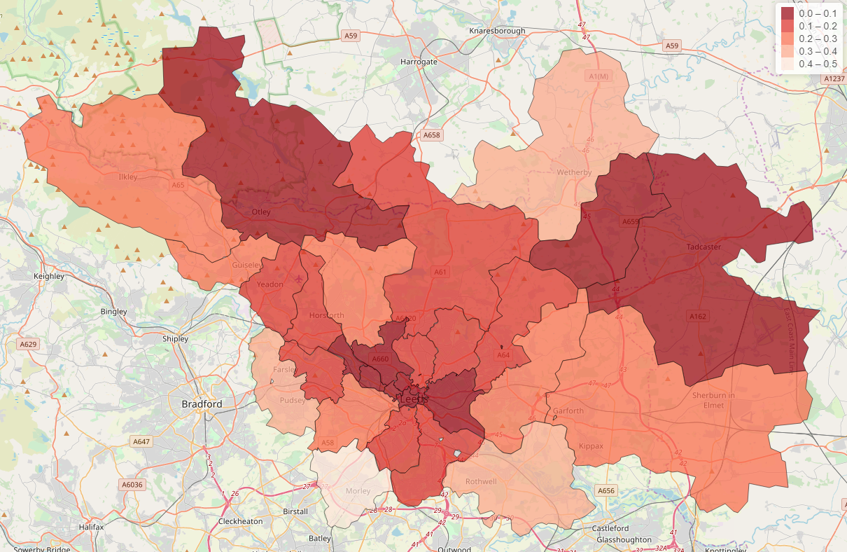
Exercise Activity in Leeds
Notes:
We also looked at the exercise activity of people in Leeds. Here we have a map of the gym visits per week per population within a district to give an idea of how intensely people are exercising. Here again we see the city centre having some of the worst values, but there is other districts outside the city centre having the same readings, so there is more randomness to this data and other factors effecting it.

Slide 10
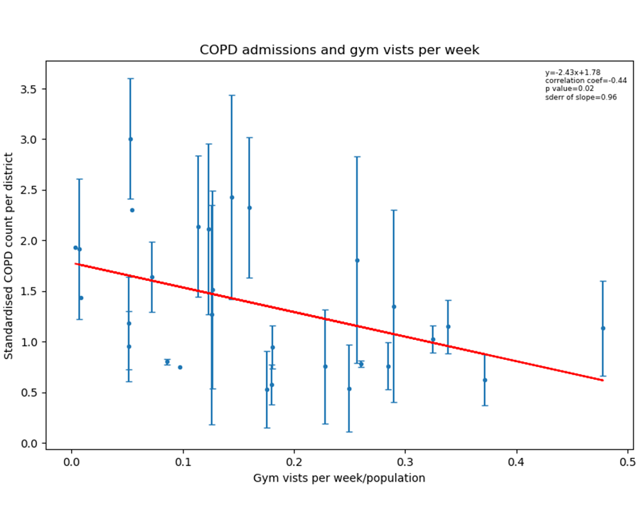
Static Models
Notes:
Doing the same regression(left) we see that there is a negative correlation between COPD hospital admissions and exercise intensity, so in districts where people exercise more regularly there are generally less COPD hospital admissions. This is another expected outcome.
We also thought it would be interesting to see if the NO2 in a region effects the intensity in which people exercise(right). We thought we may see some correlation due to compounding factors, however the correlation was very weak showing that there is a lot more other important variables that effect this.

Slide 11
Where are we now?
Process exercise data from Leeds City Council
Process NO2 data and interpolate over all of Leeds
Map NO2 data onto postcode districts
Find the change in NO2 across Leeds through the recent years
Process and map COPD data across Leeds
Run static models to find general correlations
Run dynamic models to find correlations through time
Put all variables into a temporal functional model and test its performance
Notes:
Where are we on the road map of completing this project?
We have just completed the static models so the next step is to run some dynamic models to see any correlations through time and then test our own functional models. However, we are waiting for the time stamped version of the COPD data from Public Health England. The current COPD data set is aggregated from 2013 to 2018 so to test any temporal hypothesis we need a new COPD data set.

Slide 12
Concluding Remarks
The NO2 levels in an area do effect the number of COPD hospital admissions
Places where people on average exercise more regularly have lower COPD hospital admissions
NO2 levels in an area do not necessarily effect the population’s exercise habits
Notes:
So since noticing some of these waring signs, how far have we gotten to quantifying an better understanding the problems of health and pollution across Leeds?
Well we have found that higher NO2 levels in a district leads to a higher number of COPD hospital admissions.
Also we see that higher exercise intensity leads to lower COPD hospital admissions
And as a caveat we found that the NO2 in a district does not necessarily effect the population's exercise habits
So we have already produced some useful outputs but we hope to find a lot more in the next stages of the project.

Slide 13
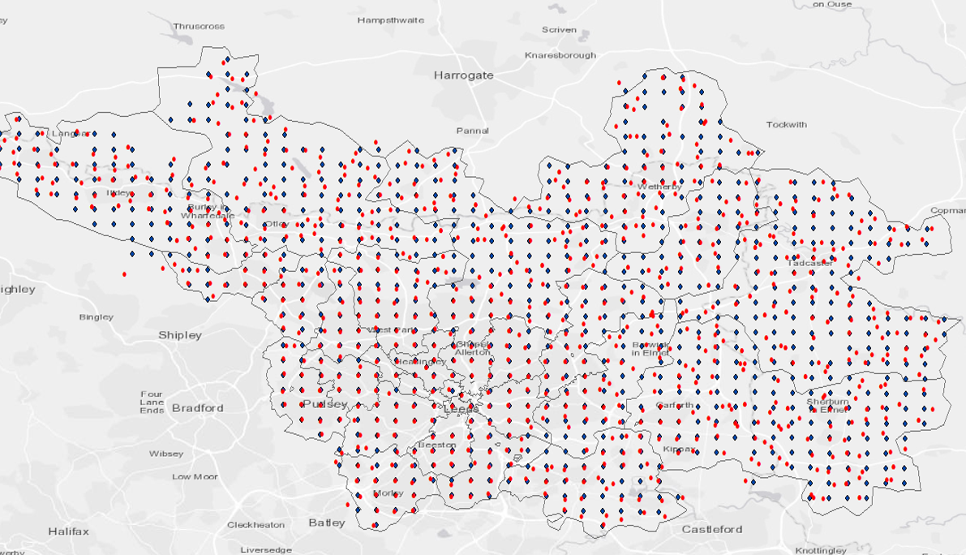

Slide 14
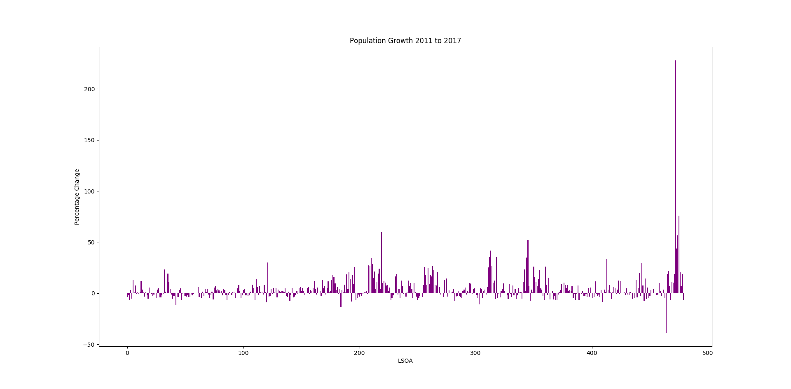

Slide 15
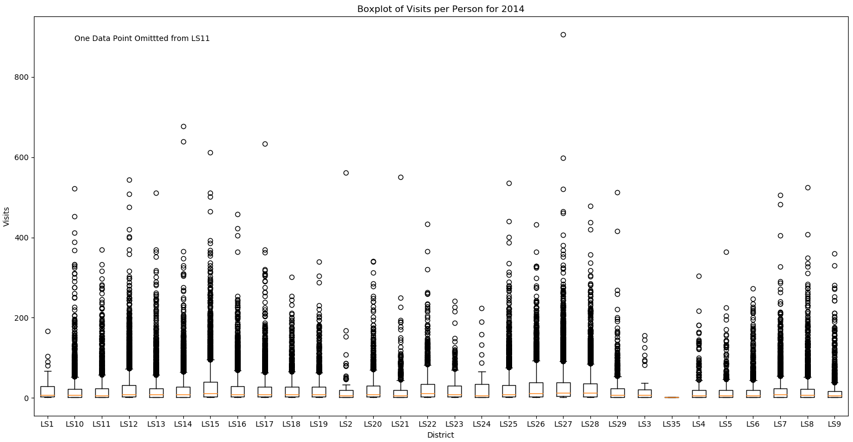

Slide 16
