Slide 1
Presentation title slide
Where do we risk marginalising those with social vulnerabilities with a blanket transport emissions policy?
Claire Shadbolt

Slide 2
Presentation title slide
Notes:
My project concerns greenhouse gas emissions in the surface transport sector. From looking at each sector, the UK have reduced their emissions in most sectors, HOWEVER, surface transport is the only sector where emissions have increased.
There is a policy gap between emitted emissions and targets the government has set - current policies are not enough. There is too much focus on supply, when demand needs to be tackled too. In terms of surface transport, demand means reducing car miles travelled and the reduction of cars needed.
Source: Tables 3, Final UK greenhouse gas emissions national statistics 1990-2017 Excel data tables.
https://www.gov.uk/government/statistics/final-uk-greenhouse-gas-emissions-national-statistics-1990-2017

Slide 3
Presentation title slide
Notes:
One way to look at demand is income.
As this graph shows, higher-income groups travel more miles - almost double the lowest income group.
Implementing a blanket policy like a tax, or a congestion charge, is disproportionate and risks marginalising groups. Higher income groups can easily afford this charge compared to lower income groups.
Policy-makers need to apply policies in the right area and target the right demographic, because vulnerability is context specific.
Source: NTS0705: Travel by household income quintile and main mode or mode: England from: https://www.gov.uk/government/statistical-data-sets/nts03-modal-comparisons

Slide 4
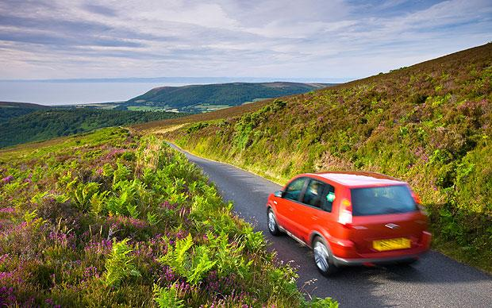
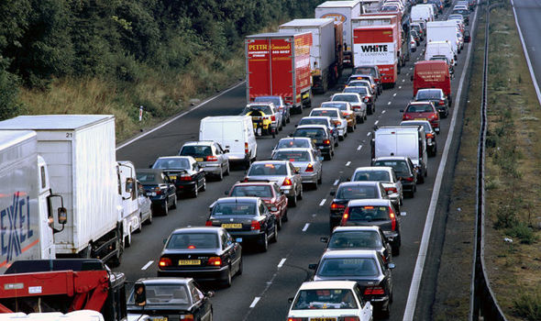
Presentation title slide
Engage with travel behaviour across demographics
Project focuses solely on driver and passenger car travel.
How far do users travel for a trip?
Where is the demand for car travel?
Notes:
Regarding my project with Dr Ian Philips, we focused solely on car travel. We would like to understand what types of trips transport users take in a car, either as the driver or a passenger, and how far do they travel for the trip.
This will help to answer where there is a greater demand for car travel.

Slide 5
Presentation title slide
Aim of the project
Describe a set of indicators for equitable transport policies by implementing a individual and household level microsimulation.
Assess the effect a policy might have on a specific location.
Where can people reduce their demand for transport?
What vulnerabilities and inequalities might arise?
Notes:
By implementing a spatial microsimulation with a synthetic population, the project will describe a set of indicators to help policy-makers identify potential equitable transport demand reduction.
It will assess where policies may be effective at decarbonising transport, while being mindful of vulnerabilities and inequalities that may arise from the enforcement policies.

Slide 6
Presentation title slide
Methodology
Constraint Table:
Create a probability distribution for an individual’s trip purpose and trip distance depending on a set of constraints.
National Travel Survey
Individual and Household level constraints:
Age
Gender
Government Office Region
National Statistics Socio-economic Classification
Rural or Urban
Notes:
The first stage is to produce a constraint table using the NTS data from the years 2015, 2016 and 2017, to produce a probability distribution of an individual’s trip purpose and distance.
Last time I talked about this project, the constraints where age and gender. The constraint table has now become richer by also including Government Office Region, National Statistics Socio-economic Classification (NSSEC), which is an employment-based classification, and if the individual lives in a rural or urban area.
All five of these constraints are intrinsically linked to travel behaviour, particularly what kinds of trips an individual takes and how far they would travel to complete the trip. For example, Age indicates whether the person is likely to be working, have children, or are retired. Therefore, this will affect how often they take trips for work or for leisure. Those who live in rural areas typically travel further for school, work and to get to leisure facilities compared to those who live in an urban area.
NSSEC indicates the individual’s level of employment, hence how far they might travel to work, if they attend meetings in other parts of the country, or work on various sites.

Slide 7
Presentation title slide
Methodology
Constraint Table:
Create a probability distribution for an individual’s trip purpose and trip distance depending on a set of constraints.
National Travel Survey
UK Census
(SPENSER)
Master Table
Monte Carlo Sampling
Constraint Table
Notes:
We join the constraint table to the SPENSER dataset, so every individual in the population has a trip purpose probability distribution.
I used the programme SPENSER to create a synthetic population. This projects future UK populations using the 2011 census.
As explained last time, I only had a synthetic population for Manchester, whereas now I have a synthetic population for the whole of England. We only simulated those who are aged 17 or above as they can legally drive in the UK, this equates to approximately 43 million individuals in the synthetic population for the year 2017.
(SPENSER – algorithm constructed by Nik Lomax, Ben Wilson and Luke Archer.)

Slide 8
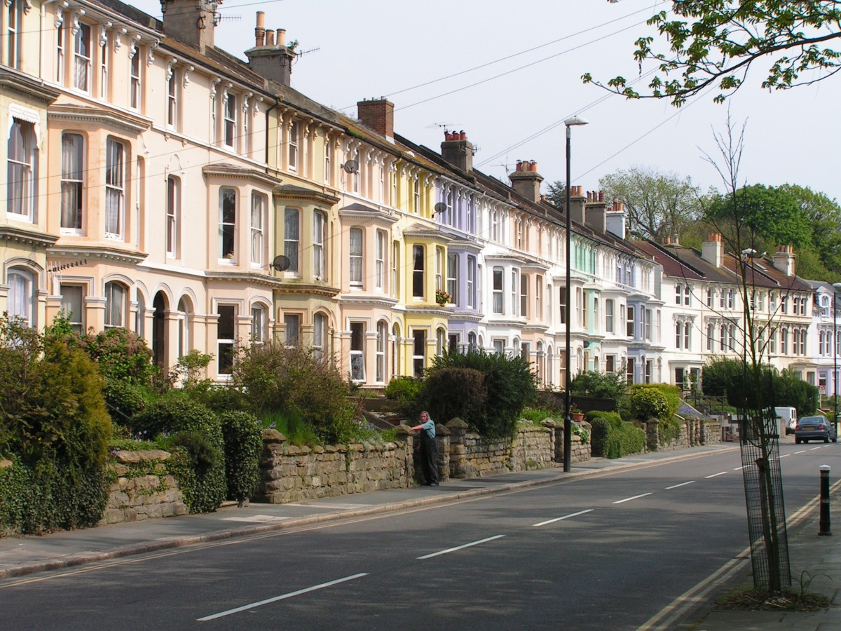
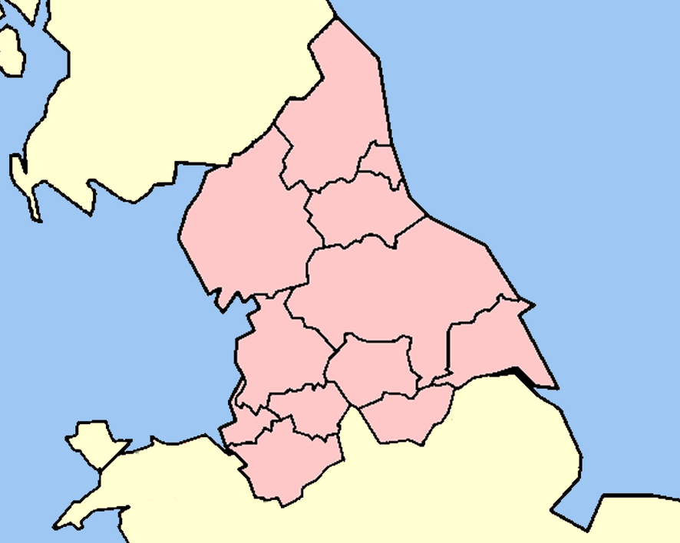
Presentation title slide
Notes:
I am going to take you through an example of how the Monte Carlo sampling process works. Where we assign a person a trip purpose and a trip distance.
Let’s take the example of someone who is male, aged between 17 and 21, has a managerial role, lives in an urban area in the North of England.

Slide 9
Presentation title slide
Monte Carlo Sampling
Sex = 1, Age group = 4, NSSEC = 1, Rural/Urban = 1 , GOR = 1
TripPurpose1 | TripPurpose2 | TripPurpose3 | TripPurpose4 | TripPurpose5 | TripPurpose6
0.3474 | 0.4526 | 0.4632 | 0.5632 | 0.7789 | 1
0.6
Notes:
This their trip purpose probability distribution. It is noted that different combinations of the constraint values will equate to different trip purpose probability distributions. If R rolled 0.6, this value lies between TripPurpose4 and TripPurpose5, therefore this person is allocated trip purpose 5.

Slide 10
Presentation title slide
Monte Carlo Sampling
Sex = 1, Age group = 4, NSSEC = 1, Rural/Urban = 1 , GOR = 1
TripPurpose1 | TripPurpose2 | TripPurpose3 | TripPurpose4 | TripPurpose5 | TripPurpose6
0.3474 | 0.4526 | 0.4632 | 0.5632 | 0.7789 | 1
 | Distance1 | Distance2 | Distance3 | Distance4 | Distance5 | Distance6
Commuting | 0.0015 | 0.2579 | 0.4087 | 0.9970 | 0.9985 | 1
Business | 0.5941 | 0.6931 | 0.6980 | 0.9455 | 0.9505 | 1
Education | 0.0400 | 0.0800 | 0.1200 | 0.9200 | 0.9600 | 1
Shopping/Personal Trips | 0.0052 | 0.2135 | 0.5781 | 0.8906 | 0.9948 | 1
Social Interaction | 0.0973 | 0.4380 | 0.7786 | 0.9002 | 0.9027 | 1
Leisure | 0.0024 | 0.2630 | 0.2654 | 0.7630 | 0.8104 | 1
Notes:
Next, we need to look at the individual’s contrasting trip distance group probability distributions. As you can see these distributions differ for each trip purpose type and they will differ for each combination of the constraint values.
Trip purpose 5 equates to social interaction.

Slide 11
Presentation title slide
Monte Carlo Sampling
Sex = 1, Age group = 4, NSSEC = 1, Rural/Urban = 1 , GOR = 1
TripPurpose1 | TripPurpose2 | TripPurpose3 | TripPurpose4 | TripPurpose5 | TripPurpose6
0.3474 | 0.4526 | 0.4632 | 0.5632 | 0.7789 | 1
 | Distance1 | Distance2 | Distance3 | Distance4 | Distance5 | Distance6
Commuting | 0.0015 | 0.2579 | 0.4087 | 0.9970 | 0.9985 | 1
Business | 0.5941 | 0.6931 | 0.6980 | 0.9455 | 0.9505 | 1
Education | 0.0400 | 0.0800 | 0.1200 | 0.9200 | 0.9600 | 1
Shopping/Personal Trips | 0.0052 | 0.2135 | 0.5781 | 0.8906 | 0.9948 | 1
Social Interaction | 0.0973 | 0.4380 | 0.7786 | 0.9002 | 0.9027 | 1
Leisure | 0.0024 | 0.2630 | 0.2654 | 0.7630 | 0.8104 | 1
Notes:
We do not need the other distributions so they can disappear.

Slide 12
Presentation title slide
Monte Carlo Sampling
Sex = 1, Age group = 4, NSSEC = 1, Rural/Urban = 1 , GOR = 1
TripPurpose1 | TripPurpose2 | TripPurpose3 | TripPurpose4 | TripPurpose5 | TripPurpose6
0.3474 | 0.4526 | 0.4632 | 0.5632 | 0.7789 | 1
 | Distance1 | Distance2 | Distance3 | Distance4 | Distance5 | Distance6
Social Interaction | 0.0973 | 0.4380 | 0.7786 | 0.9002 | 0.9027 | 1
0.4
Notes:
Now, we need to roll again to allocate a trip distance group to the individual. Let’s say this time R rolls 0.4. This lies between Distance Group 1 and 2, hence, this individual is allocated Distance Group 2.
Overall, for this trip this individual travels 2 – 5km for the purpose of social interaction in a car.

Slide 13
Presentation title slide
Methodology
Constraint Table:
Create a probability distribution for an individual’s trip purpose depending on a set of constraints.
National Travel Survey
UK Census
(SPENSER)
Master Table
Monte Carlo Sampling
Assign Travel Behaviour
Constraint Table
Notes:
I repeated this assignment process a number of times to a produce a weekly car travel diary for everyone in the synthetic population. The number of trips varied depending on which age/NSSEC group the individual belonged to, by looking at the NTS data these attributes had the greatest influence on number of trips an individual took each week.

Slide 14
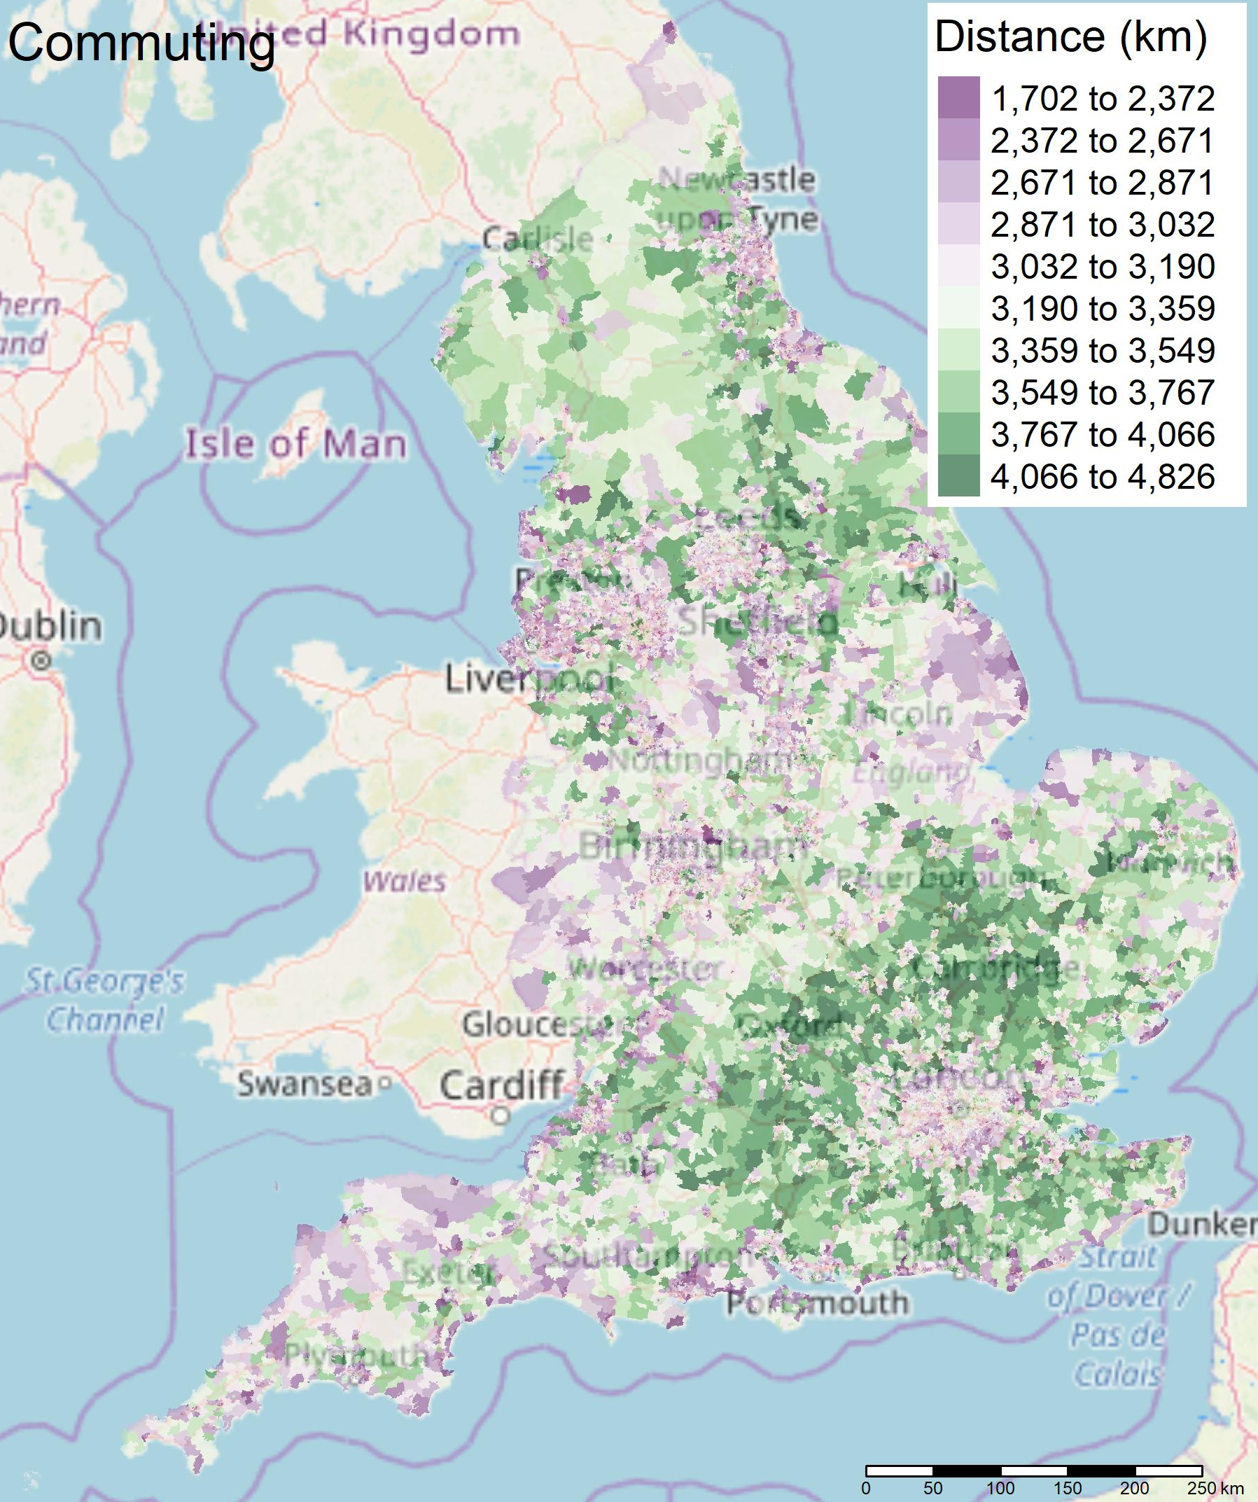
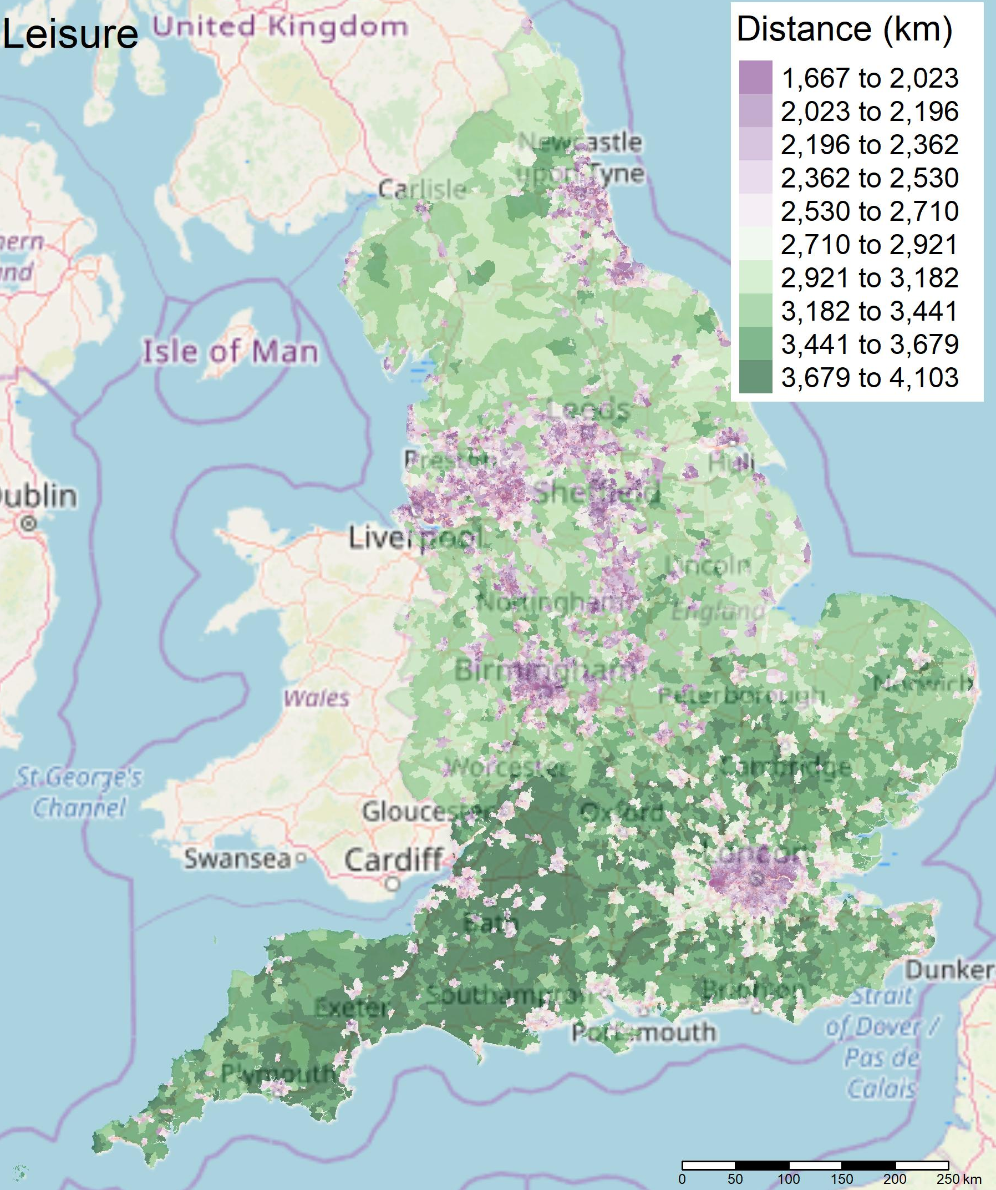
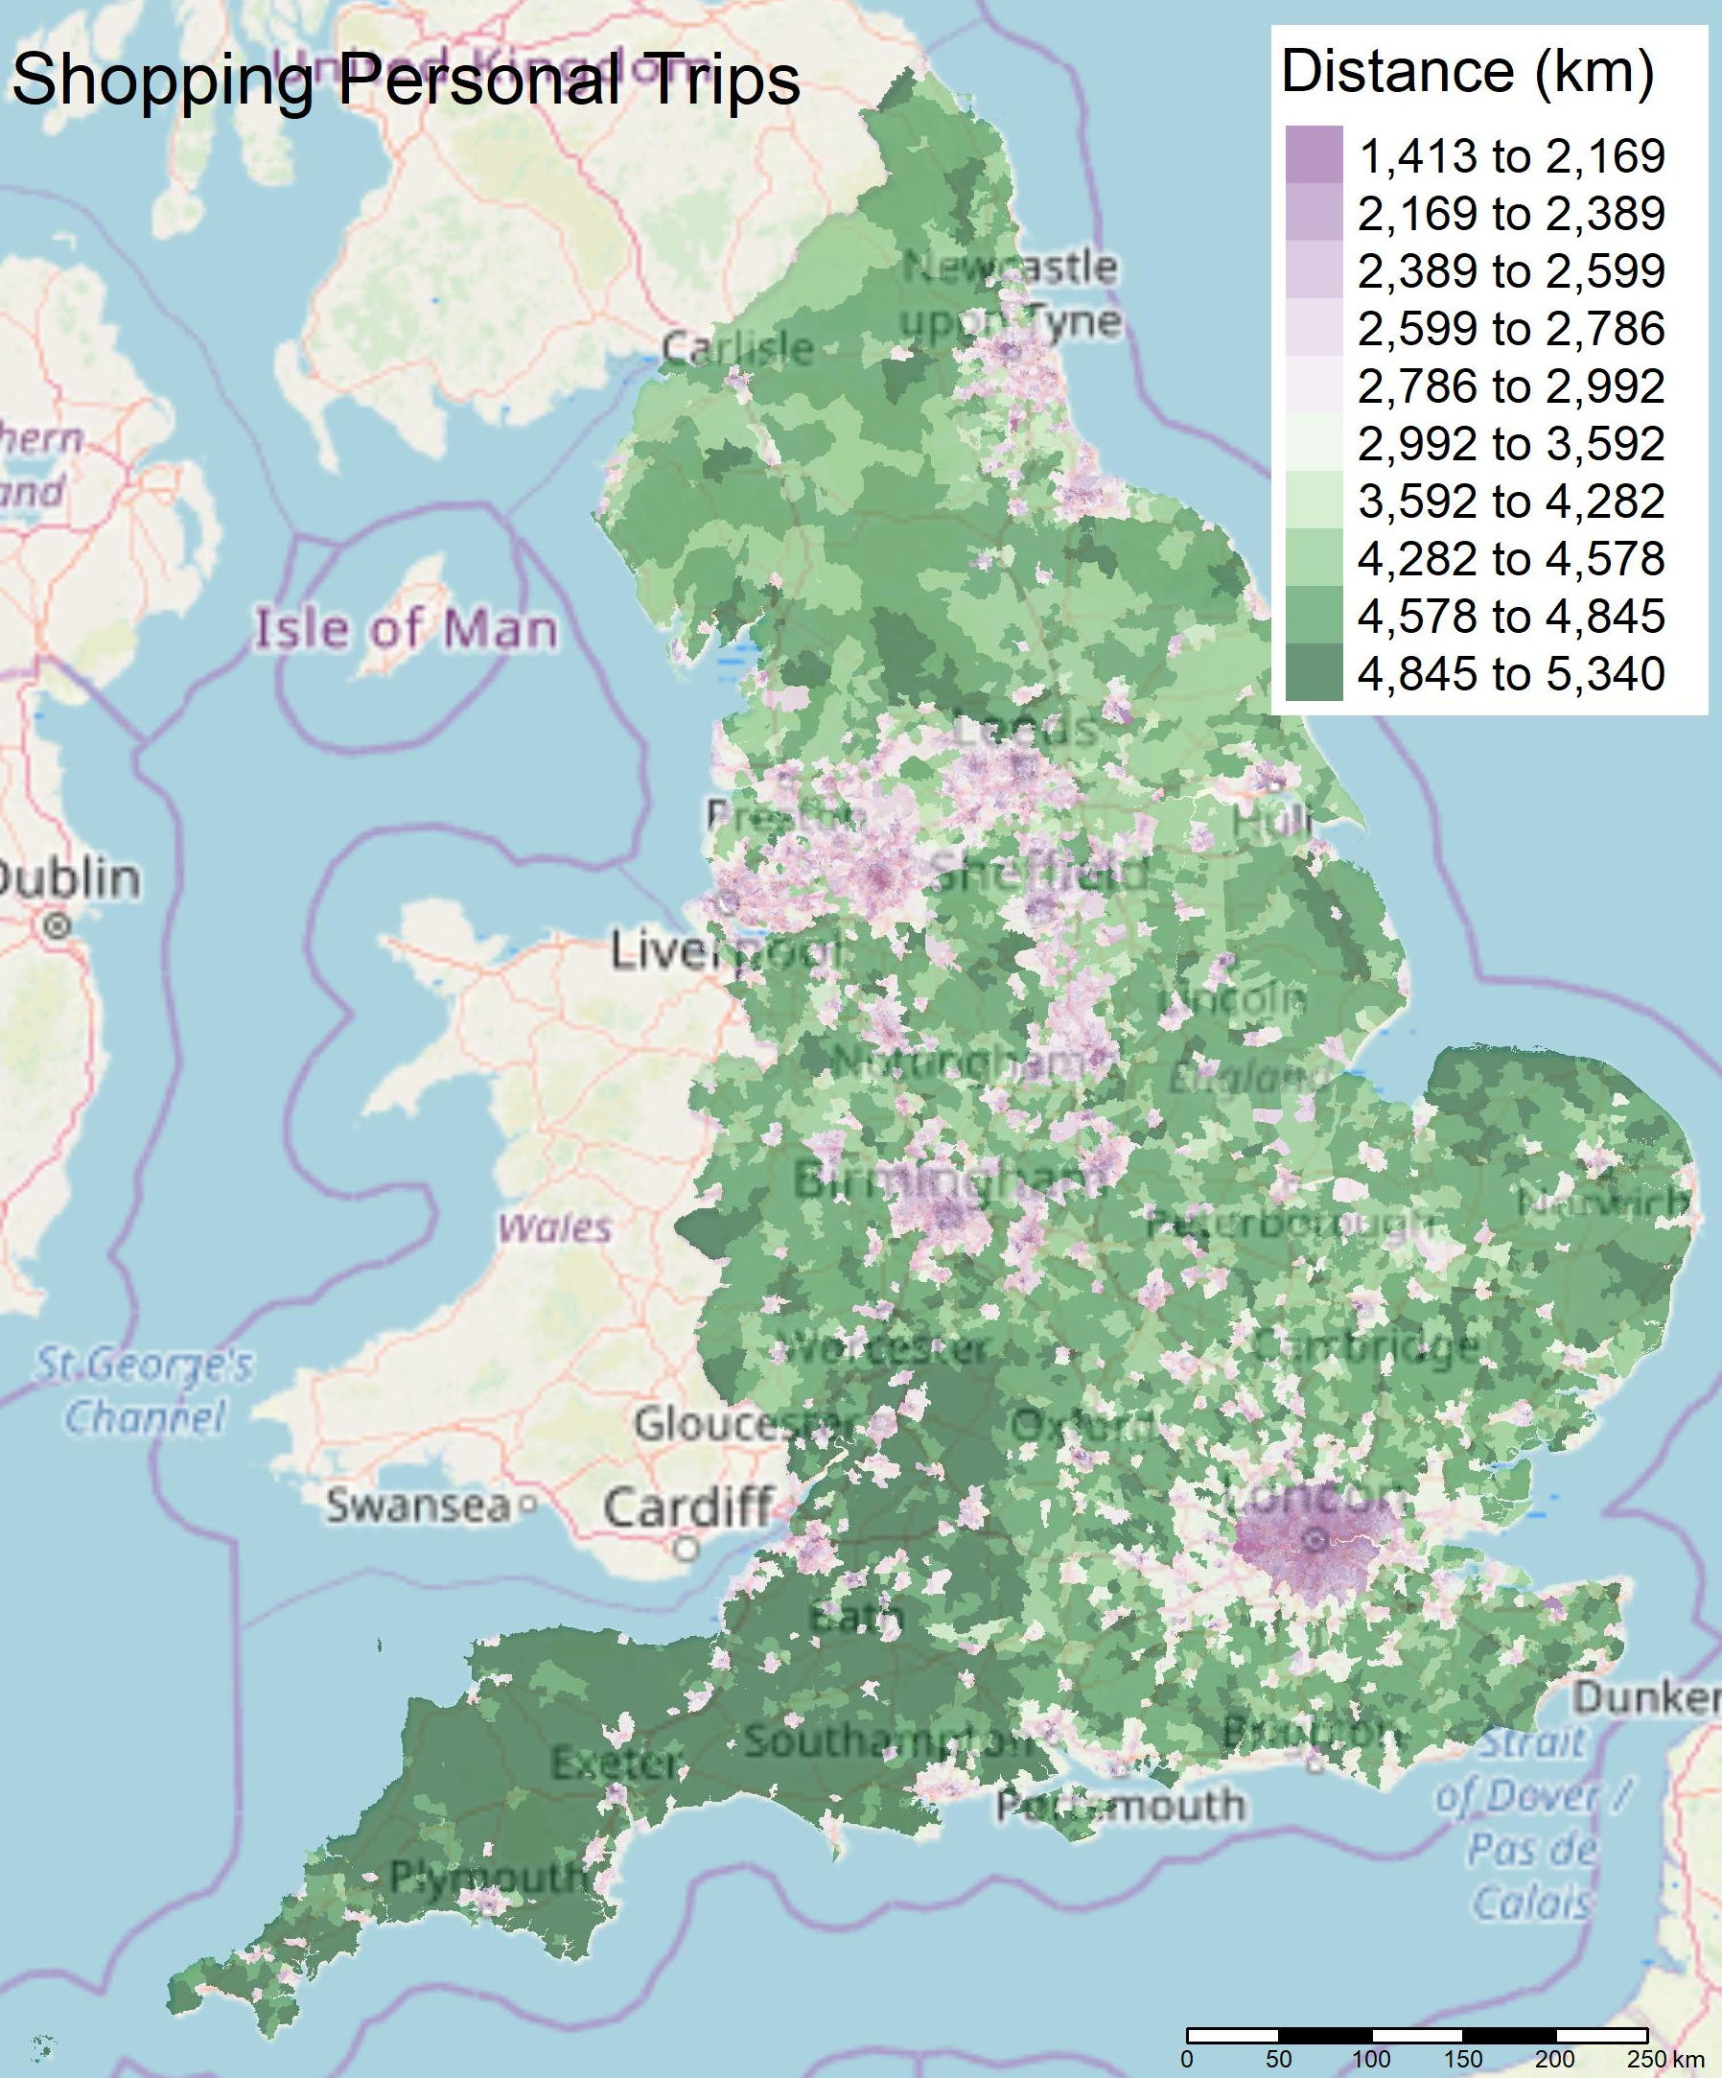
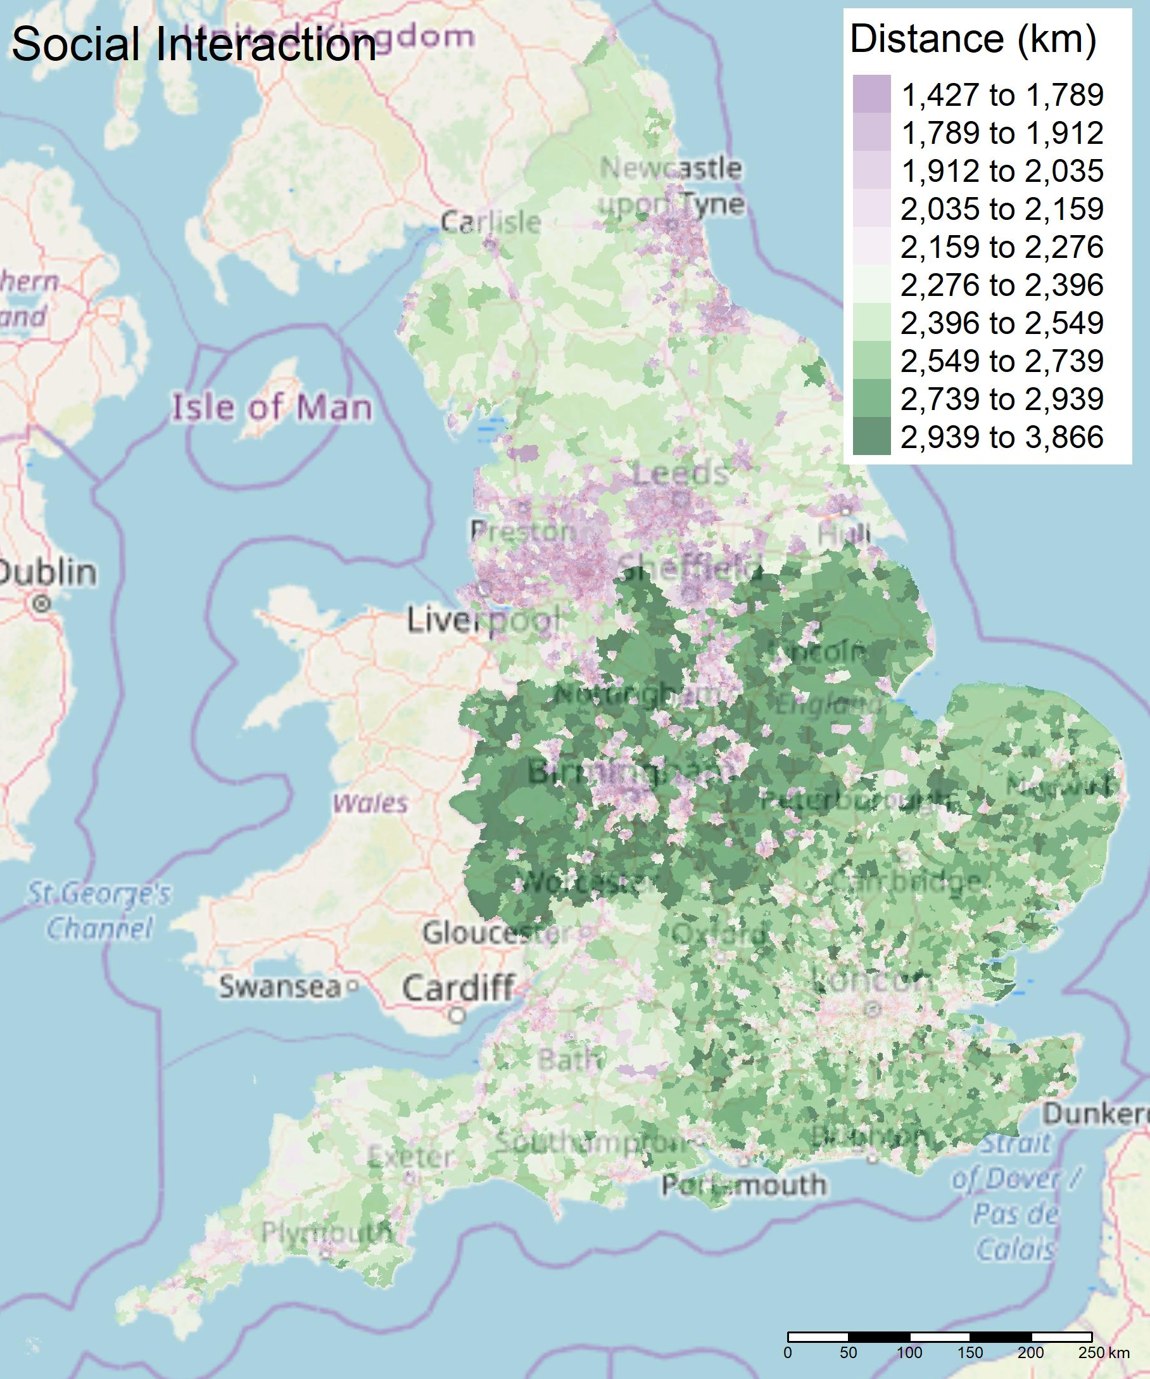
Presentation title slide
Mean Distance Travelled by Car per Person per Year by LSOA
Notes:
Next, I scaled up the weekly trips to create yearly car travel diary and converted the distance groups into kms, it is noted this will overestimate the distance travelled by individuals. These values were converted into mean distance travelled by car per person per year by LSOA for each of the trip purposes. These were then plotted in R for the whole of England.
Dark purple indicates small yearly travel distances, while green indicates larger yearly travel distances for the trip purpose. As you can see there are regionally differences in the distance travelled for a trip purpose. For example, those who live in the East and South East of England travel more for commuting. Whereas, for Leisure and Shopping/Personal Trips those who live in the South West travel more. And finally those in the Midlands travel the most for social interaction.

Slide 15
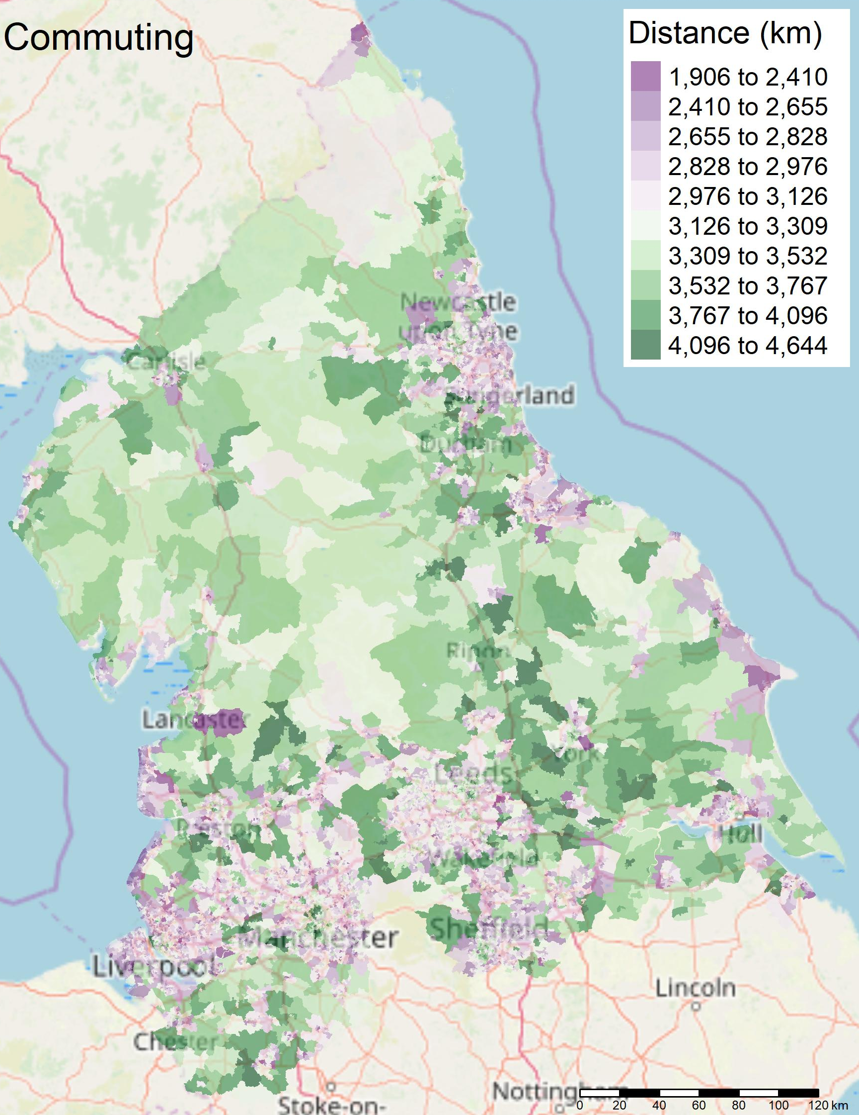
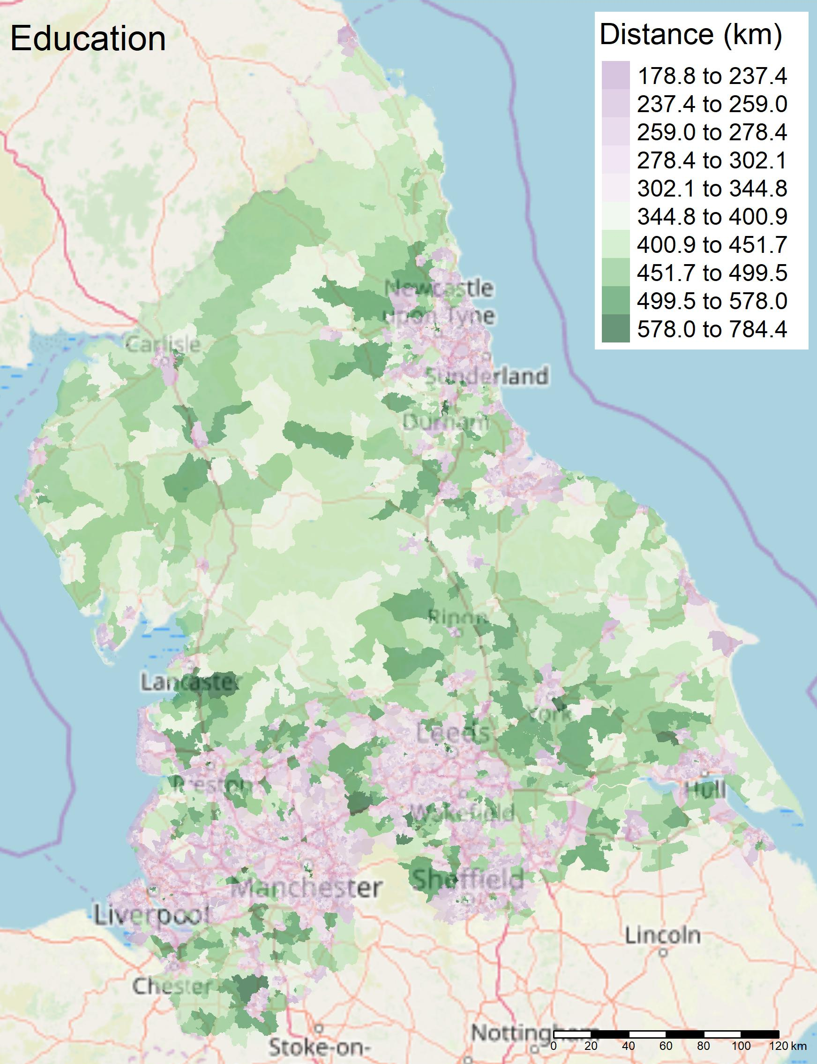
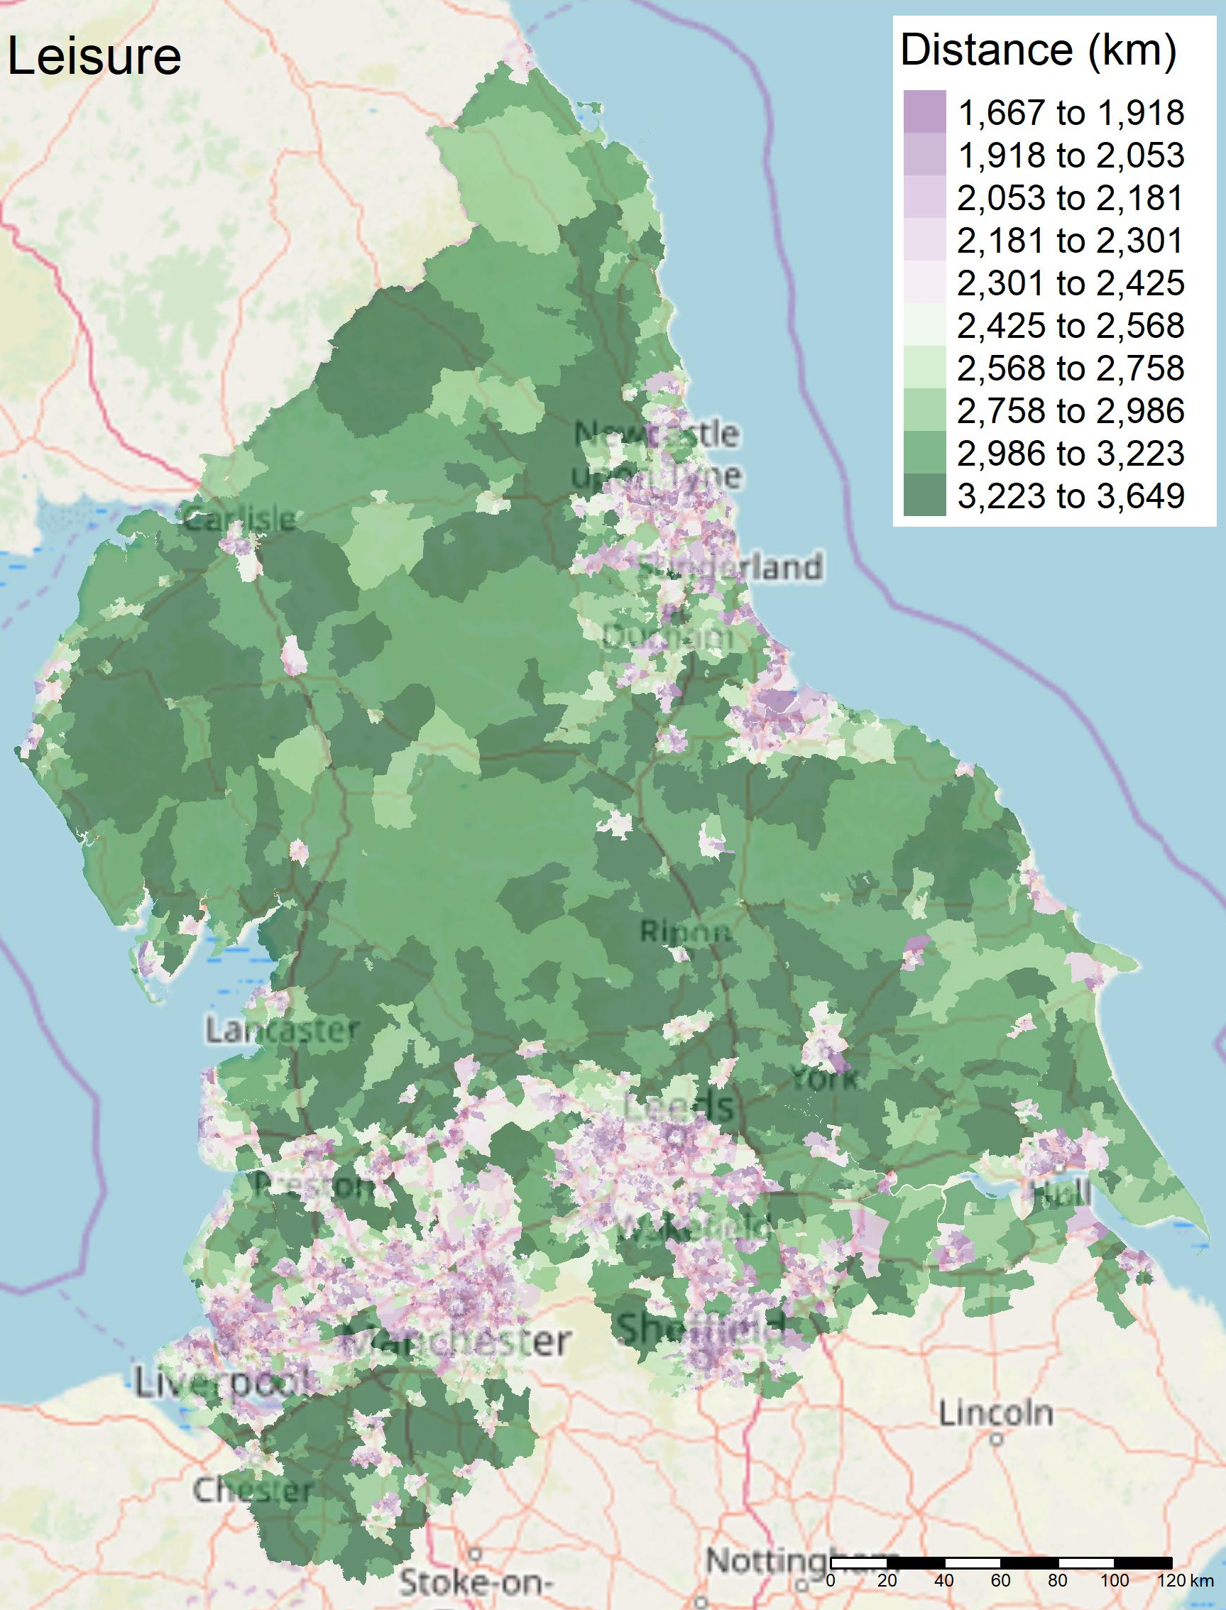
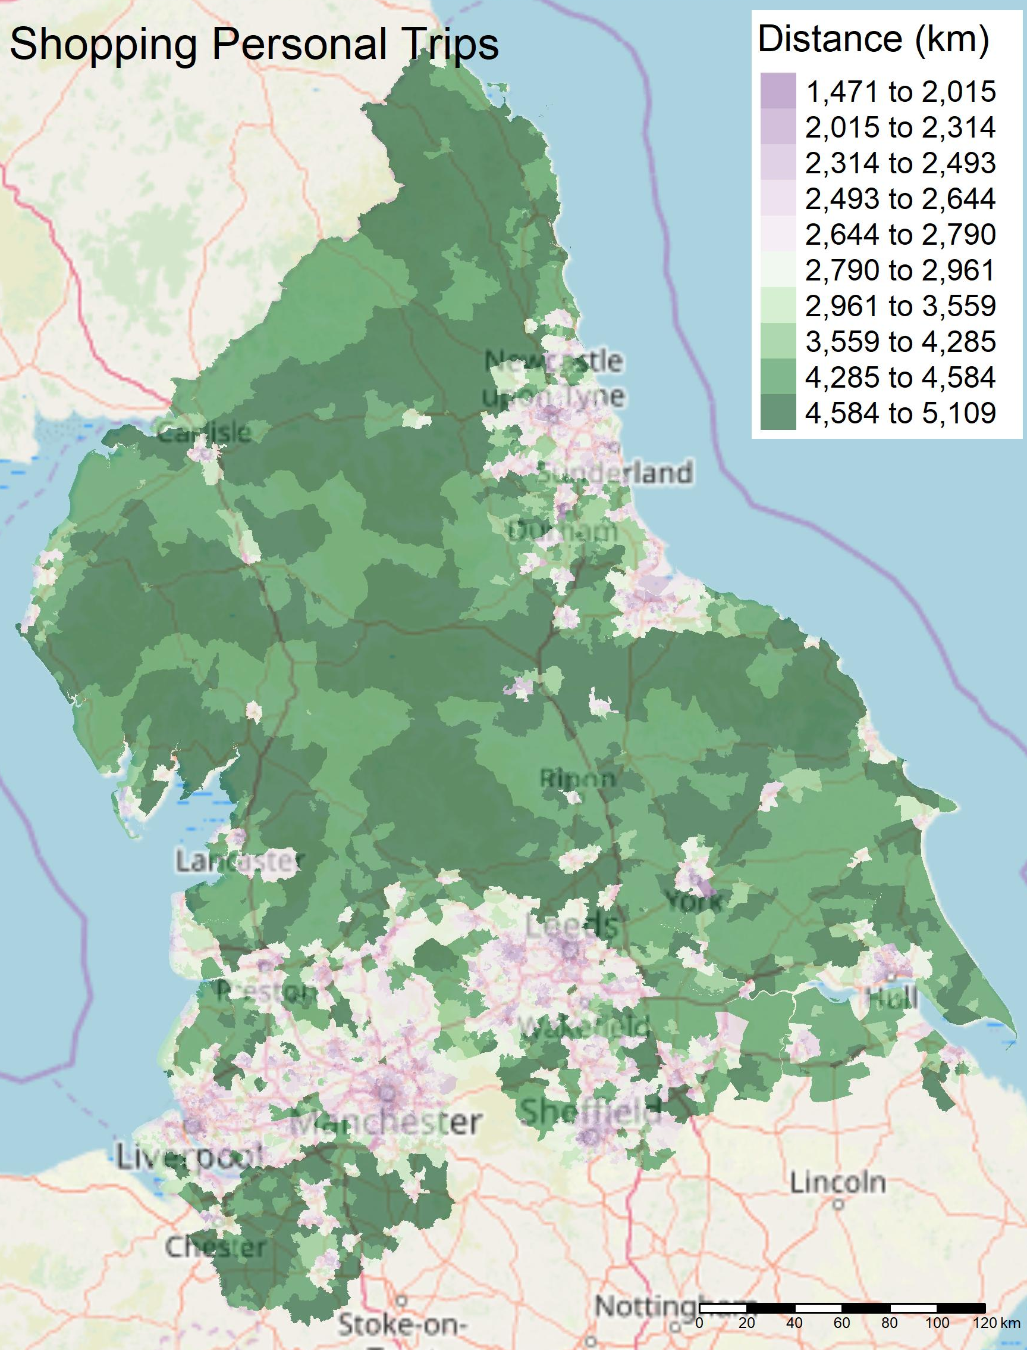
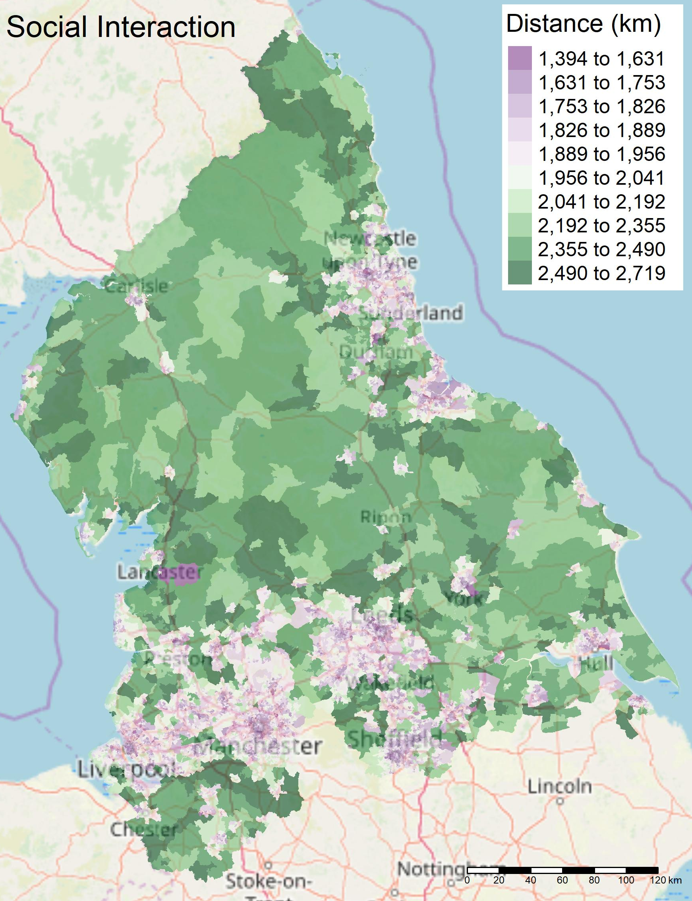
Presentation title slide
Notes:
If we zoom in to the North, we can see greater detail. There are clear differences between rural and urban areas, in terms of distance travelled for a trip purpose.

Slide 16
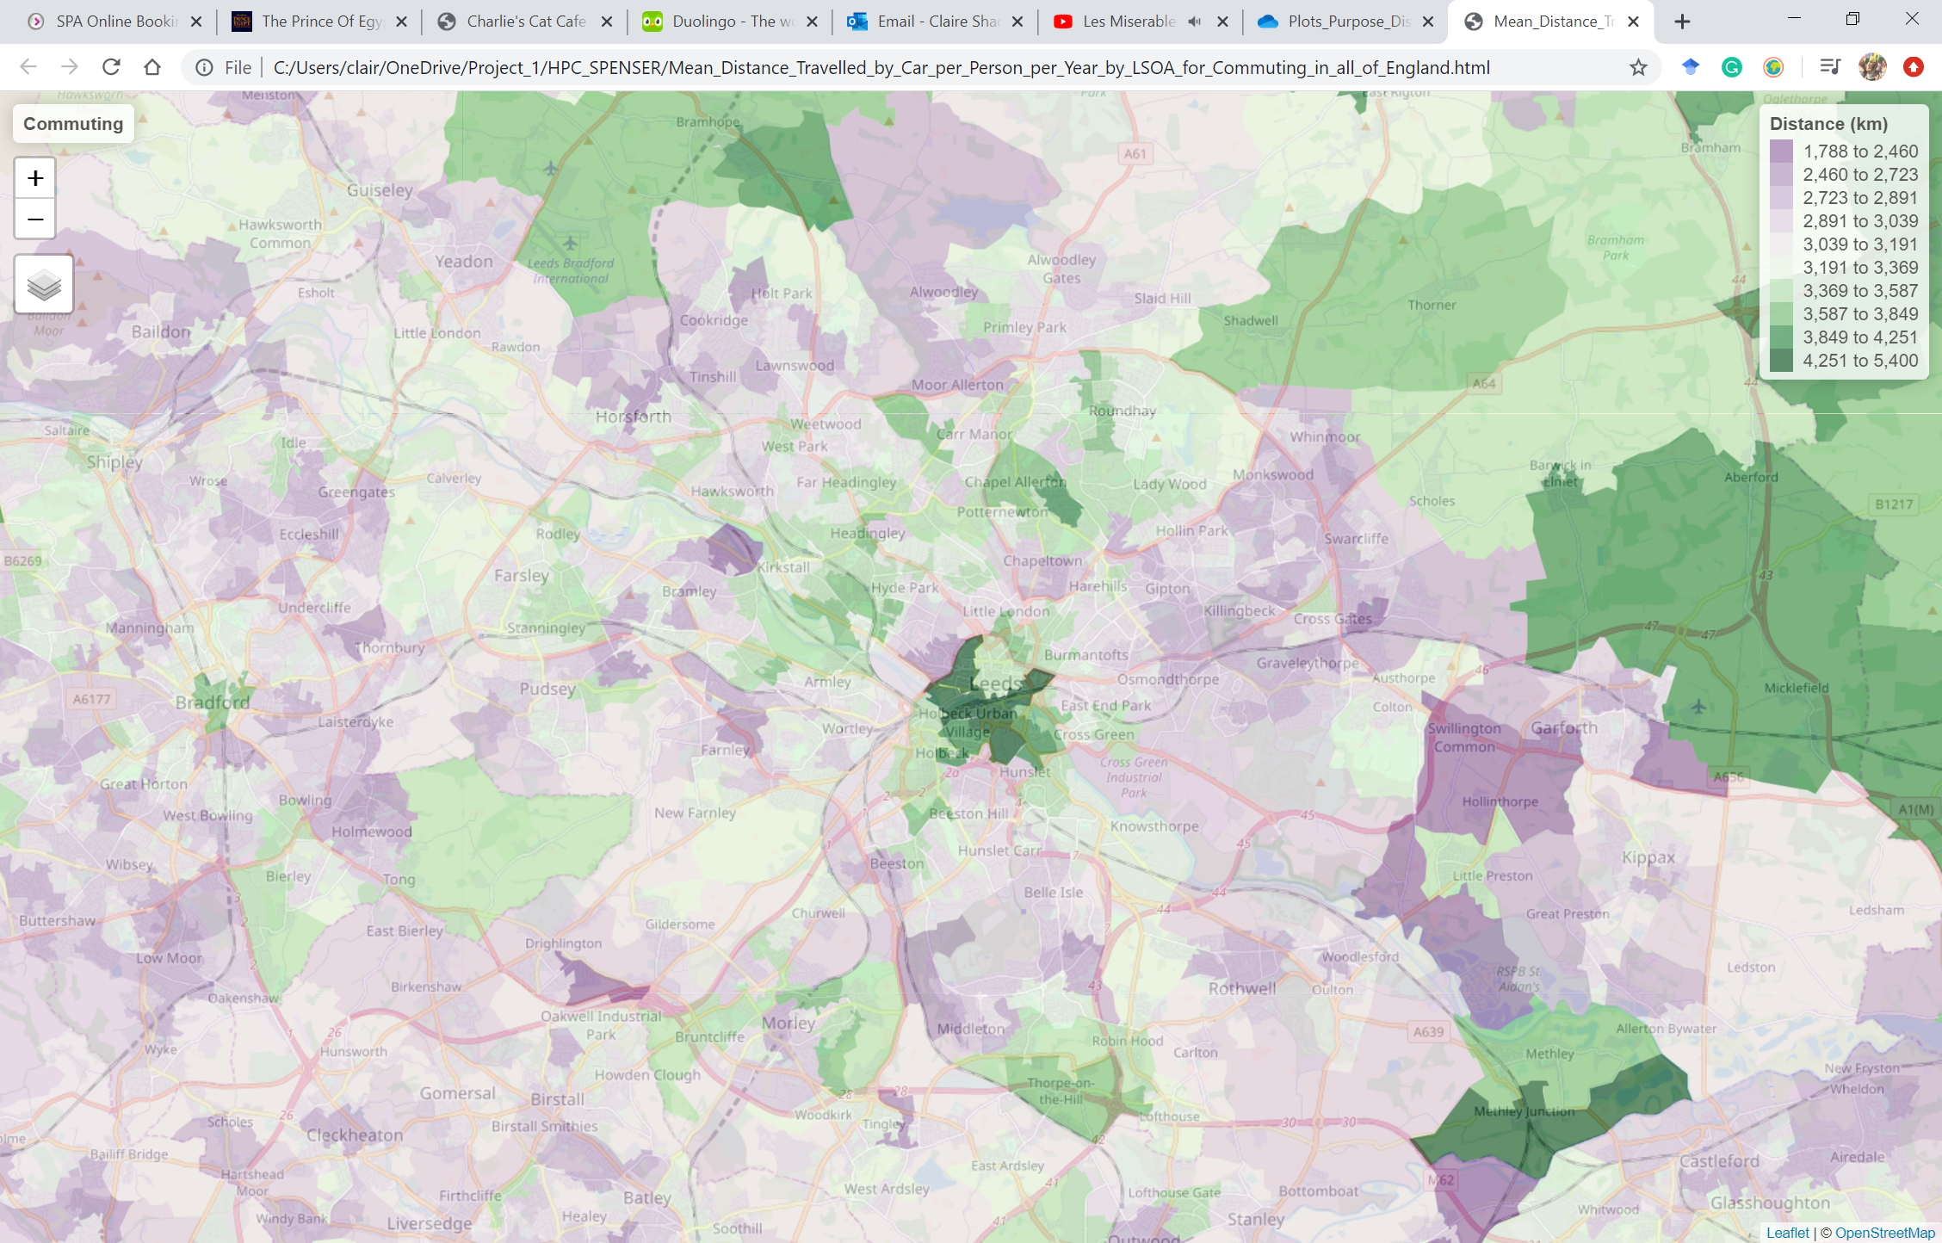
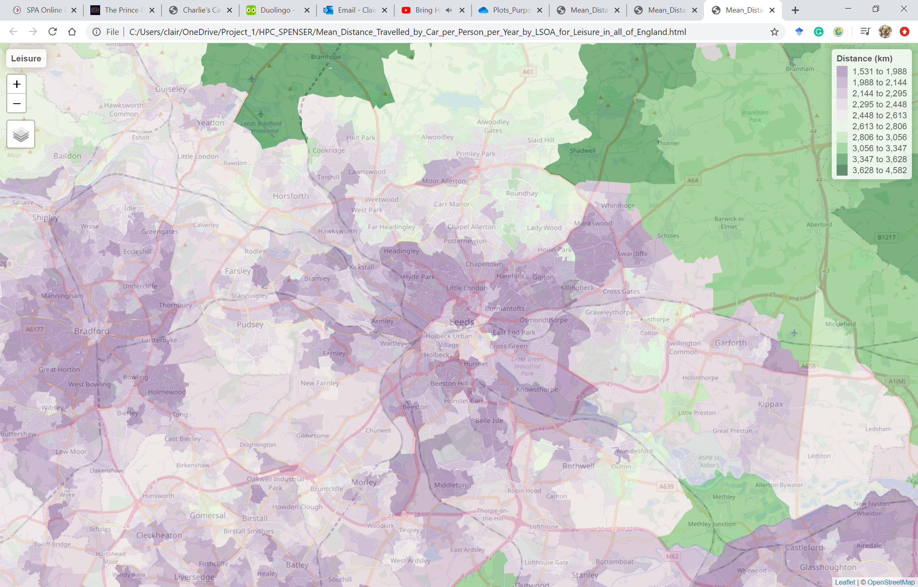
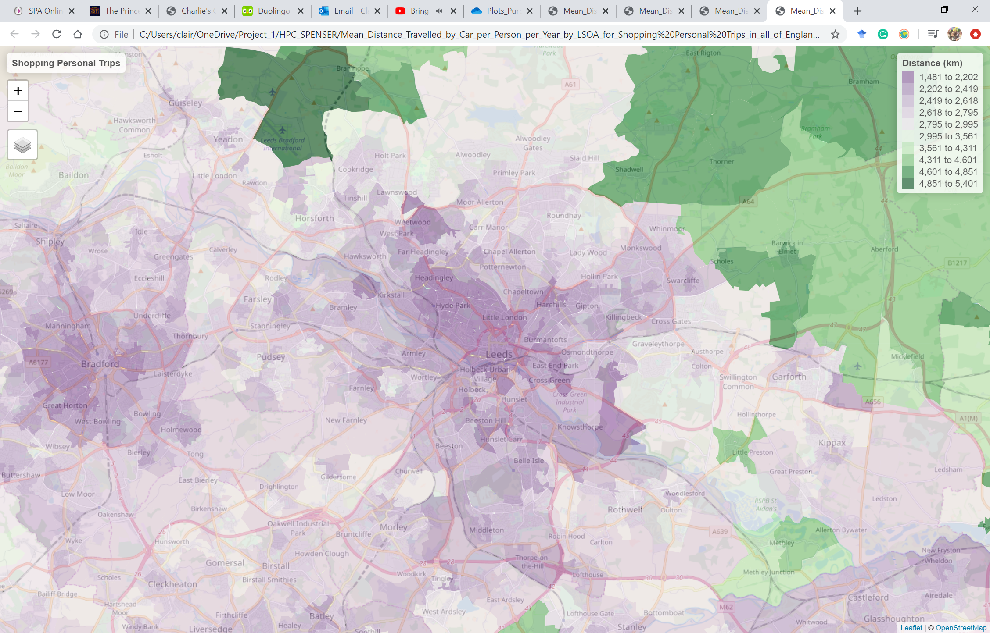
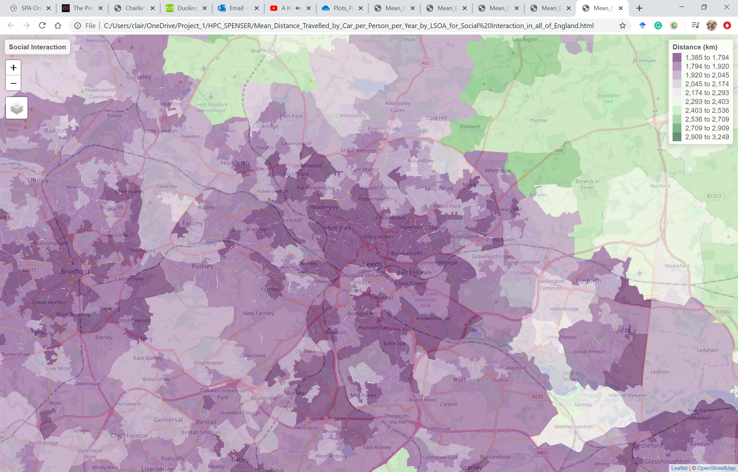
Presentation title slide
Notes:
And if we zoom in again, we can see the differences between LSOAs in terms of distance travelled within cities, for example Leeds and Bradford.
It demonstrates that there is a spatial element to trip purpose type and trip distance based on the demographic of the area.
This will be insightful for policy-makers to visually see where the demand is for car travel by displaying the information on an interactive map. This strengthens science communication with those who are not familiar with programming technicalities.

Slide 17
Presentation title slide
Next Steps
Assess the differences between LSOAs and regions
Create a set of indicators of demand
Validation of the results
MOT and NTS estimates
Notes:
To create a set of indicators of car travel demand, I am currently trying to assess why differences between LSOAs occur, by looking at the demographics of the LSOAs.
The next step is to validate the results of this project. I am currently using annual mileage data from the MOT and the yearly distance averages the NTS predict for each trip purpose type, to see if there is a correlation between those results and the results of this project.
This research project is one way to identify how demand can be reduced, while also being mindful of any groups that might be at risk to certain policies.
Focusing on supply is not the solution, need policies to focus on demand as well for the UK to mitigate and combat the effects of climate change.

