Slide 1
Presentation title slide
Can data help give children equal access to education in Bradford? A look at the school admissions process.
Holly Clarke
Supervisory Team: Mark Mon Williams, Ning Lu, Alison Heppenstall, Nick Malleson

Slide 2
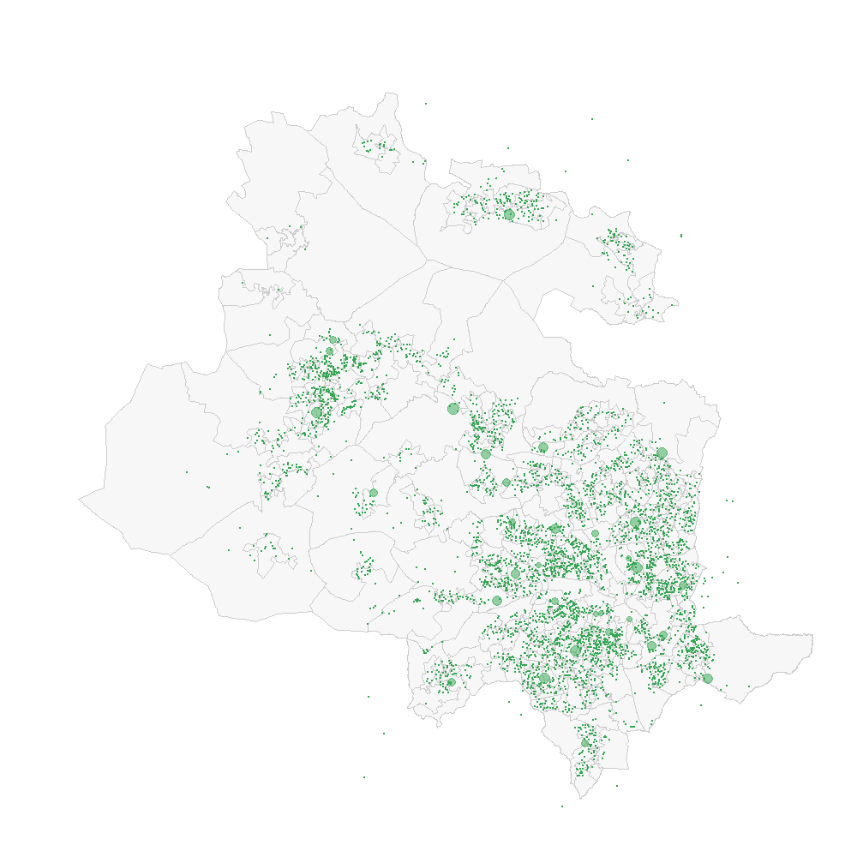
Presentation title slide

Slide 3
Presentation title slide
Is the school admissions system causing unequal access to education?

Slide 4
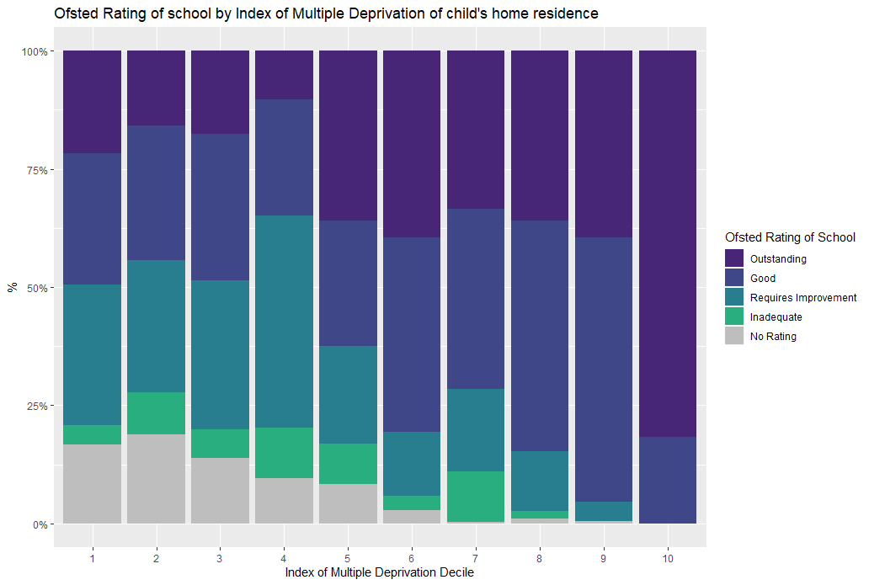
Presentation title slide

Slide 5
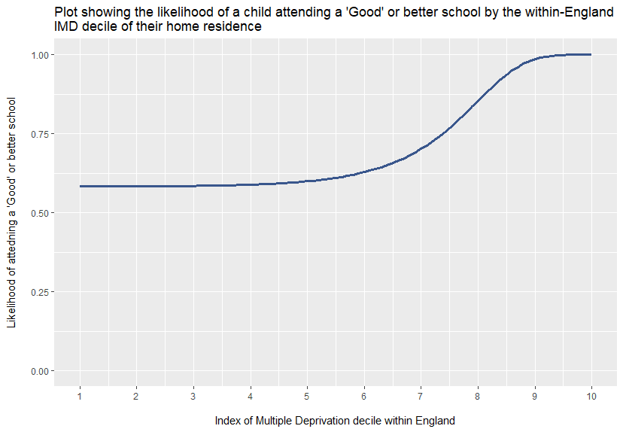
Presentation title slide

Slide 6
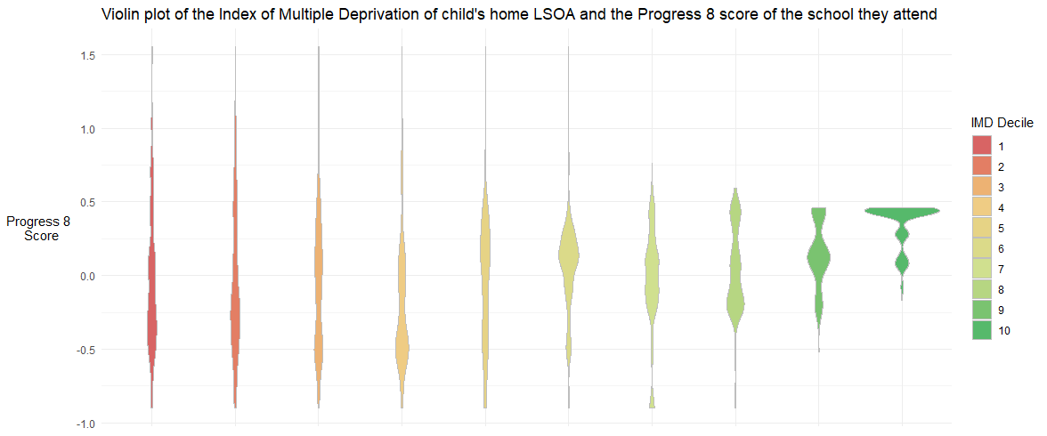
Presentation title slide

Slide 7
Presentation title slide
Is this caused by admissions?

Slide 8
Presentation title slide
Apply to up to 5 schools with preferences
Schools apply over-subscription criteria
Algorithm matches pupils with the top preference school they were accepted to
Pupils who don’t get into any preference school are assigned to their closest school with available places
Pupils

Slide 9
Presentation title slide
Geography
Schools’ Selection
Parents’ Preference

Slide 10
Presentation title slide
Is there inequality in whose preferences are satisfied by the school admissions system?

Slide 11
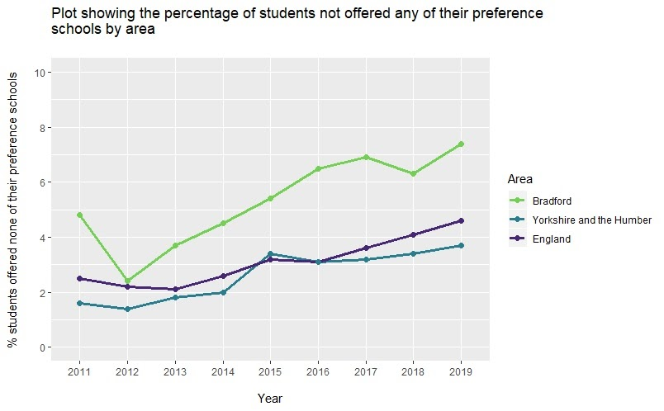
Presentation title slide

Slide 12
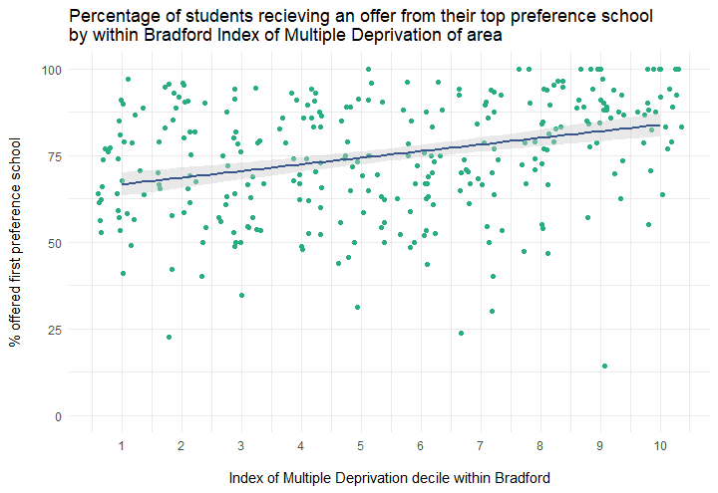
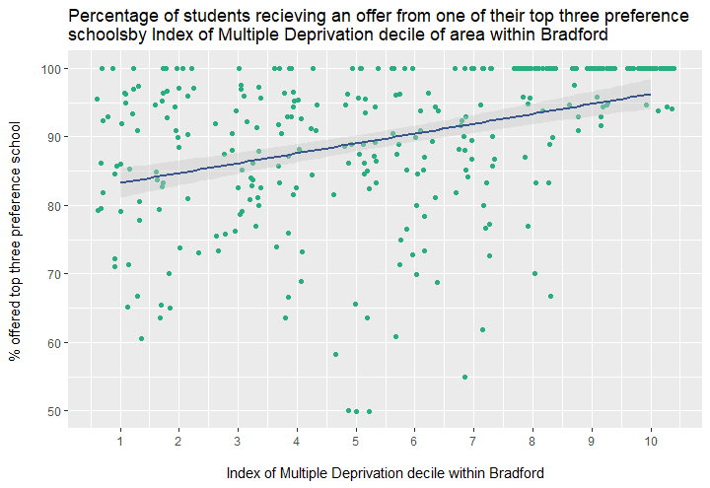
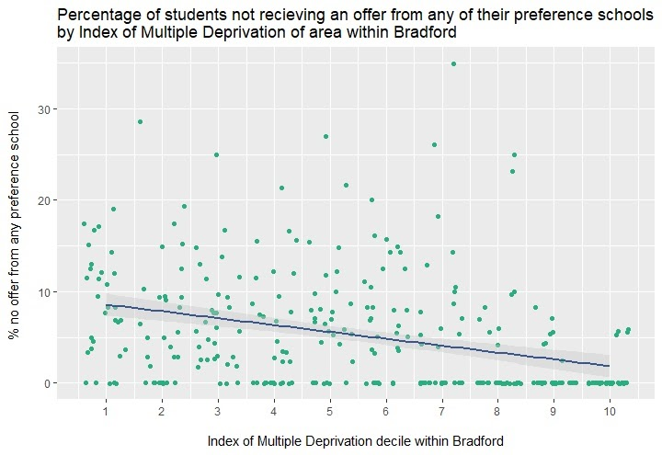
Presentation title slide
Top preference school
Top three preference school
No preference school

Slide 13
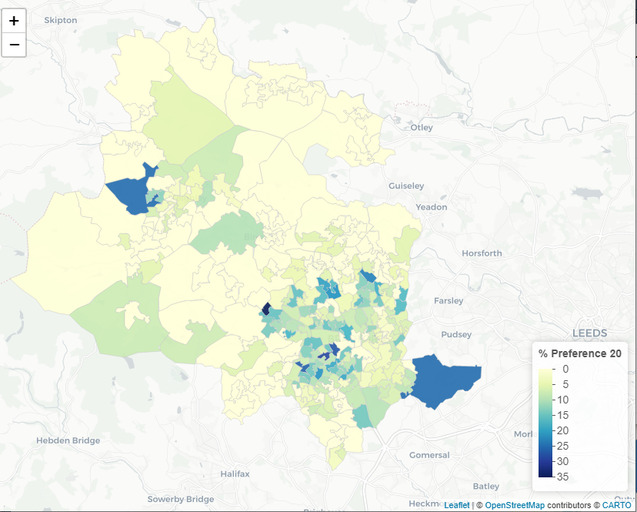
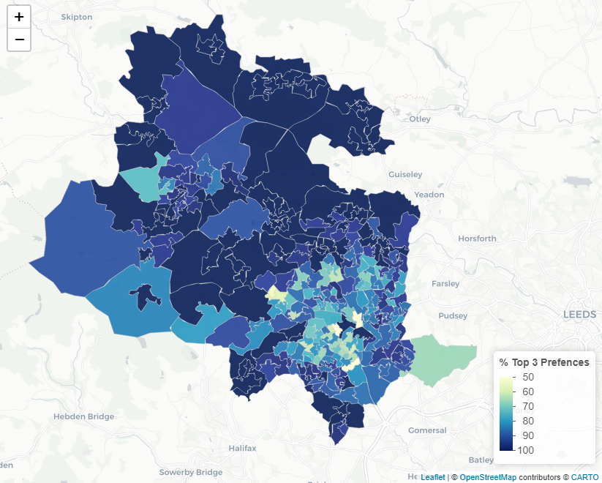
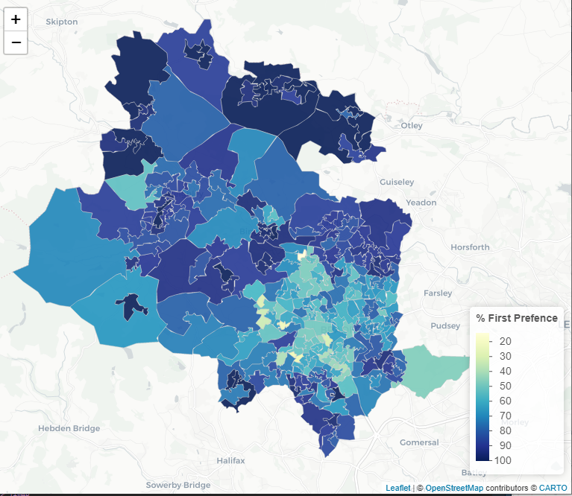
Presentation title slide
Notes:
In some areas of Bradford 100% of students are getting into their top preference school, at the same time in others 35% are not receiving an offer from any of their preference schools.
In real terms this means that within one of the 10% most deprived areas in Bradford 66.6% of children are predicted to get into their top preference school compared to 83.8% within the 10% least deprived areas of Bradford. Similarly, 83.3% of these children are predicted to get one of their top three choices compared to 96.2% in the least deprived areas, and they are predicted to receive no offers from any of their preference schools in 8.6% of cases compared to just 1.8% for the most advantaged students.

Slide 14
Presentation title slide
Does school selection criteria have a role in this inequality?

Slide 15
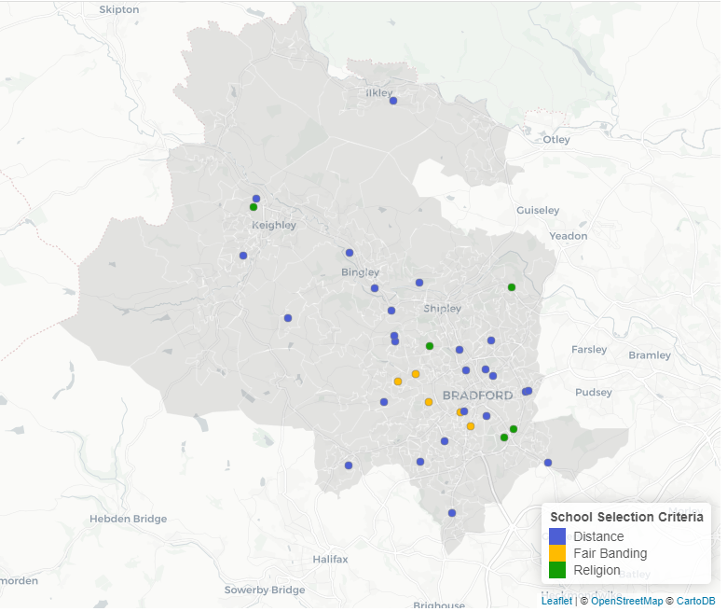
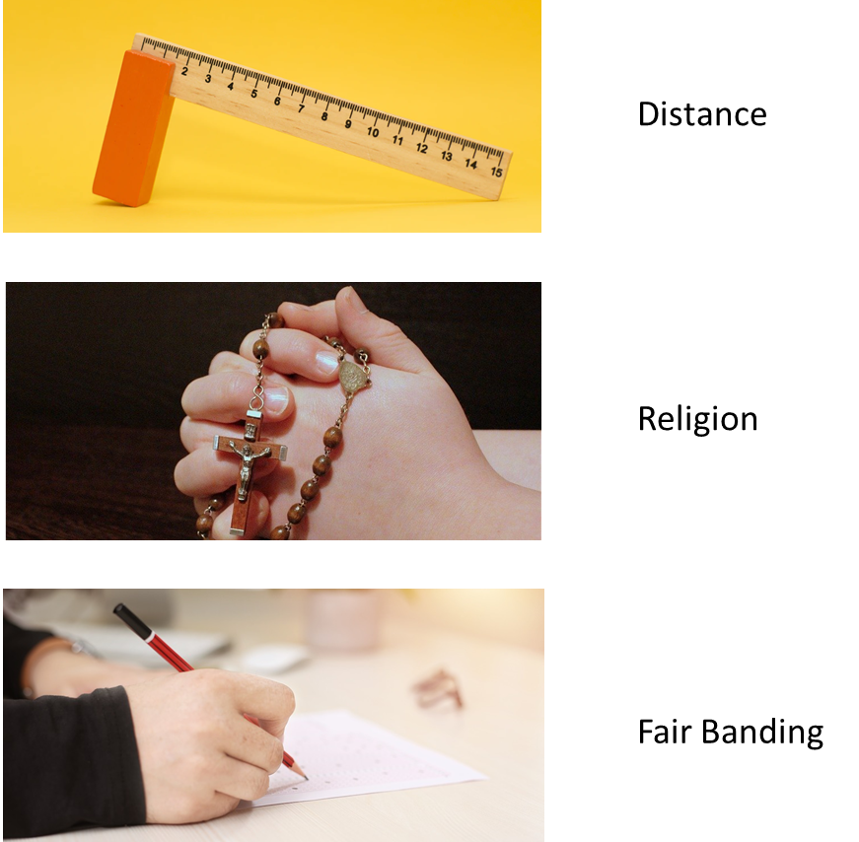
Presentation title slide

Slide 16
Presentation title slide

Slide 17
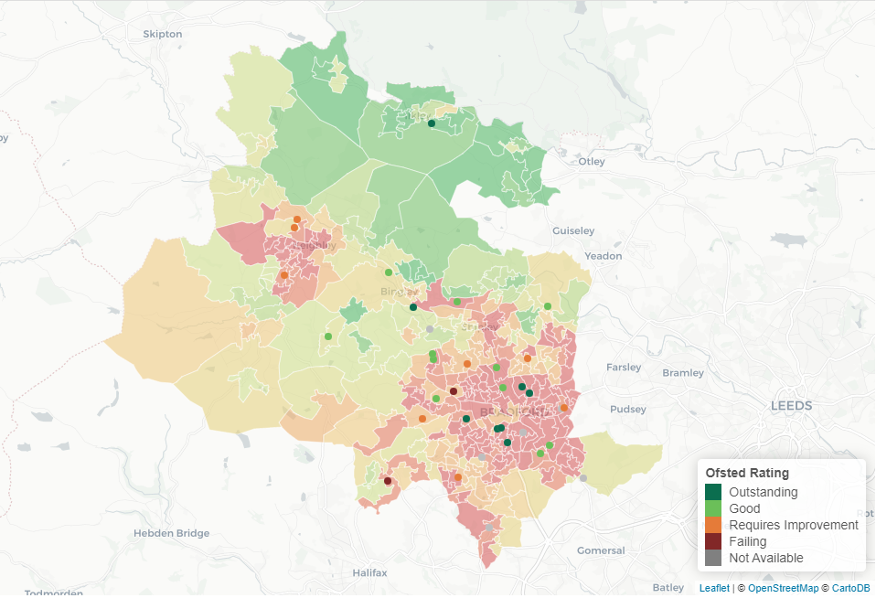
Presentation title slide

Slide 18
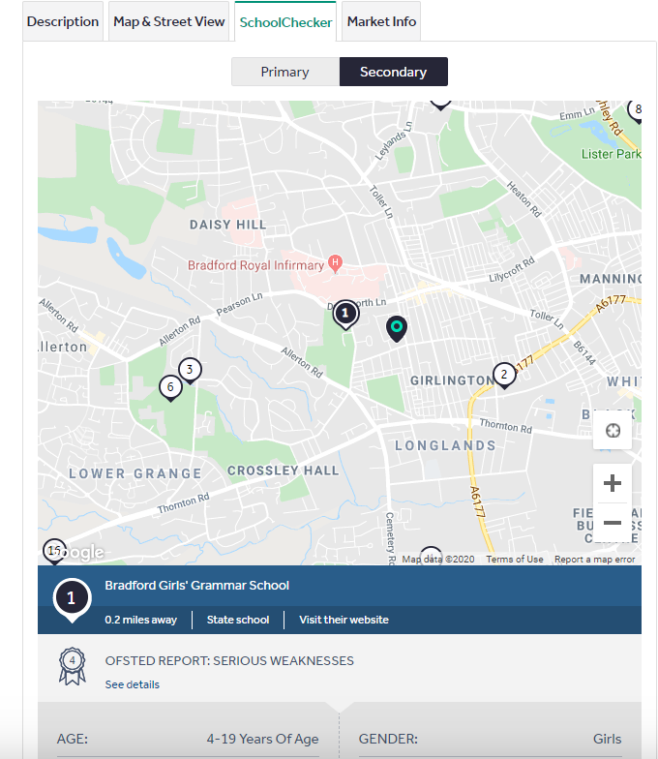
Presentation title slide

Slide 19
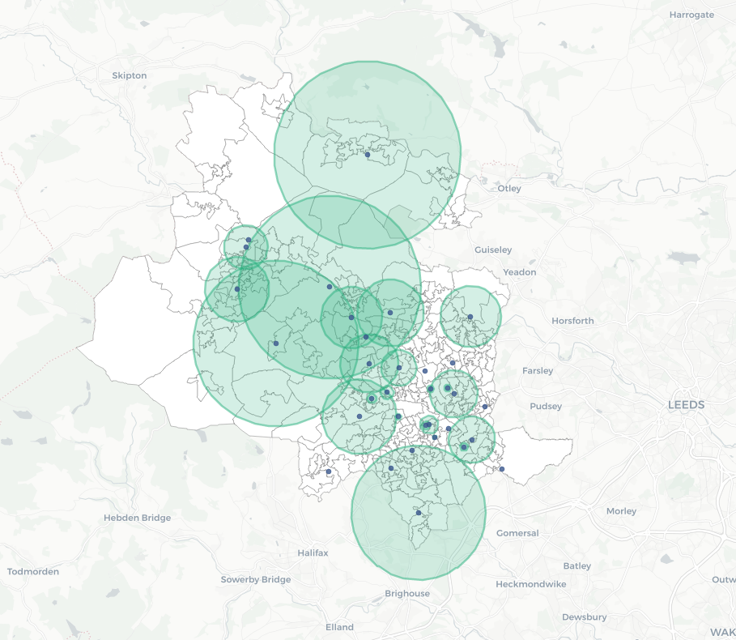
Presentation title slide

Slide 20
Presentation title slide

Slide 21
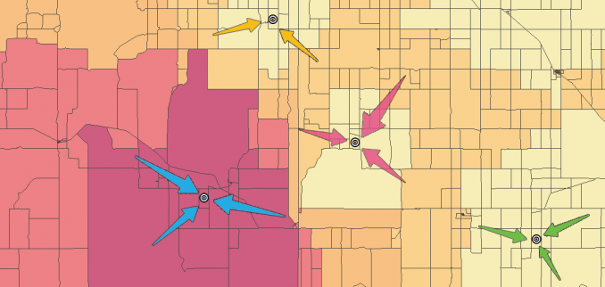
Presentation title slide
SPATAL INTERACTION MODEL

Slide 22
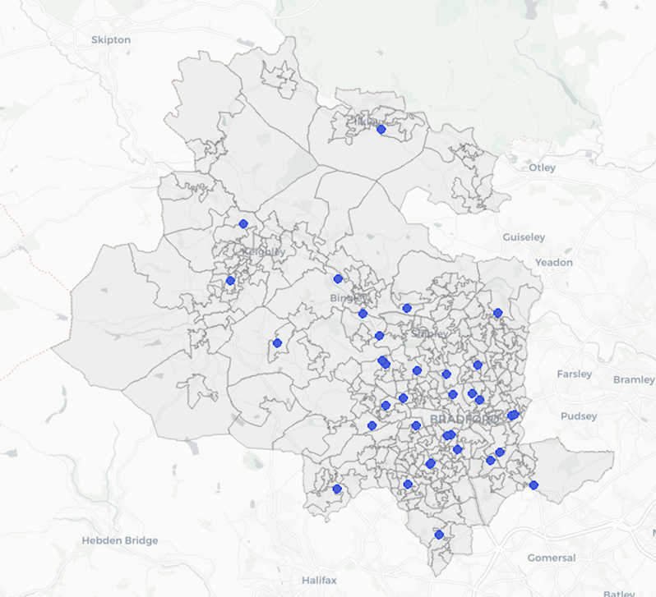
Presentation title slide

Slide 23
Presentation title slide
constraint
‘mass’ of destination zone j
distance decay function
Flow between origin(i) and destination(j)
‘mass’ of origin zone i

Slide 24
Presentation title slide
A B
i
j
‘mass’ of destination zone j
Constraint so number of children attending each school and leaving each LSOA is conserved
distance decay function
Flow between origin(i) and destination(j)
‘mass’ of origin zone i

Slide 25
Presentation title slide
 | D1 | D2 | D3 | …
O1 | 41 | 0 | 6 | …
O2 | 3 | 21 | 80 | …
O3 | 106 | 3 | 1 | ...
O4 | 0 | 50 | 0 | …
O5 | 0 | 3 | 0 | …
O6 | 1 | 0 | 21 | …
… | … | … | … | …

Slide 26
Presentation title slide
-2.04 (R2 = 0.845)
-1.90 (R2 = 0.816)
-1.79 (R2 = 0.913)
-1.36 (R2 = 0.754)
Undersubscribed
-1.67 (R2 = 0.69)

Slide 27
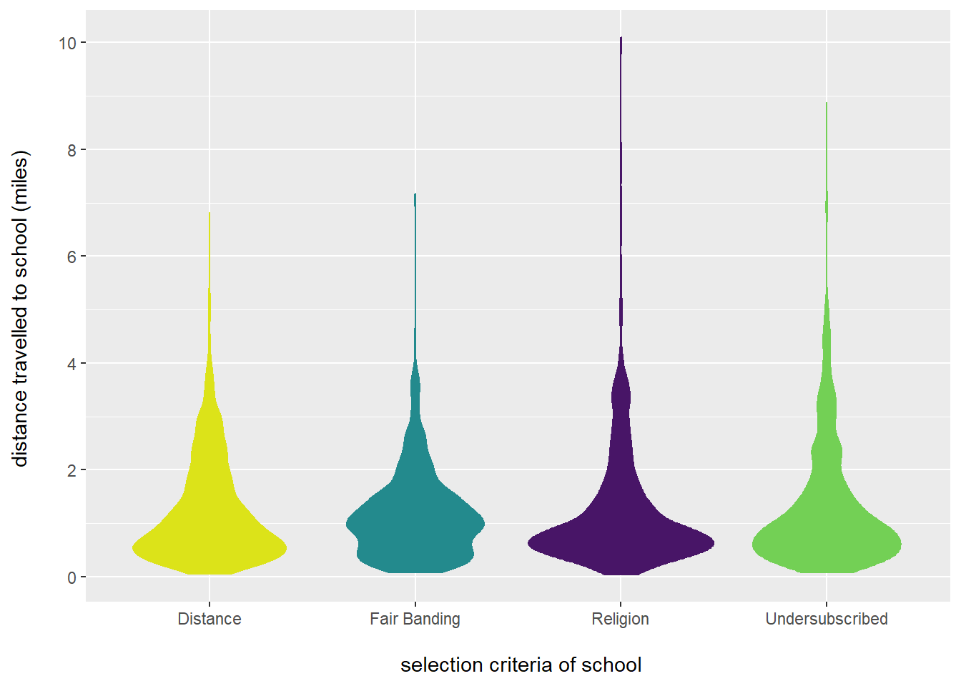
Presentation title slide

Slide 28
Presentation title slide
-2.04 (R2 = 0.845)
-1.67 (R2 = 0.69)

Slide 29
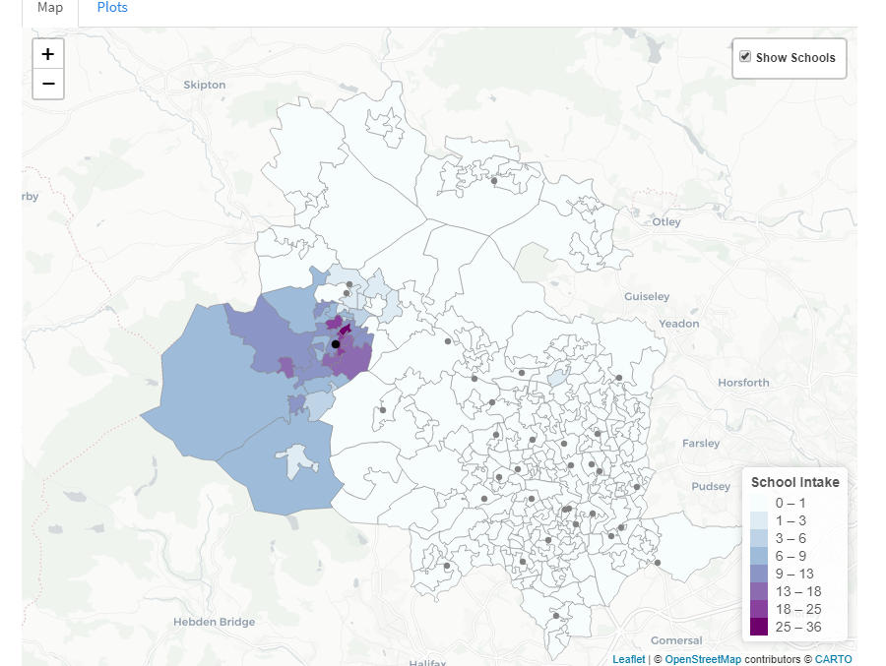
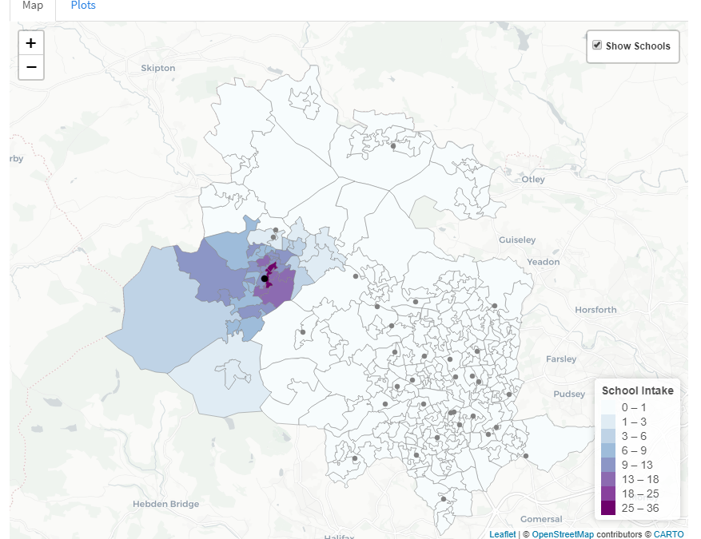
Presentation title slide
Distance

Slide 30
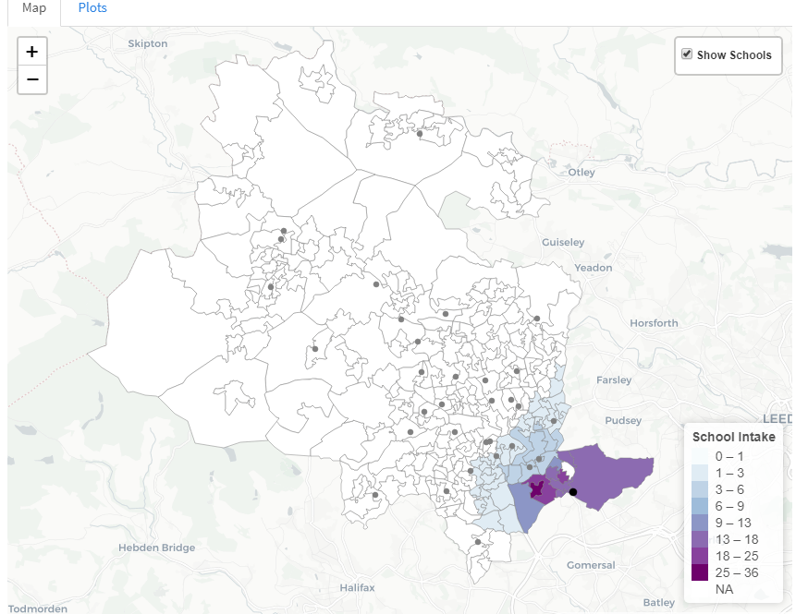
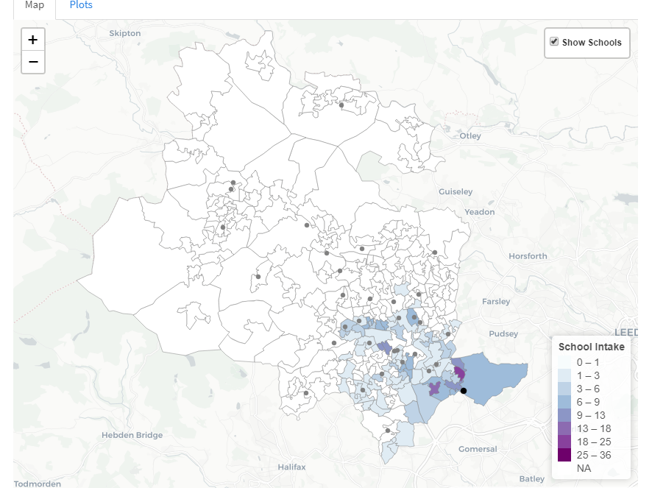
Presentation title slide
Undersubscribed

Slide 31
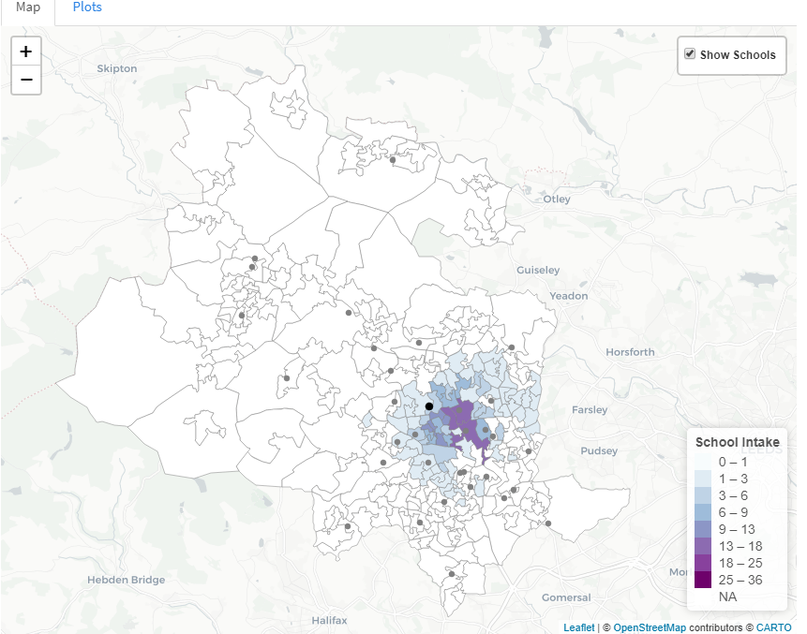
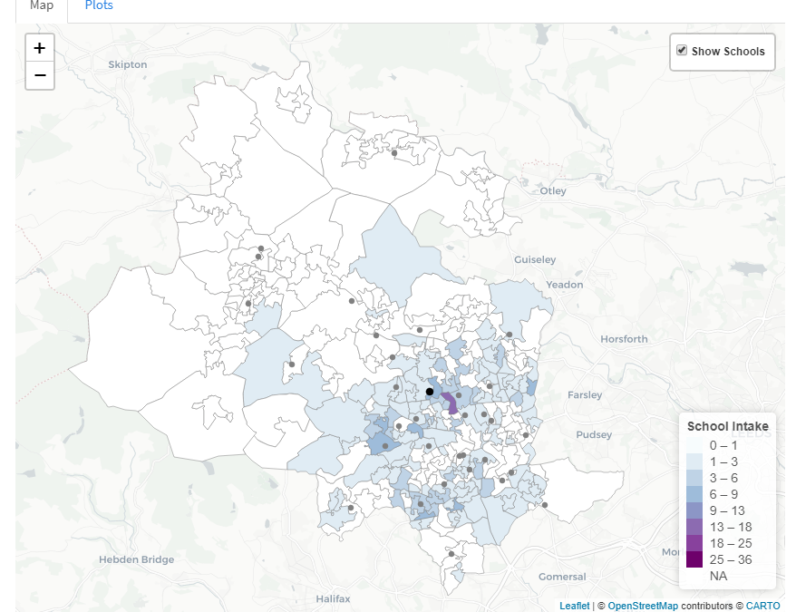
Presentation title slide
Religious
Notes:
31

Slide 32
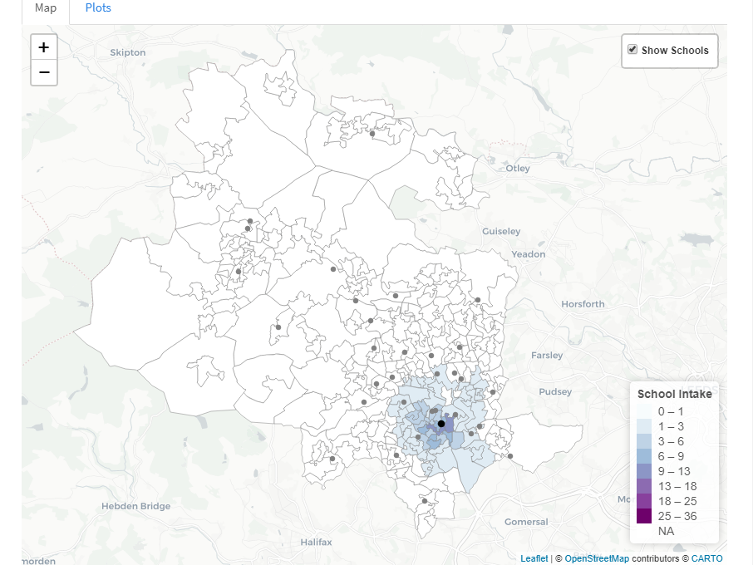
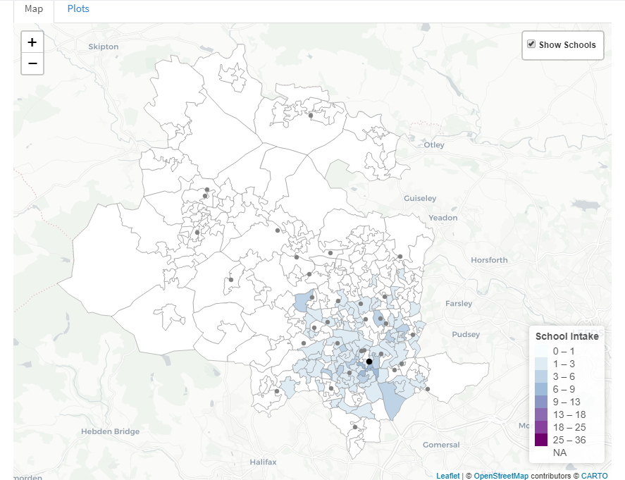
Presentation title slide
Fair Banding

Slide 33
Presentation title slide
?

Slide 34
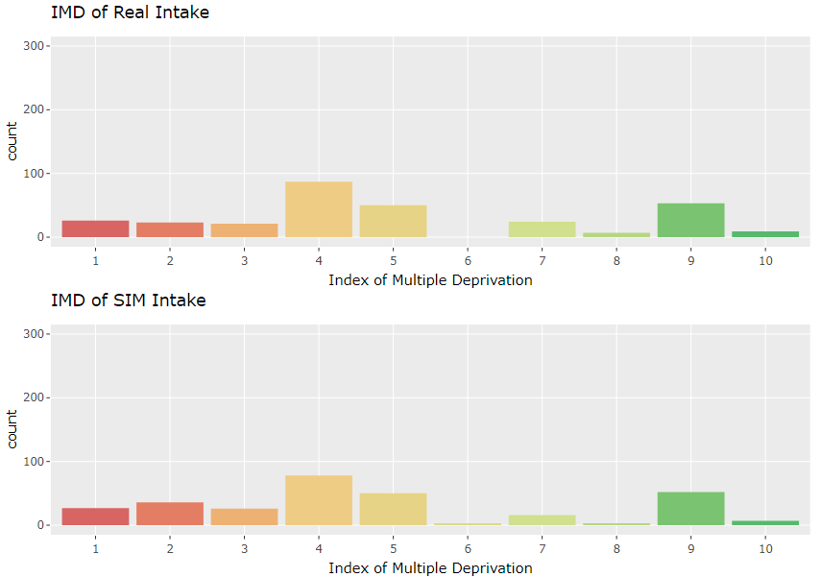
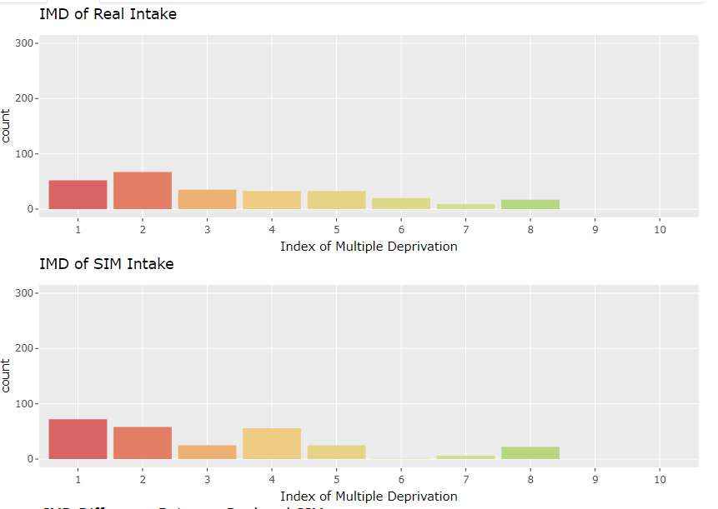
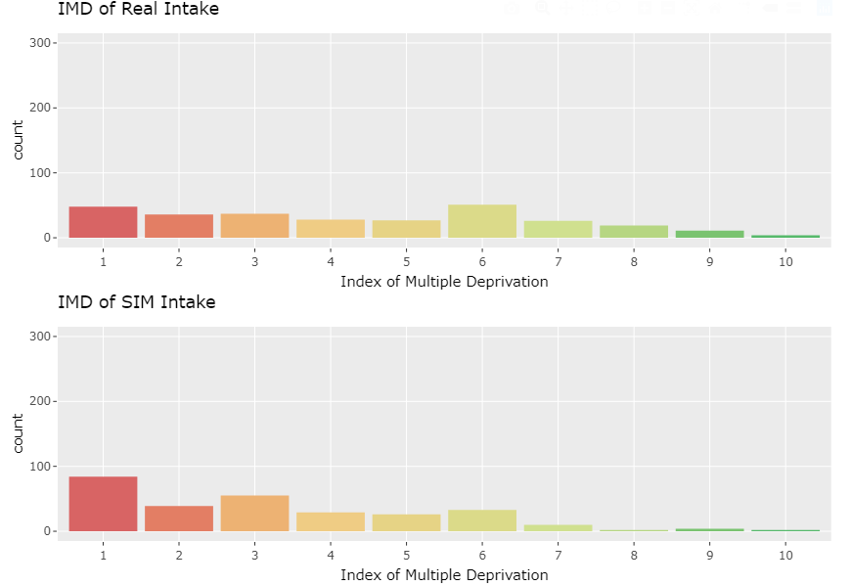
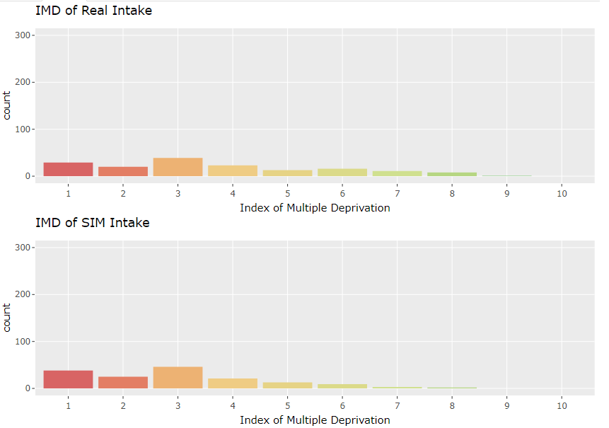
Presentation title slide
Distance School:
Undersubscribed School:
Religious School:
Fair Banding School:

Slide 35
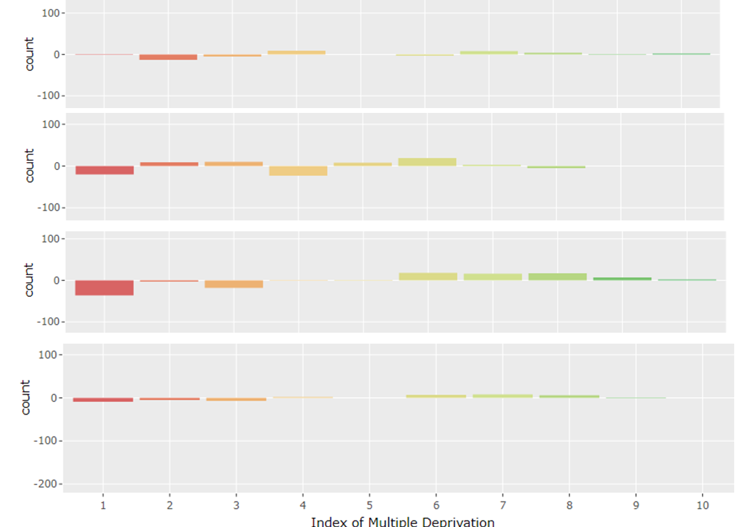
Presentation title slide
Distance School:
Undersubscribed School:
Religious School:
Fair Banding School:

Slide 36
Presentation title slide
SUMMARY
Inequality in school access is not straight forward in Bradford but there is clear inequality in terms of certainty and choice.
SIMs can give us insight on how selection criteria impacts the distances students travel to school and also to estimate expected school intakes if all schools used distance-to-school as a selection criteria.

Slide 37
Presentation title slide

