Slide 1
Linking Pollution, Health and Lifestyle in Leeds
Vijay Kumar
Supervised by: Dr Haiyan Liu, Prof Jeanine Houwing-Duistermaat,
Dr Georgios Aivaliotis
Notes:
This presentation is an update on a my project which is focused on pollution exercise and health data in Leeds.

Slide 2
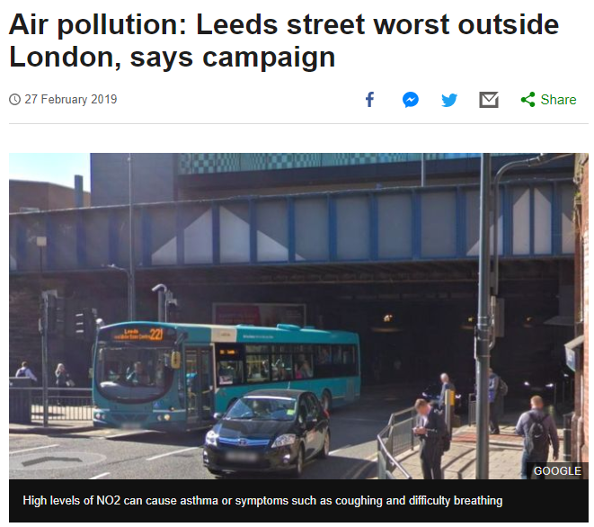
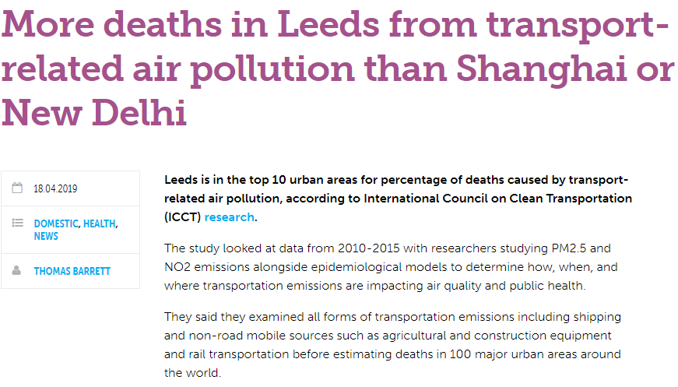
Presentation title slide
Pollution in Leeds
Notes:
You don’t have to look far to see examples of pollution having an effect locally in Leeds, Here are a few news articles that show there maybe a potential problem with pollution. We want to better quantify this and find out to what extent this effecting out public health. To do this we need to pick a specific health outcome we think pollution and exercise may effect and monitor it.

Slide 3
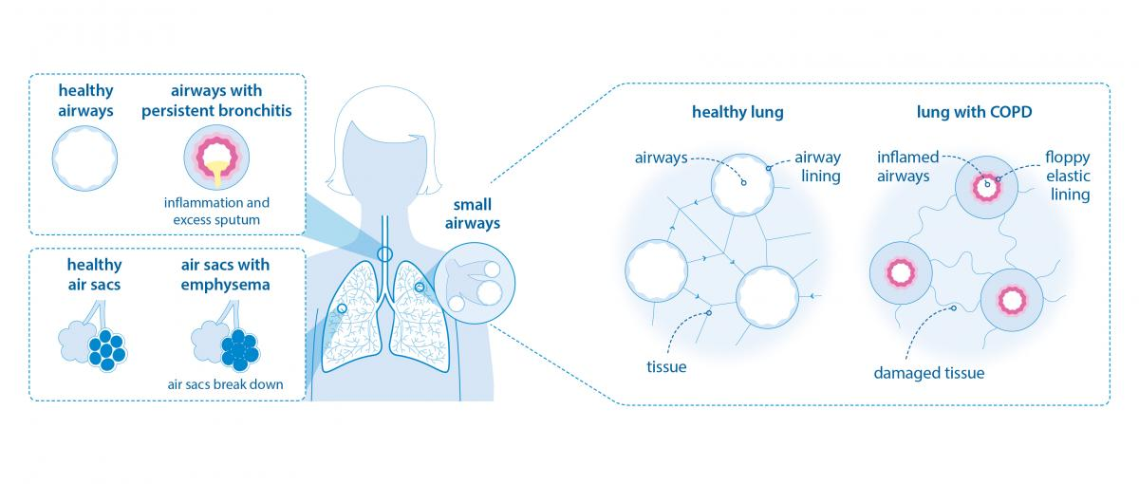
Presentation title slide
Chronic Obstructive Pulmonary Disease
Notes:
The health outcome we have chosen to look at is COPD hospital admissions. This is a disease that is effected by many things with air quality being one of them. Sufferers will experience symptoms such as shortness of breath, excess build up of mucus and salvia, wheezing and air being trapped in the lungs. This can lead to a decreased quality of life and improperly managed can lead to the contraction of other diseases that can be fatal.

Slide 4
Presentation title slide
Objective
Gather, analyse and map COPD across Leeds
Map NO₂ across Leeds and find any links with COPD
Look at the population’s exercise habits and find any links with COPD
Test a temporal functional model to see the effects of both variables on COPD
Notes:
We are setting out to analyse COPD hospital admissions by the geography of postcode districts and look for any interesting pattern. We will do the same with NO2 data from and across Leeds along with exercise data (exercise being focused on more in the future). But the over all objective is to build a functional model that accounts for both covariates and gives and appropriate COPD outcome. What we are most interested in is the temporal aspects, over what time scales do these things happen? How long does someone have to be exposed to high levels of NO2 for before they are admitted to hospital?

Slide 5
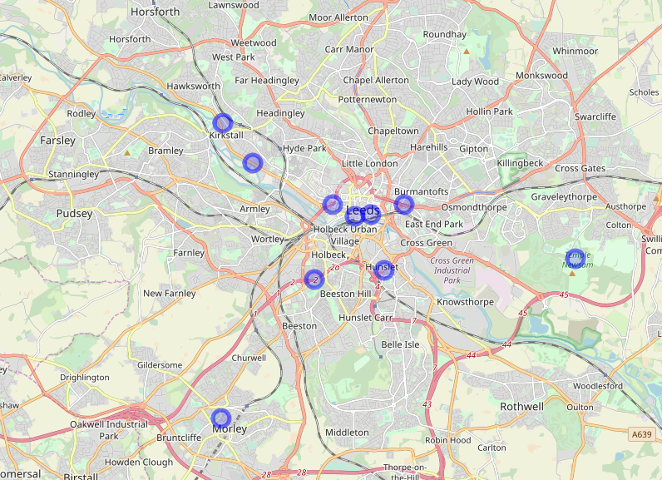
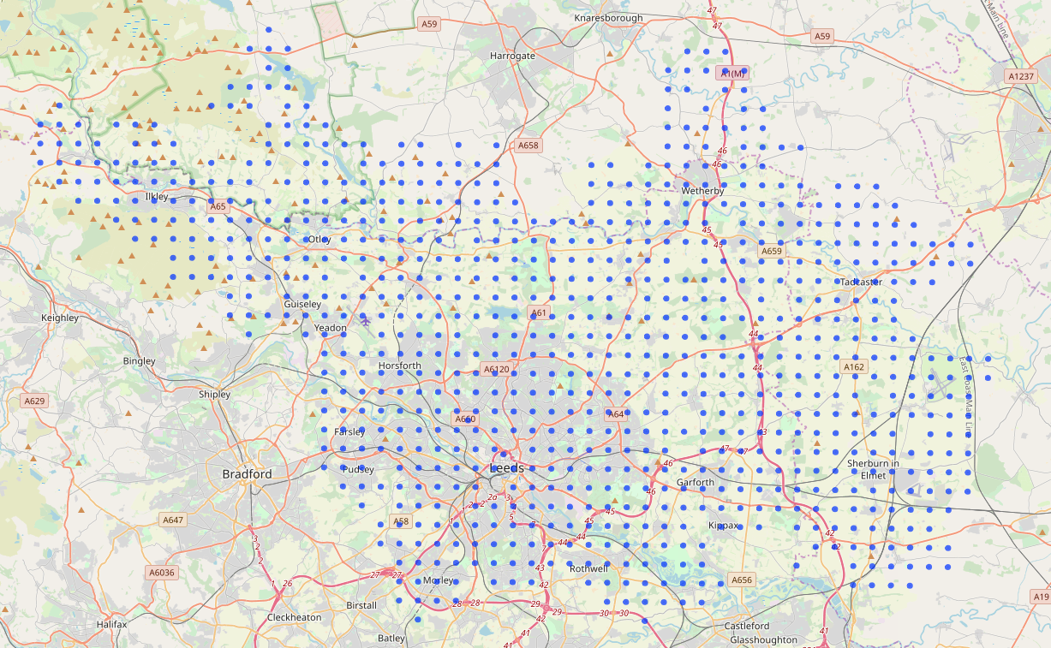
Presentation title slide
Pollution
Notes:
Pollution data is collected every 15 minutes from these automatic monitoring points across Leeds (left) and then interpolation is used for points all across Leeds (right) to get a full map of the city.

Slide 6
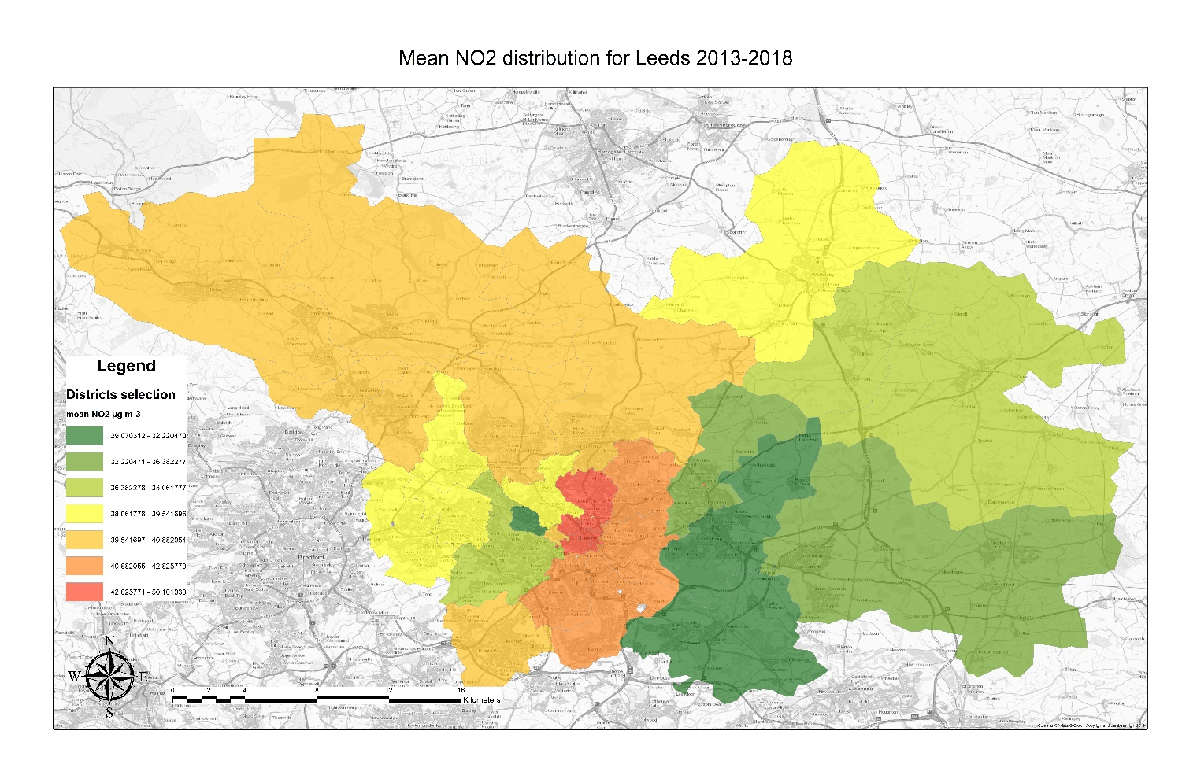
Presentation title slide
Mean NO2 2013-2018
Notes:
Looking at the mean NO2 across Leeds from 2013-2018 you get a map looking like this. It is clear that the city centre regions have the worst values.

Slide 7
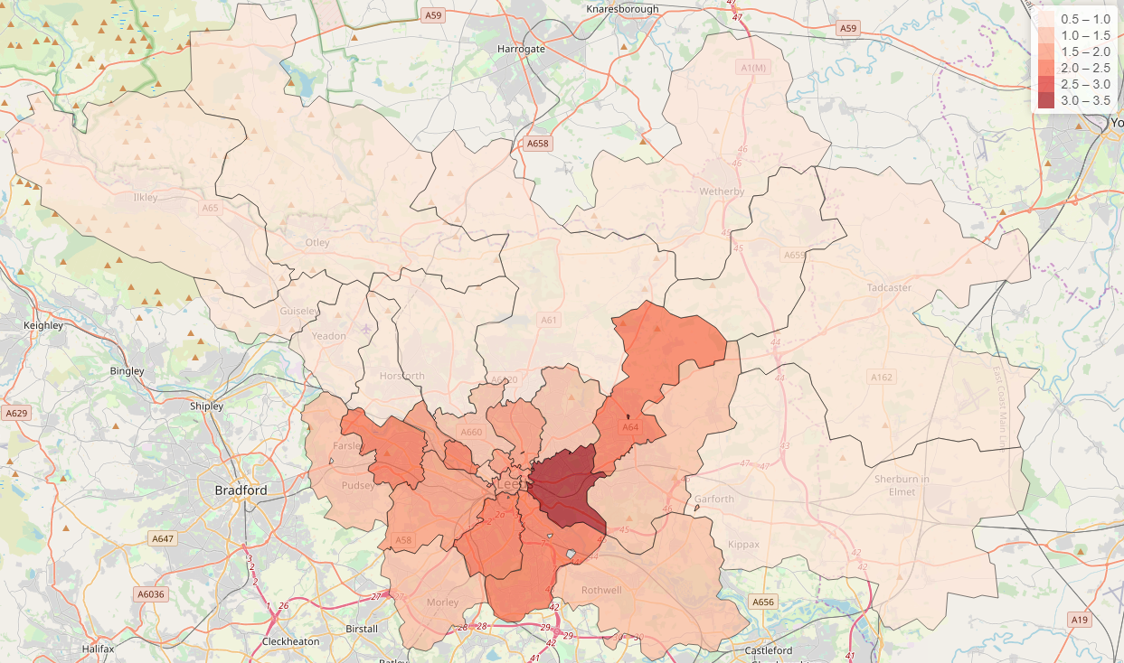
Presentation title slide
COPD Hospital Admissions 2013-2018
Notes:
Mapping COPD hospital admissions looks something like this. This is a standardised count so 1 would be the expected amount of admissions for an average population of the required size region. As you can see there is values as high as 3, which is not ideal.

Slide 8
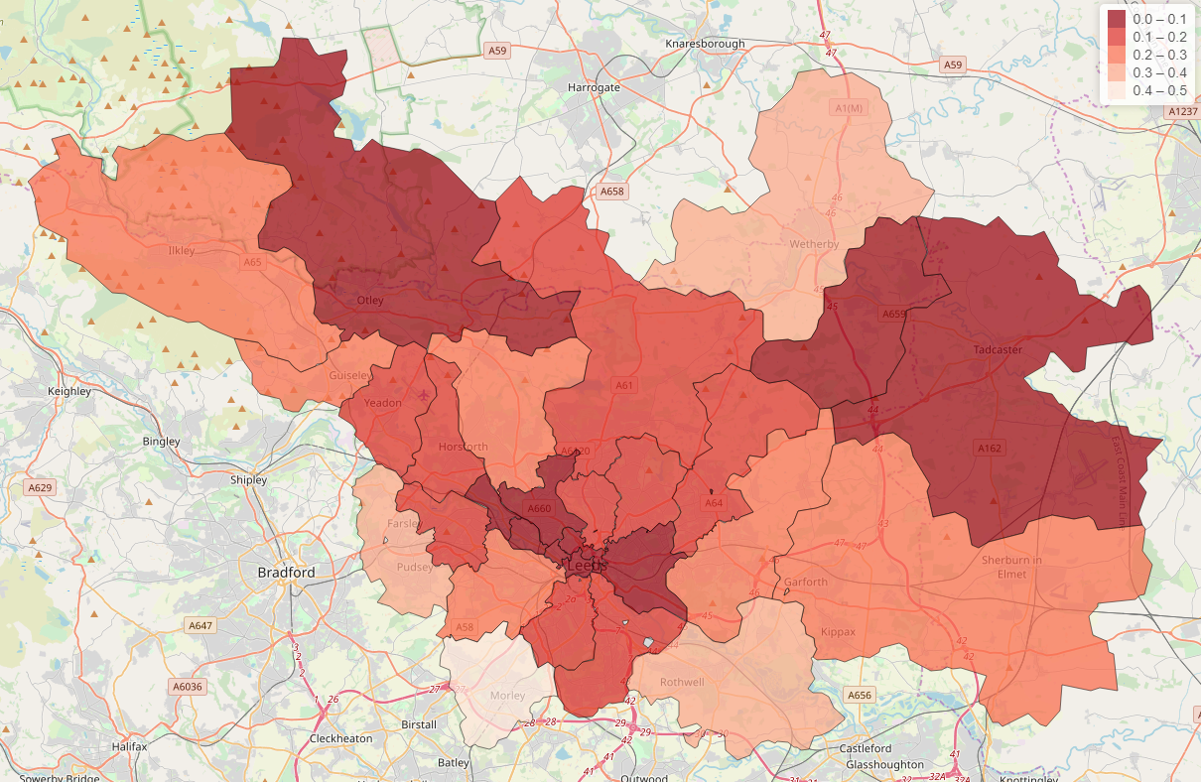
Presentation title slide
Exercise Activity In Leeds
Notes:
I have left this in as it is still interesting however we will not be using this exercise data in our functional temporal models. This is a look at how regularly people use council facilities such as swimming pools, gyms and athletic tracks. The value is visits per week per population.

Slide 9
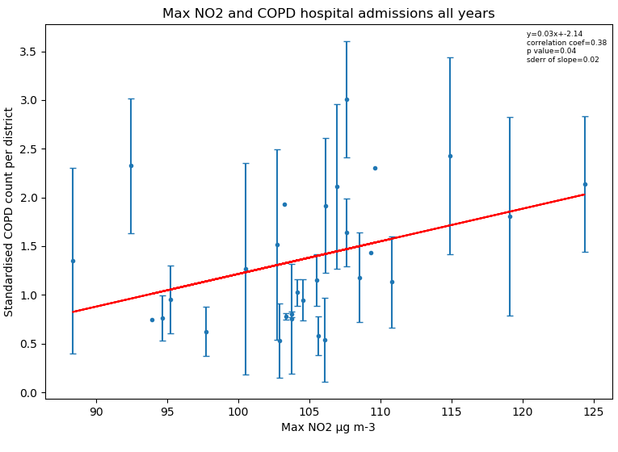
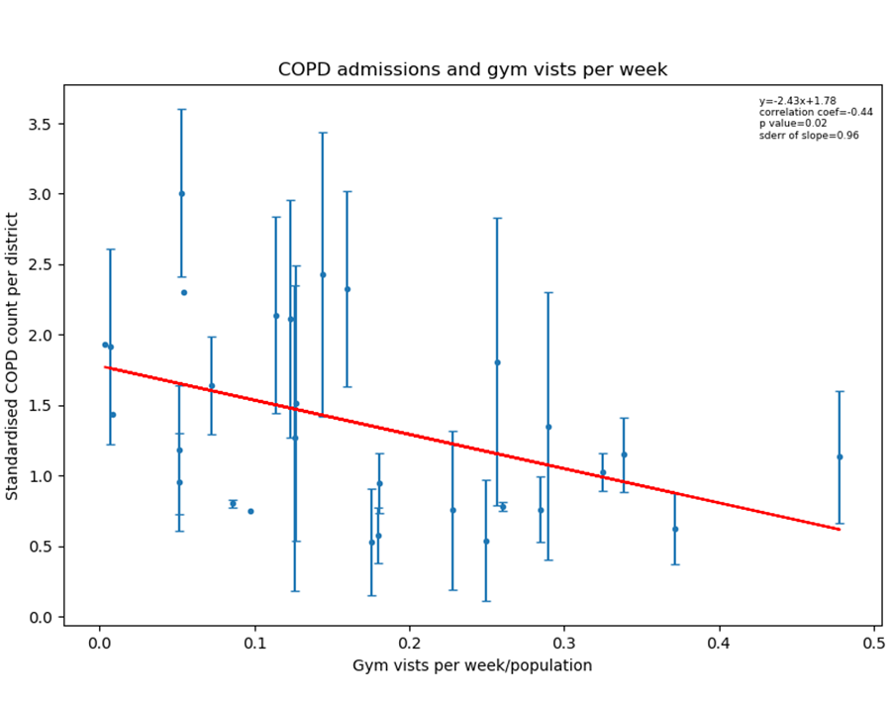
Presentation title slide
Static Models
Notes:
Just running some simple regression ignoring time we can see some general trends. Places with higher maximum NO2 readings generally will have more hospitalisations for COPD, and places where people exercise more often have less COPD hospital admissions. This is done with static COPD data but we now have temporal COPD data by postcode level so we can look at COPD throughout time. As I stated before we haven’t managed to incorporate the exercise data into out model due to there being only 6 observation points over 6 years. At the moment we are currently focusing on NO2 and COPD.

Slide 10
COPD Through Time
Day
Notes:
On the left is the raw COPD admission data for 18 postcode districts around Leeds. On the right is the smoothed curves or these. What is important to us is finding the timescales that are important in COPD hospitalisation,

Slide 11
Effect Lag
24.5 weeks
3.5 weeks
NO2 Exposure
Lag Time
Admission
Notes:
We have found that there is some correlation between the COPD and NO2 curves. We have found that before a peak in COPD hospital admissions there is normally a period of 24.5 where people are exposed to relatively high levels of NO2. This is followed by a lag time of 3.5 weeks where NO2 do not affect the situation (in other words the damage has already been done even if NO2 levels drop), after this we will see a peak in hospitalisations. We used a search grid looking over many different timescales including scenarios of no lag, however 24.5 and 3.5 weeks gives the most accurate results. This is useful as if you have access to historical NO3 data dating back 24.5 weeks, you can predict the COPD hospital admissions in 3.5 weeks time. This can help in better planning and allocation of health resources in the future.

Slide 12
Future Work
Experiment with different physical activity datasets and incorporate this covariate into the model
Collaborate with other academics to better pollution interpolations
Experiment with LSTM neural networks to predict COPD hospital admissions
Notes:
In the future we hope to incorporate exercise as a covariate into the model. We also want to get better pollution data to make our outputs more accurate. Lastly, we may explore using long-short term memory neural networks to see if they can better predict COPD hospital admissions.

Slide 13
Notes:
The model

