Slide 1
Presentation title slide
Simulations of crowd movements: from offline to real-time
Thomas Richards
t.c.richards@leeds.ac.uk
Intern working on DUST project
Supervisory team: Nick Malleson, Jonathon Ward, Minh Kieu

Slide 2
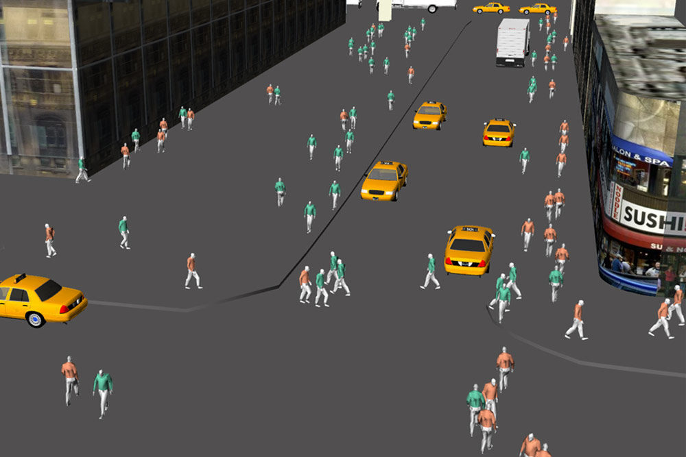
Presentation title slide
Crowd simulation using Golaem, Game of Thrones
A simulated crowd evacuating crowd, from Axblad and Gonzalez (2018)
Burrohappold Engineering urban planning tool
Notes:
There are many situations where it is useful to simulate how individual entities (for example vehicles or people) move and interact within a given spatial area.
For example, simulating evacuating crowds for emergency management, special effects in cinema, and simulating a street for urban management.
Broadly speaking there are 3 different modelling approaches depending on the time scale and the size of the crowd: the flow-based approach, the particle system approach, and the agent-based approach (Axblad 2018, p6).
In urban analytics, an agent-based approach is useful and this presentation discusses how we are working to improve this approach and then how we plan to demonstrate this in a proof-of-concept model of a real life situation

Slide 3
Agent-based models (ABMs)
Useful for simulating crowds with heterogenous behaviours of individuals
Offline models from historical data
But, no established methodologies for Dynamic Data Assimilation (DDA) in agent-based models of crowd simulations
Notes:
Why are agent based models preferable to other techniques?
Flow-based models treat crowds as a single fluid entity which has the benefit of reducing computational cost, but cannot factor in details of individual agents.
Particle-based methods do model individual agents but focuses on the physical forces guiding the agents
Agent-based models however, allow us to model each as an intelligent individual that can decisions based on the environment.
Each agent is assigned a list of variables which will affect their behaviour.
This allows us to model behaviours such as speed of movement, response to panic, etc. at the individual level across a heterogenous population
So if we wanted to model the movements of individuals in a building, we could build a model based on historical data which might help us find design flaws in a structure we are building.
However, models are usually calibrated once using historical data
This means that over time, the prediction tends to diverge from the real situation and would therefore be unable to predict future events based on the situation in a building right now.
We are working on improving these models by incorporating real-time data through methods known as dynamic data assimilation, thought there are no currently established methods for crowd simulations.
These techniques can improve the predictive capability by calculating the difference between the model and the true state, and then constraining the model to the real situation.
Other fields such as meteorology have successfully applied DDA to improve predictions of weather patterns for example using the Kalman filter/particle filter.
We want to use these techniques to develop a real-life application of DDA into an ABM as a proof-of-concept

Slide 4
Project goal
Construct an agent-based model that uses dynamic data assimilation in a real world application
Notes:
Before we build a model we need to be able to obtain data.

Slide 5
Smart Building
Notes:
As part of the DUST project, researchers at University of Leeds are working in collaboration with Connected Places
They provide data-oriented solutions to businesses.
One project they have set up is a Smart building which has 18 sensors in different locations throughout the building
We want to use data from these sensors to build an ABM which models peoples movements through the building

Slide 6
Cactus Smart Building, Ground Floor
Open-Office
Café
Desks: 201-208
Desks: 209-216
Desks: 217-220
Desks: 221-228
Café-1
Desks: 229-232
Desks: 233-240
Desks: 241-244
Desks: 245-254
Café-2
Café-3
Sensors
UM-Meeting-Room-UM01
Exhibition-Area
Exhibition-Area-1
Exhibition-Area-2
UM-Meeting-Room-UM01
Notes:
Representative floor plan of the smart building, where dots represent sensors

Slide 7
Cactus Smart Building, Ground Floor
Open-Office
Café
Desks: 201-208
Desks: 209-216
Desks: 217-220
Desks: 221-228
Café-1
Desks: 229-232
Desks: 233-240
Desks: 241-244
Desks: 245-254
Café-2
Café-3
UM-Meeting-Room-UM01
Exhibition-Area
Exhibition-Area-1
Exhibition-Area-2
UM-Meeting-Room-UM01
Notes:
A red X represents a single agent, or in our model, a person

Slide 8
Cactus Smart Building, Ground Floor
Open-Office
Café
Desks: 201-208
Desks: 209-216
Desks: 217-220
Desks: 221-228
Café-1
Desks: 229-232
Desks: 233-240
Desks: 241-244
Desks: 245-254
Café-2
Café-3
UM-Meeting-Room-UM01
Exhibition-Area
Exhibition-Area-1
Exhibition-Area-2
UM-Meeting-Room-UM01
Notes:
Red arrows demarcate the initial prediction of trajectory over time with each X along the line at different iteration of the model
Red arrows represent prediction from a static model calibrated then run.

Slide 9
Cactus Smart Building, Ground Floor
Open-Office
Café
Desks: 201-208
Desks: 209-216
Desks: 217-220
Desks: 221-228
Café-1
Desks: 229-232
Desks: 233-240
Desks: 241-244
Desks: 245-254
Café-2
Café-3
UM-Meeting-Room-UM01
Exhibition-Area
Exhibition-Area-1
Exhibition-Area-2
UM-Meeting-Room-UM01
Notes:
Green arrows represent the divergence from this model based using a dynamic ABM which updates the model and recalibrates based on sensor readings.

Slide 10
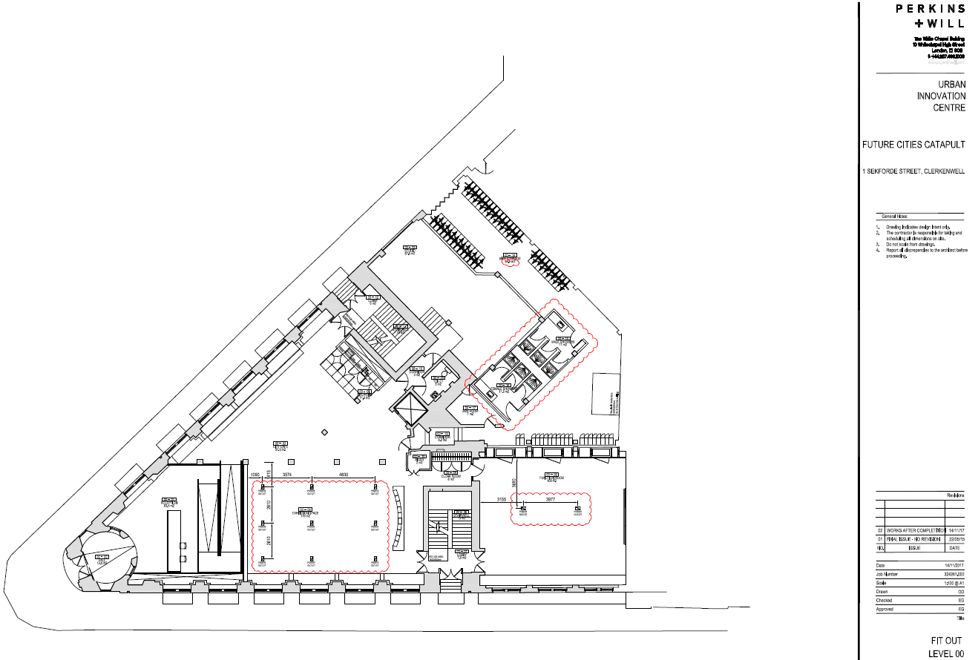
Notes:
The actual floor plan of one floor of the building

Slide 11
Sensors measure:
Atmospheric volatile organic compound levels (VOC)
CO2 levels
Temperature
Pressure
Humidity
Light Intensity
Noise Levels
Occupancy (number of people)

Slide 12
To build a model of the Smart Building…
Access the data
Build Python module to retrieve data
Build SQL database to store data
Visualise and understand the data
Notes:
To can construct a model, we need a number of things.
First, we need to access the data from the sensors, which is available through an API.
I therefore wrote a python module to retrieve data from the sensors.
I also built an SQL database to store the data.
And finally, we need to visualise and understand the data to understand how the building is being used.
Most recently, I have been working on a script for this final point which is able to retrieve and plot data directly from the database, which is where the figures come from in the next few slides.

Slide 13
Notes:
The script allows you to dynamically plot any time range directly from the database.
This slide shows a plot of all of the parameters from all sensors and includes all sensor readings from when they started recording on the 5th Feb to up until the end of last week.
Each individual sensor reading is indicated by a single dot.
While it is difficult to pick out any detail on a plot like, this it is useful for some things.
For example, we can pick out weekdays by the existence of 5 consecutives spikes that we can see in most readings, followed by a gap which is the weekend
We can also see a big gap where there is no sensor readings for around a week where they were offline for some reason.
However, with such a large range of time and so many sensors and parameters, it is hard to pick out any detail on a plot like this.

Slide 14
Notes:
In case you want to look more specifically at the trends from measurements of a single parameter, the script takes an argument which allows you to plot only the parameter or parameters that you are interested in.
For example, this figure just shows the occupancy readings, which is the number of people within the vicinity of the sensor, for the same time range as the previous slide.
Again, this is a little crowded because it shows so many sensors over such a broad time range, but it does let us visualise overall how many people are coming into the building.
Note for example, that the final week in March is marked a drastic decrease in people in the building as people stop coming into work due to COVID-19.

Slide 15
Notes:
To get a better idea of how people are actually using the building, it is better to look at sensor readings over the course of a typical day
The script allows you to plot only the sensors you are interested in.
This image shows readings from one sensor in each of 3 different rooms between midnight on the 4th and midnight on the 5th March.
Note the spike in VOCs and CO2 that moves from the café to the informal meeting area early in the morning.
These might be from perhaps the catering staff cooking breakfast, or someone making toast.
We can also see a big spike in the number of people in café 2 between 12 and 2.

Slide 16
Notes:
One final way that this script can help us to visualise the data is by aggregating the data from all sensors in a room.
Using this function will give you a sum of occupancy, and a mean for all other readings.
For example, this plot shows us how people move between the office, the café, and the exhibition area throughout the day, and the mean noise levels from all sensors in those rooms.

Slide 17
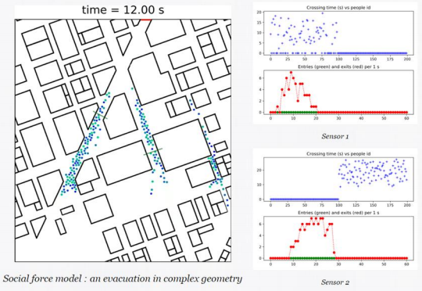
ABM software review
Screenshot from Cromosim as part of software review:
https://urban-analytics.github.io/dust/docs/ped_sim_review.pdf
Notes:
I have also written a review of potential software for building the model, which is available from this link at the bottom.
This slide shows a screenshot from the review showing some software called Cromosim

Slide 18
Conclusion
Plotting from the database allows us to understand how people are using the building
This information will be used to build a model which incorporates real-time data through data assimilation
Review: https://urban-analytics.github.io/dust/docs/ped_sim_review.pdf
Email: t.c.richards@leeds.ac.uk
Notes:
In conclusion, I have showed the progress I have made towards building an ABM of the smart building
I’ve shown some data which will help us to better understand how people are using the building and what data we can get through sensors
And this information can be used to design a model which incorporates real time data through data assimilation.

