Slide 1
LIDA transitional ways of working
Part of the University’s plans for transitioning staff back to campus, to use desk space in the South side of Worsley level 11
LIDA will no longer have access to desk space from 7th January 2022 and will be located exclusively on the North (reception) side of Worsley level 11
Does not affect the safe rooms on the South side of LIDA which will remain part of LIDA’s office space
The South side meeting room will continue to be available for members of the LIDA community to book (subject to current University Covid restrictions).

Slide 2
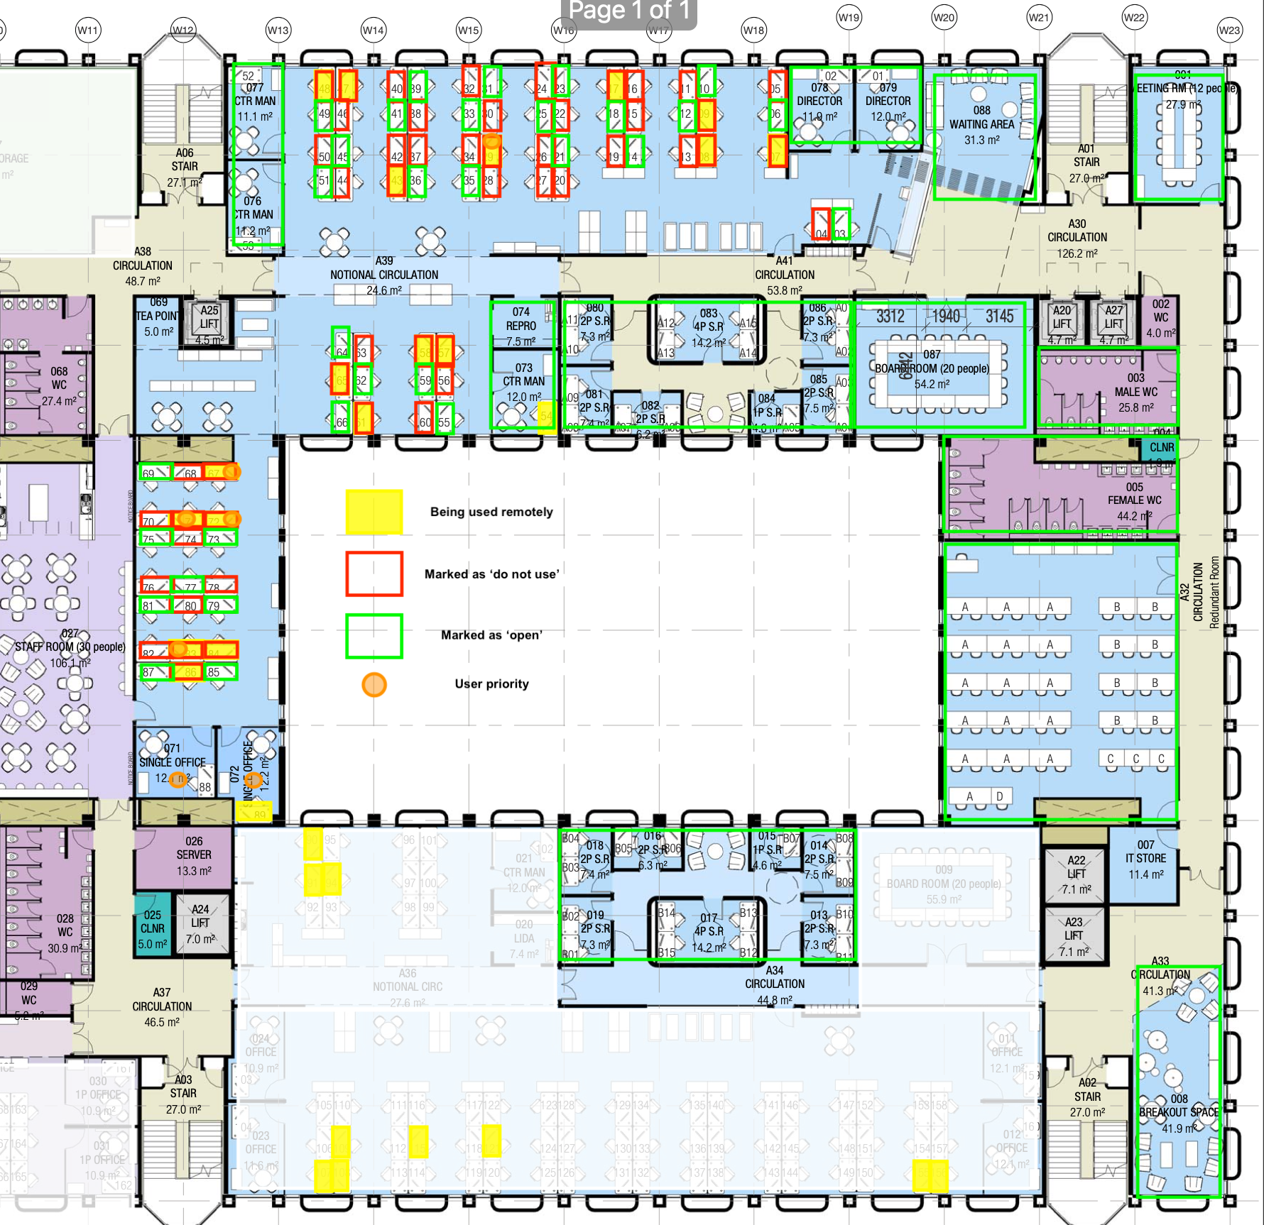
Worsley Level 11 floor plan
North side capacity: 82 (open plan area)
North side desks currently available to book: 33

Slide 3
How LIDA will support you and you can help us during the transition
We will support all North and South side desk users to remove any belongings on their desks by 10th December and provide secure storage (where appropriate)
Any remaining items after this date will be removed for collection
Office space on the North side of LIDA continues to be accessible as per current arrangements, with all colleagues/groups able to book and access the existing desks, safe rooms, reception Board Room, meeting rooms and training cluster
Working with Line managers, Estates, HR and IT to ensure continuity and minimal/no disruption to individual researchers work on or off campus during the transition.

Slide 4
How LIDA will support you and you can help us during the transition
On campus and remote working requirements discussed with all desk users individually on both North and South side of LIDA over the coming weeks
Please let us know about:
Occupational health needs
Standard software, SEED access, bespoke hardware/software requirements
Laptops and docking stations
Storage (work and personal).
Please also discuss your requirements with your line manager/occupational health
Hope to open up more North side desks in coming weeks (subject to H&S approval). All level 11 meeting rooms and safe rooms remain available to be booked.

Slide 5
Supporting future ways of working in LIDA
‘Future ways of working’ survey responses informing how we support you and your teams when working in LIDA during the transition and longer term
Some possible ideas:
Re-configuration of the LIDA office space: potential options include quite meeting rooms for Teams calls, confidential office space, shared office space and breakout areas
More storage space for work items and locker space for personal belongings
Move to one device (laptop) and use of docking stations (through Faculties/Schools/Institutes)
Online booking system (‘Planon’) being trialled to enable self managed individual and team bookings of hot desks (‘neighbourhood)
Capacity management to support individuals and teams work together as effectively as possible
User group to help design and implement future ways of working.

Slide 6
Next steps
Contact Karen Mendes (K.Mendes@leeds.ac.uk) to request/arrange removal of personal items by 10th December 2021
Contact Kim Wright (K.L.Wright1@leeds.ac.uk) asap to discuss bespoke on campus and remote working requirements to support the transition
Send your ideas and suggestions for supporting Transition and Future Ways of Working to: Lida@leeds.ac.uk

Slide 7
Questions

